Slide 1
Regular Season Meeting #2
Week of 4/6-4/9

Slide 2
Agenda
Test Review
Videos
Trail Mechanics Review
Dealing with Challenging Behavior

Slide 3
Test Review
80% needed to pass.
Highlights many HS/NCAA Rule Differences.
Meant taken with book.
Goal is to improve rules knowledge.

Slide 4
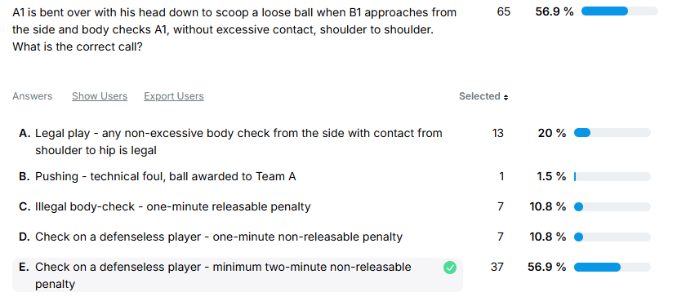
Test Review

Slide 5
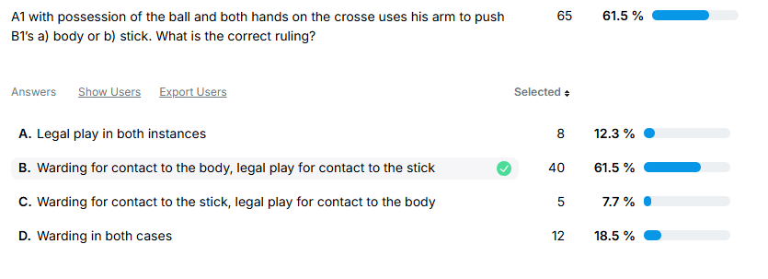
Test Review

Slide 6
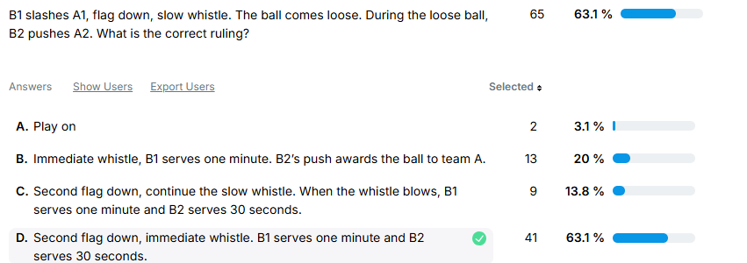
Test Review

Slide 7
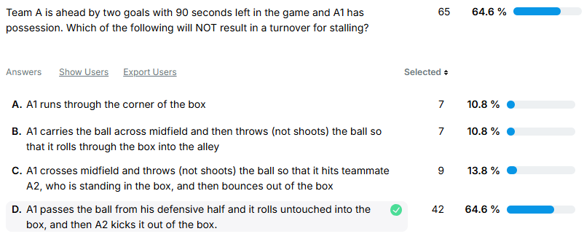
Test Review

Slide 8
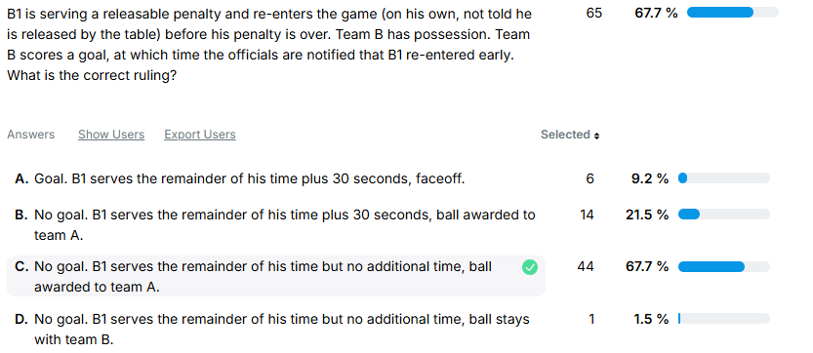
Test Review

Slide 9
Trail Mechanics

Slide 10
Trail in Transition - Best Practices
Give Reset signal, start timer & start goalie count.
Stay even with the ball or just behind.
Don’t have to sprint but you should jog up the field. Coaches look for hustle.
Watch the big picture.
Identify “middies” and count offsides.
Slow restarts near the box.

Slide 11
Trail in Transition
Don’t go looking for coaches but be available if needed.
Count again as you get into your trail position.
Keep moving until you get into position, final position should be about 5-7 yards above the box near the wing line.
Develop a routine or checklist as you come up the field.

Slide 12
Offsides & Over and Back Tips
Offsides
Always Count Forward.
Try to identify pairs.
Count Again when you come into settled play.
If something looks off - point at the guy you think might be offsides and recount to confirm.
Officiate play first, offsides is secondary.
Over & Back
Get to the midline.
Look to your partner for help.
Make clear deflection.
Watch for push/offsides.
Quick whistle on over and back.
Bring the ball back on restart.

Slide 13
Foul Reporting
Preliminary Signal to partner/field.
Trail jogs to table area to report foul.
Stand still report foul.
Lead gets the field ready.
After reporting foul check field and restart.
Coaches do not need explanations for every “routine” foul.
Report foul calmly.

Slide 14
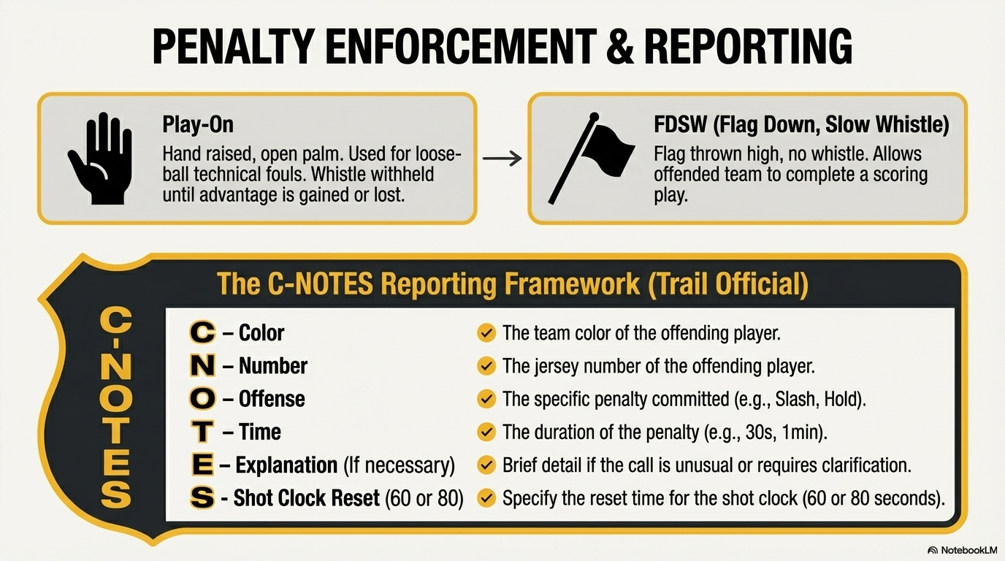

Slide 15
Fights & Behavior
Preventive Officiating
Freeze Benches
Someone needs to have the big picture
Don’t be afraid to eject players

Slide 16
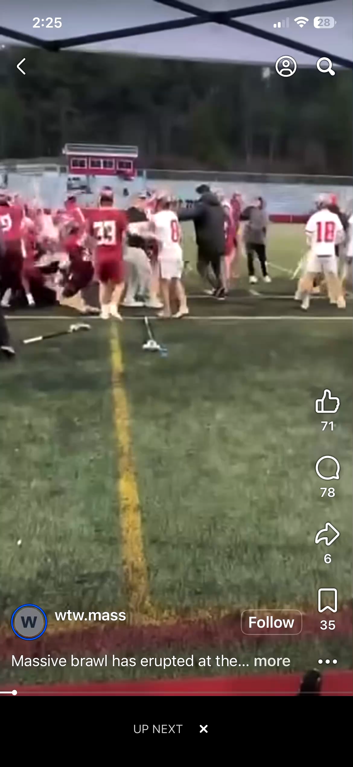

Slide 17

The Ramp
Ejection
Rule 5:12
1 to 3 Minutes
Unsportsmanlike
Conduct
For poor behavior by Team A, options are:
Try to work through these steps in order.
Sometimes you may need to skip steps, especially with taunting and racist behavior.
Rule 5:10
30
Second
Conduct Foul
With B in Possession
Rule 6:6
Award Ball to Opposing Team
Loose Ball Conduct Foul
Verbal Warning
Notes:
Ejection Rule 5:12
3 minute NR USC in addition to ejection: must leave premises unless no school personnel can supervise in which case player is confined to bench area. Ejection can occur after the game has ended!
USC Rule 5:10
Conduct Rule 6:6

Slide 18
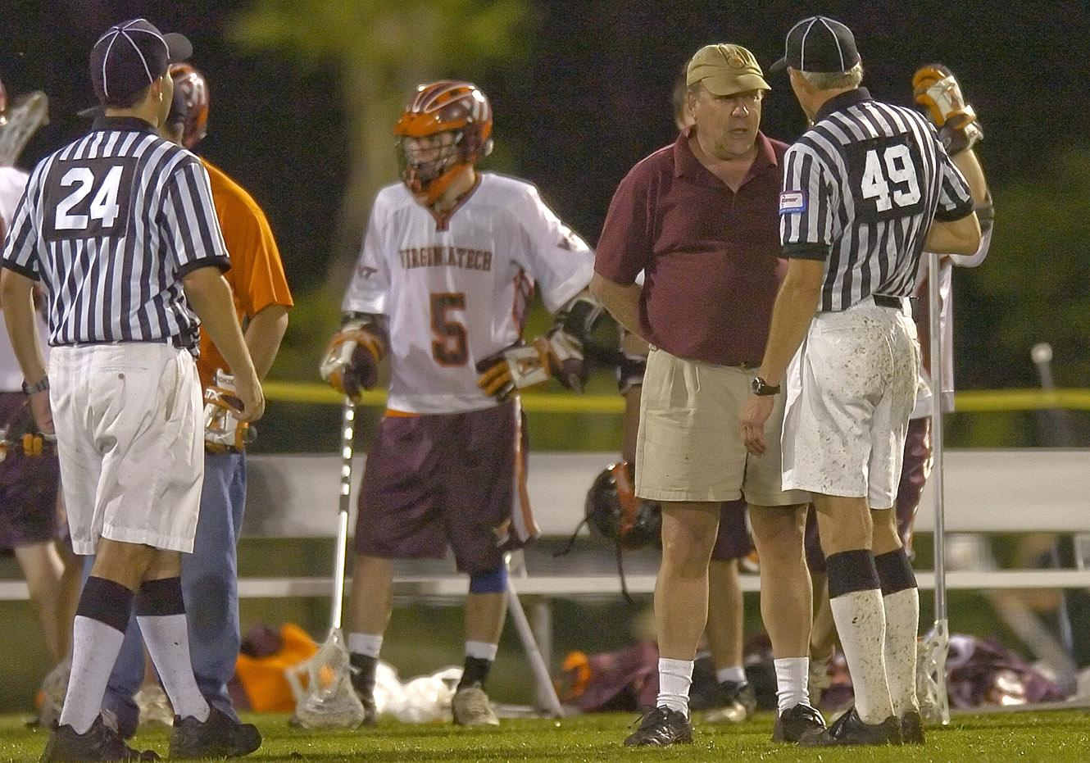
Dealing with a difficult coach
Undivided attention
Be non judgmental
Focus on feelings
Allow for silence
Clarify message
Develop a plan
Use a team approach
Use positive self talk
Recognize personal limits
Debrief

Slide 19
Meeting Schedule
April 6-9 Regular meeting #2
April 27 7:30 Go To Meeting
May 11-14 Regular Meeting #4
June 15-18 Socials
Full Schedule on Website

Slide 20
Q&A

