Slide 1
EMLOA Newbie Meeting
March 30-April 2, 2026

Slide 2
Agenda
Introduction to meeting and reasons for it
Arbiter do’s and don’ts
5 things you may have been yelled at for
Tips for Advancement
Mentor Program
How to get games
Assigners on hand
Questions and answers

Slide 3
Arbiter Checklist
Ready to be assigned checked
Profile information & phone numbers updated
(Some school will use this info for payment purposes)
Picture posted on profile page
Blocks updated regularly (all, not just lacrosse)
Travel limits and leave city current
Accept or decline games promptly
Live connection or supplemental presentation
Notes:
Supplemental presentation or go live

Slide 4
5 Things You May have been yelled at for already!

Slide 5
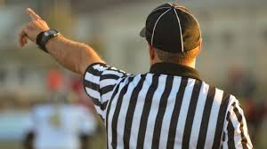

They’re Off Sides!!!!!
Maybe they are and maybe they are not.
Don’t panic….Take a “picture” and keep officiating while you count.
Missing an offside could have an impact on the play but missing a hit could impact the player.

Slide 6
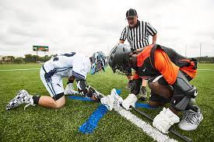
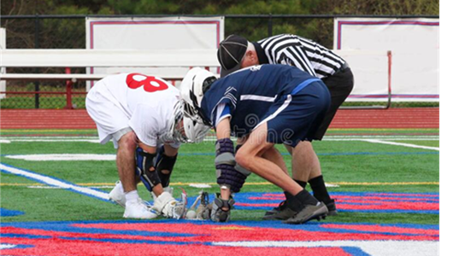
Face offs – Could be a number of things here
He went early, he is leaning, he is holding him, he’s withholding, it’s stuck, he kicked the cross
A lot of happens on a faceoff. Recognize the infraction and blow it quick.
Support your partner. Answer questions
from coach and get answers for them.
Communicate, Communicate, Communicate
w/ the faceoff players.

Slide 7
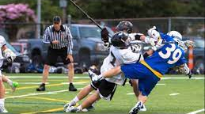
The Big Hit
A big hit can change the tempo, emotion and energy level of the rest of the game. We must recognize it and call it when necessary.
Notes:
Emphasize the different levels and how the foul may be different

Slide 8
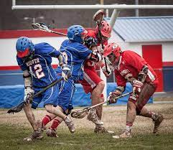
Never Ending Scrums
The longer a loose ball scrum goes on the more likely something bad could happen.
The longer the ball is loose the threshold should change.
Play-ONS need to be quick
and loud.
Notes:
Lower levels, find a way to get ball in someones stick

Slide 9
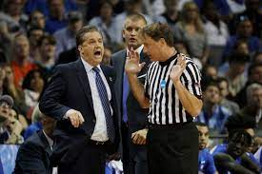
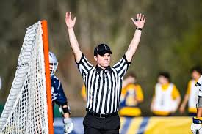
What is he calling?
Signal, Signal, Signal!
Whistles are the best as voices don’t always carry.
Out of bounds are the easier calls to make, point with confidence, restart with confidence.
Notes:
Know your signals, for benefit of partner, coaches, players and yes spectators.

Slide 10
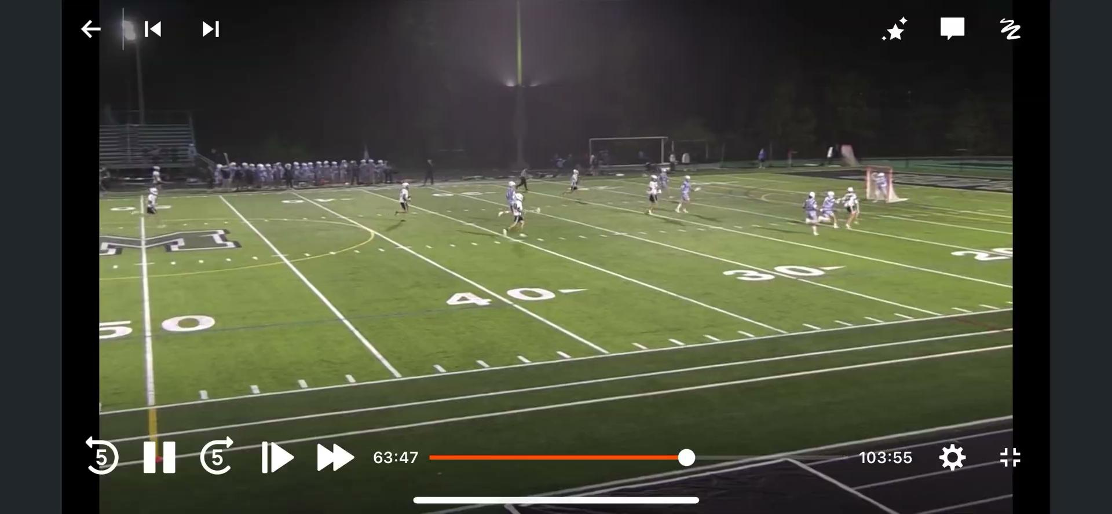

Slide 11
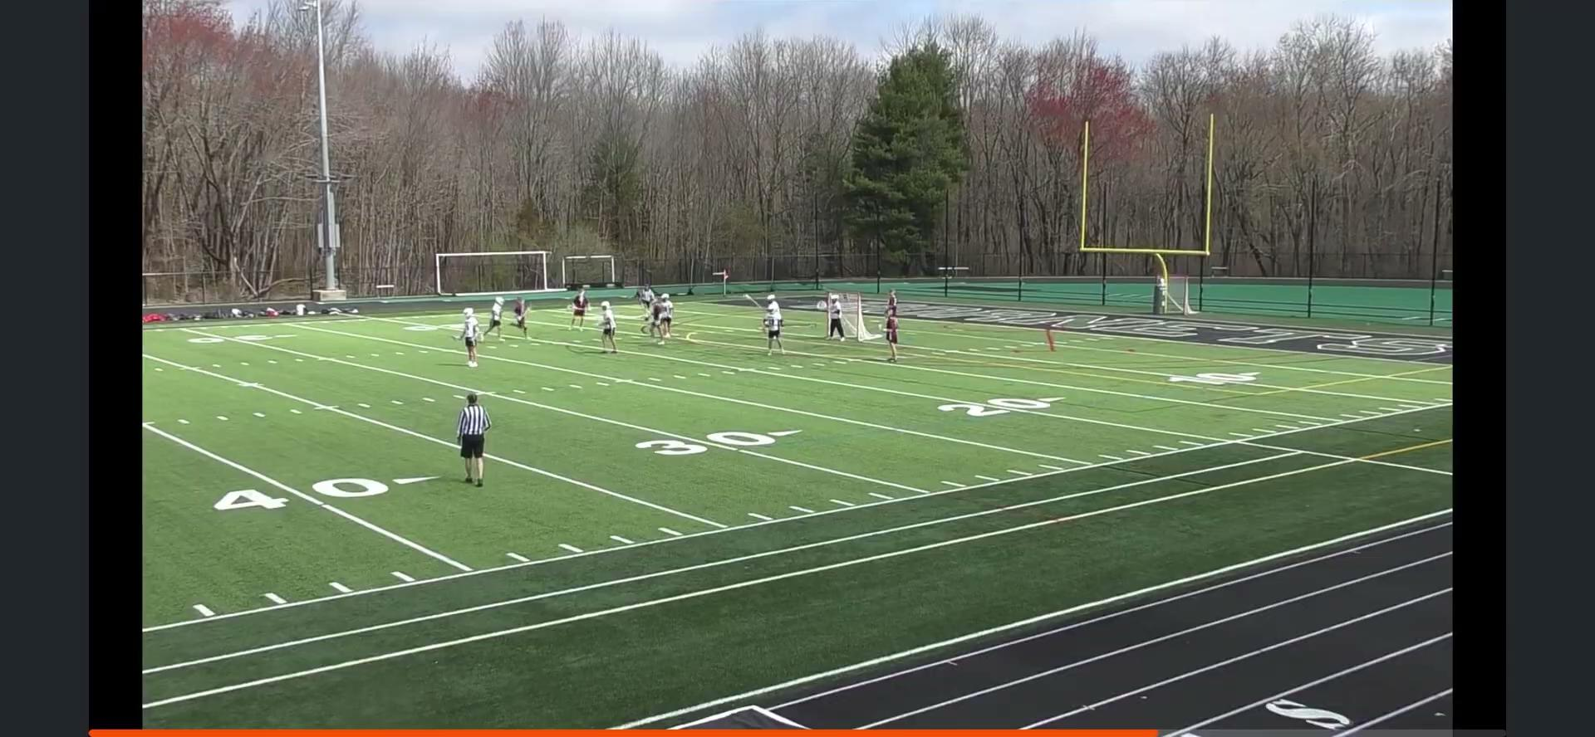

Slide 12
Tips for Career Advancement
What are your goals?
Get more games
Officiating Varsity Games
Selected for Playoff Assignments
Selected for Late Round Playoff Assignments
Officiate at the College Level
Availability
Rules Knowledge
Game Management in Communication
Finding Good Mentors
Being Open to Feedback
Learning from Mistakes

Slide 13
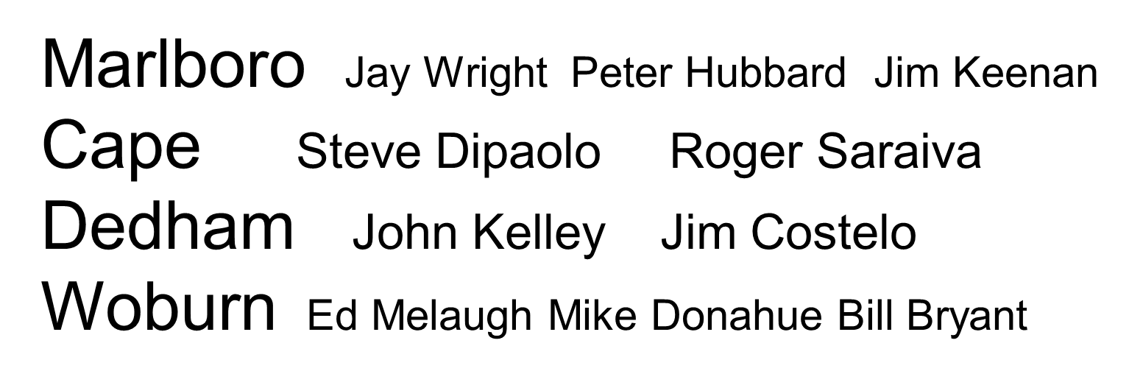
Mentoring Director Jay Wright jwright53@verizon.net
Regional co-ordianators
Notes:
Introduce the regional person, be sure all who want to have a mentor have one matched up, and introduce the idea behind the program

Slide 14
How to Get Games!!
Preparation
Rules knowledge in general, especially any changes And know rules as they apply to a specific game, NCAA vs NFHS vs MYL vs TPL vs PLL Confer with coaches before all games for equipment certification, youth level for rules clarifications
Uniform have different options available and communicate with partner to match
Fitness be in shape and able to handle the demands of the game to be in the right position at the right time
Be on time Know where you are going, what field game is played on, anticipate traffic. If scheduling is tight, notify partner of issues
Question If assigned to a game that is in conflict with another game or tight in terms of time, notify assigner to correct ahead of time
Weather Reach out to school if weather may influence if a game is being played, inform you partner of any info obtained. This applies to unusual times, days that games may be listed on Arbiter. Communication can save you a trip to find no game

Slide 15
How to Get Games!!
Availability
Arbiter Specific availability must be maintained and updated regularly. This includes full and part day blocks, both for games and personal obligations. Travel limits, leave city also included here
All-Calls Check email regularly for daily all-calls for additional games. Also posted on EMLOA.org
Assigners General availability should be communicated to any assigner you wish to work for. Changes too!! And this includes introducing yourself to assigners, including background to lacrosse as a player, coach or if you have officiated other sports.
Notes:
This may duplicate live presentation but HAS to be covered.

Slide 16
How to Get Games!!
Proactive
Mentor Great resource to utilize, but you must initiate. Observe him, and have him observe you. Get feedback from partners during and after games.
Rule book Get into it after each game. Try and answer your own questions, or just reinforce a call you made. Work with your mentor here too, and bring questions to weekly meetings
Websites USLacrosse has numerous video presentations available. EMLOA.org has rule changes, differences and other info for reference posted
Promote You are your biggest advocate. You need to get in front of the assigners, both in terms of email, text or phone, but also physical preference. Mentor can help here to as well as veteran officials. Remember, we are all independent contractors.

Slide 17
How to Get Paid
Keep Track of Everything
High Schools - Either ArbiterPay or Check by Mail. Ask coach or AD on-site. Some schools have paperwork, some take information from arbiter.
Youth - MYL Sundays - Paid onsite. Either check, cash, some do venmo/paypal. Ask the home coach before end of the day.
Youth - MYL Select - Paid by league. Fill out game report with score.
Youth - TPL - Paid by Darrell Benson in check periodically throughout the season.
3. Tournament - Payment methods vary. Ask assignor.
If you haven’t been paid by a school. Check with partner to see if he has been paid, then contact school AD. CC assignor on emails to schools. Payment by from high schools can take a month or two.

Slide 18
Assigners
High School
Darrell Benson
John Hill
Roy Condon
Bob Maguire
Jim Tighe
See Schools tab on EMLOA.org website for specific school and youth league info
Youth
Randy Wong (MYL - West Central)
Rick Catalano (MYL - MetroWest/ some West Central)
John Izzo (MYL - Northeast)
Steve DiPaolo (CTL)
Paul Quill (MYL - Northwest)
Darrell Benson (TPL, OCLL, MYL - South Central)
MYL-Metro Boston shared by Benson, Izzo, and Catalano

Slide 19
Questions and Answers open discussion
This PowerPoint presentation will be on the
EMLOA.org website, 2026 Presentations
Notes:
Solicit any and all querstions

