Slide 1
Regular Season Meeting #1
Week of 3/17-3/20

Slide 2
Agenda
Rule Changes and Points of Emphasis
Start of Season
Videos
Common Sense Officiating
Mentor Program

Slide 3
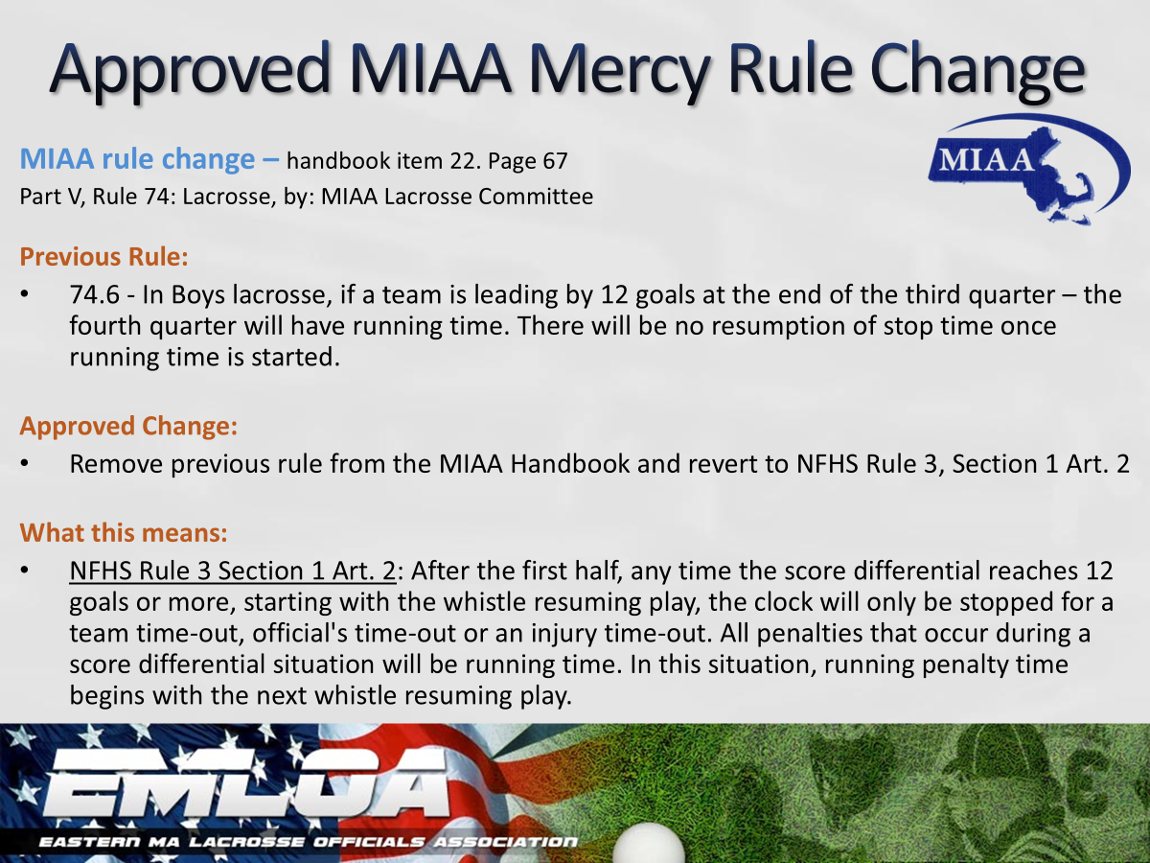
Mouthpieces
When you certify coaches: Mention that all players equipment must be worn properly including mouth pieces and helmet
Check during opening line-up. If they don’t have one send them off.
If a player doesn’t have one or it in call the foul

Slide 4
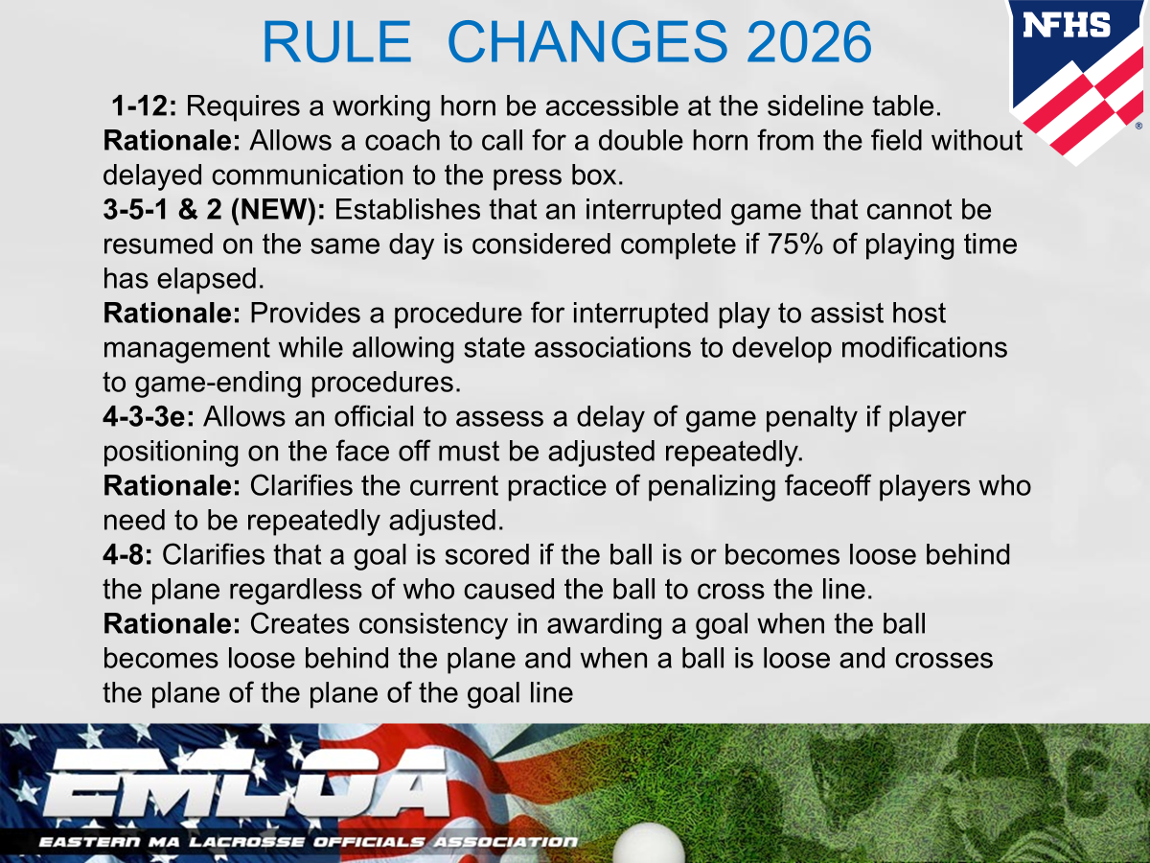

Slide 5
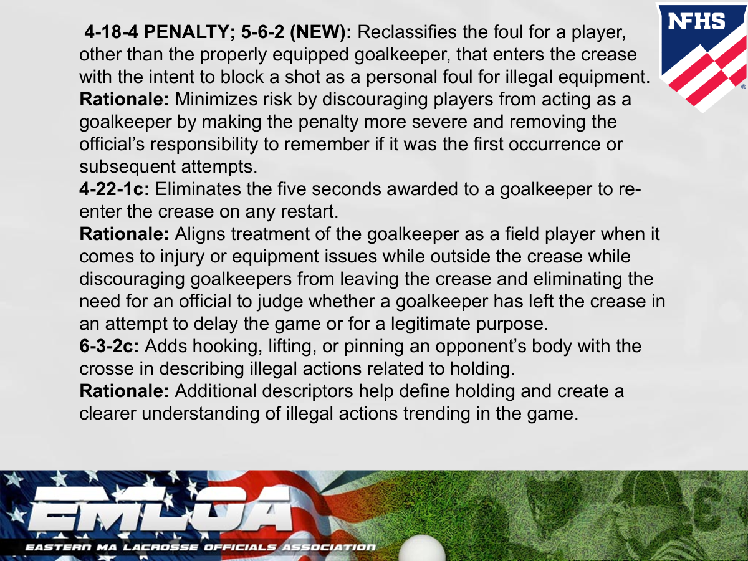

Slide 6
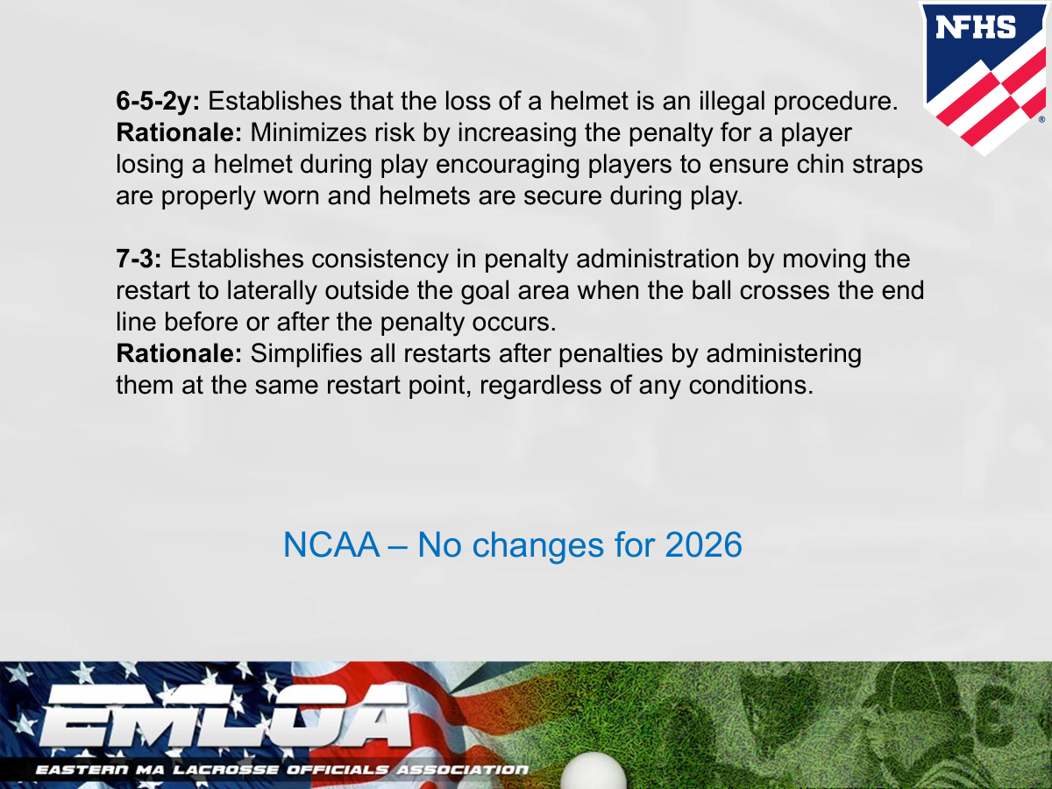

Slide 7
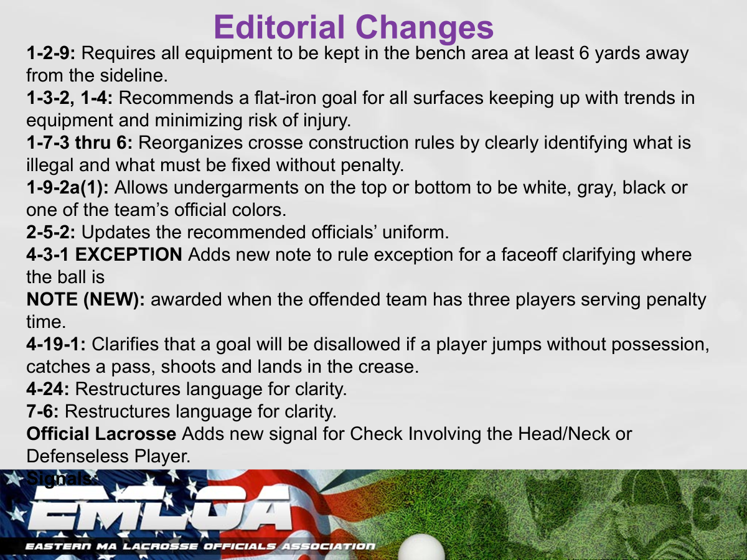

Slide 8
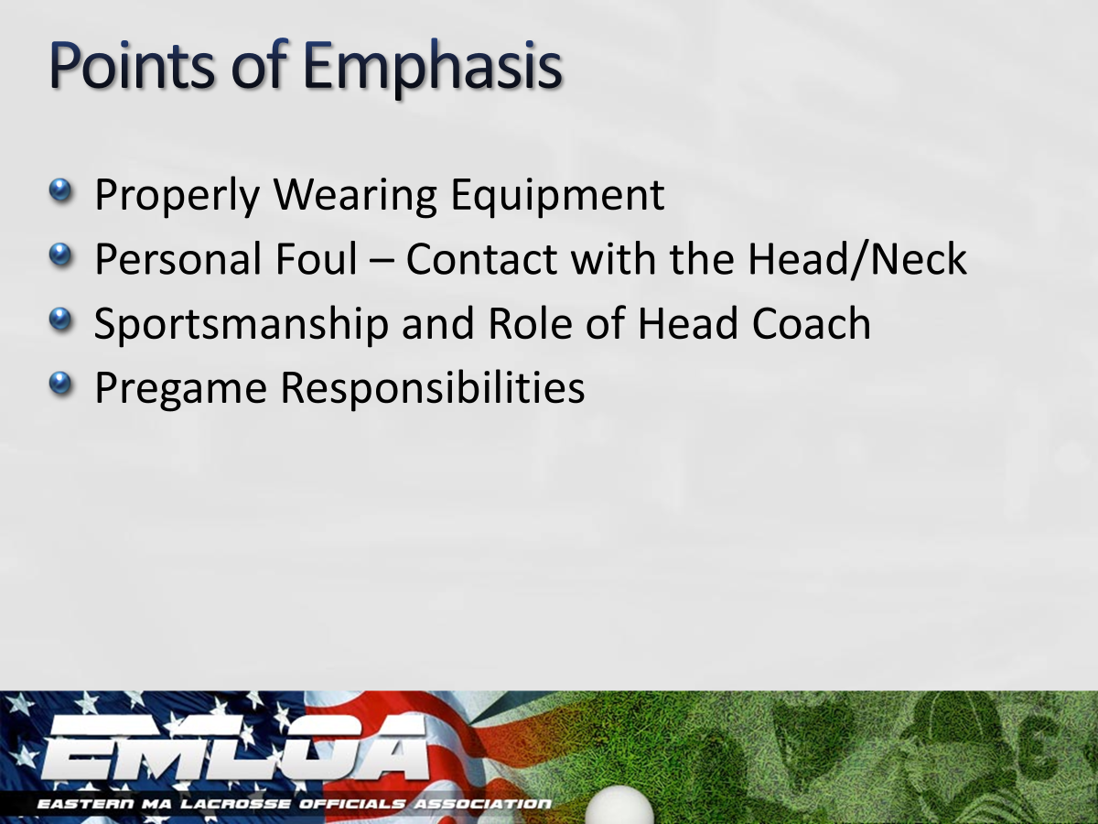

Slide 9
Beginning of the Season Tips
Set the tone for the season. Call the fouls, enforce mouth pieces, do face offs right
Don’t screw your fellow officials in the next game by not doing it right in your game
Arrive on-site 20-30 minutes early and be on the field at least 15 minutes prior to game
Be flexible – It is likely not the coaches fault that the bus was late

Slide 10
Beginning of the Season Tips
Conduct coaches meetings at the youth level and understand the rule differences for different age groups and leagues
You only get one chance to make a first impression, so make sure your first impression is a good one.
Enjoy it – we are not getting rich doing this but we are compensated well for our time.

Slide 11
Mouth Pieces & Stick Checks
Mouth Pieces - Should be enforced at all levels. Check during the opening faceoff and make it a non-issue during the game.
Stick Checks - Do we still do checks? In varsity games we should be.

Slide 12
You Make the Call
Discuss with the people around you.

Slide 13
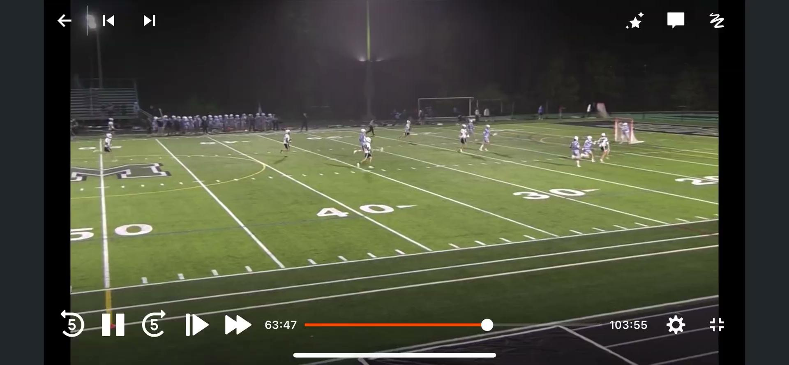

Slide 14
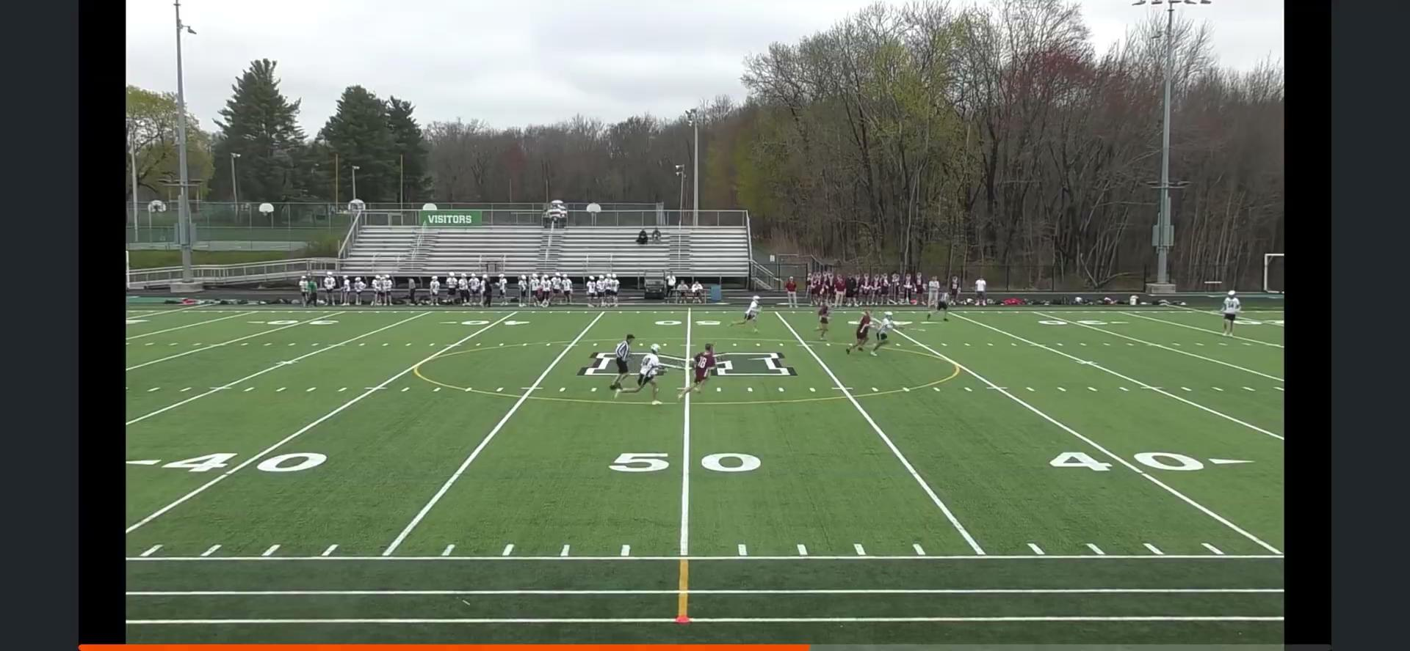

Slide 15
Common Sense Officiating Know the Game, Not Just the Rules!

Slide 16
What we will Cover
Type of game you’re in
Coaches
Communication
Advantage/Disadvantage
Penalties
When the pressure builds

Slide 17
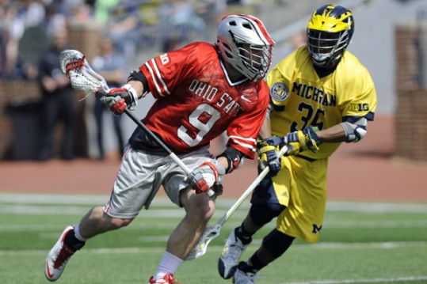
Type of Game/Pregame
Rivalry game?
Competitive or Playoff type game?
Blow out?
Teams with a history of dumb shit
Previous experience with teams/coaches

Slide 18
Coach Reputations
Rational vs. Irrational coach
Is he a football coach or hockey coach primarily
Is he knew to the area or game
Is he a veteran coach

Slide 19
Faceoff – Build a Relationship
You see these guys A LOT.
Talk to these guys, let them talk to you
Hear their concerns and think about it. Sometimes they are valid and sometimes they’re not
You will see them 20+ times a game so develop a good working relationship with them

Slide 20
Positive Encouragement
Talk to the kids! During play and dead balls
When they hear you on the field and listen tell them “good” or “I like it”
When they foul let them know what they did and how they could have done it right
Acknowledge good plays. They are kids and here to have fun. Make it fun for them!

Slide 21
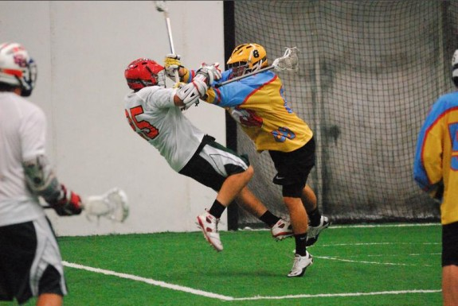
“Oh Shit Calls”
Big hits that everyone “OHHHHS” it’s probably a flag
Everyone else thought it was a flag and you didn’t…you probably fucked up
GET BIG HITS!!!

Slide 22
Advantage/Disadvantage
Does it affect the players ability to make a play?
If a foul happens that doesn’t affect the play, do we have to have a call? i.e. a player steps off sides 10 yards behind the paly…did that give him or his team any advantage?
Is it a 1 goal game?
Safety is never a question. Always make that call!

Slide 23
Do I Need to be that Good?
What game are we in right now?
Let’s talk about this

Slide 24
Keeping Score of Penalties
Does one team have 10 penalties and the other have zero?
Just think about this and be aware
Do both teams have 15?
Start having longer time served now
Foul out

Slide 25
Let a push go at one end, remember that at the other end
Be consistent!
Know the game you’re in and what point in the game it is

Slide 26
When the Pressure Starts to Build
Talk to your partners during breaks
Talk about what coaches are saying
How many time outs each team has left and who is likely to use them and when
Anticipate situations
Talk about players/situations to watch

Slide 27
Mentoring Officials
If you are a veteran official make it a goal to help make someone else better.
You don’t need to formally assigned as a mentor to help someone out.
Do things the right way, teach them one needed, and give feedback when appropriate.
We need to do a better job helping first and second year officials get better.

Slide 28

2026 Regional Coordinators
Jay Wright
Marlboro - Peter Hubbard & Jim Keenan
Cape - Steve Dipaolo & Roger Saraiva
Dedham - John Kelley & Jim Costelo
Woburn - Ed Melaugh, Mike Donahue, Bill Bryant

Slide 29
Overview
The Mentorship program is designed to provide you with the resources you need to help you quickly become competent, confident refs
Mentor/Mentee pairings have been done and announced the week of March 16th
Phase 1
Compliance
Arbiter registration for EMLOA
Demosphere/OttoSports registration for Youth Assigning
MIAA background check and registration
EMLOA High School Rules Exam
Mentee must complete these items and utilize Mentor to assist

Slide 30
Phase 2
Introduction to assigners
Youth leagues
High School & Middle Schools
Contact with assigners
Mentee needs to introduce themselves to assigners
Highlighting lacrosse experience (if limited that’s OK)
Outline other sports officiating
Availability-afternoons-evenings-weekdays-weekends
Phase 3
On field
Mechanics—in the right place at the right time
Foul recognition
Working together as a team
Dealing with unusual situations
Dealing with coaches and players
Post-game review with partner of each game followed by review with mentor with additional questions and “where do I go from here?” as needed

Slide 31
What you need to do next?
Mentor contact Mentee (if you haven’t already)
Mentee should initiate contact as needed moving forward
Mentee needs to maintain availability in both scheduling programs
Mentee should ask each and every partner for feedback, not just his mentor
If Mentee hasn’t heard from mentor, touch base, but onus of the program is on the mentee
And if scheduling allows and can be coordinated, mentee and mentor doing a game together

Slide 32
Resources Available to You
Review the EMLOA website (www.emloa.org) – it has a lot of resources including:
“Rules and Mechanics” – 2 and 3 man mechanics documentation and YouTube videos
“Schools” – High School assigners
“Youth Lacrosse Leagues” – Youth league assigners
“Mentorship Program” – Mentor/Mentee expectations. Mentor/Mentee matchups, Goals and Activities sheets, Evaluation sheets
Evaluations program – Evaluations are done on a limited basis

Slide 33
Mentee Expectations
Onus of the mentor/mentee relationship is on the mentee!
Mentor will help you as little or as much as you want
Suggest you talk at least once a week at the start of the season with your mentor
Ask questions to all the experienced refs you work with

Slide 34
We Need more Mentors
Some of the regions are short on mentors if you could please volunteer it would be greatly appreciated!

Slide 35
Assignors/Assignments
Same Stuff Every YEAR!!!!
Accept/Decline Assignments Timely
Update Availability
Notify your assignor immediately if there is a fight/ejection/anything they should know about
Some Youth Leagues using Demosphere to assign
Understand payment procedures

Slide 36
Newer Officials
ASK for HELP!!!
Introduce yourself
Watch a varsity game or half and ask questions at halftime or after the game
There are lots of resources…use them!

Slide 37
Meeting Schedule
March 16-19 Regular meeting #1
March 30-April 4 Newbie (1-5 years)
April 6-9 Regular meeting #2
April 27 7:30 Go To Meeting
May 11-14 Regular Meeting #4
June 15-18 Socials
Full Schedule on Website

Slide 38
Q&A

