Slide 1
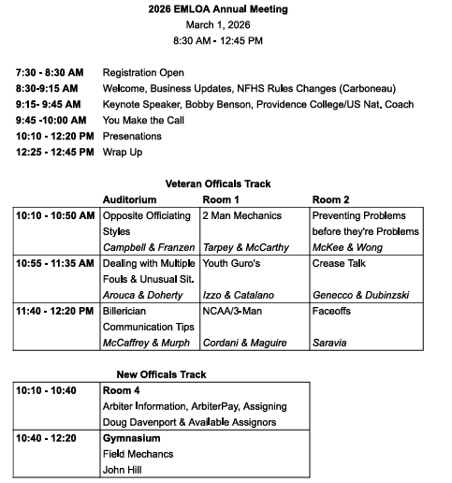

Slide 2

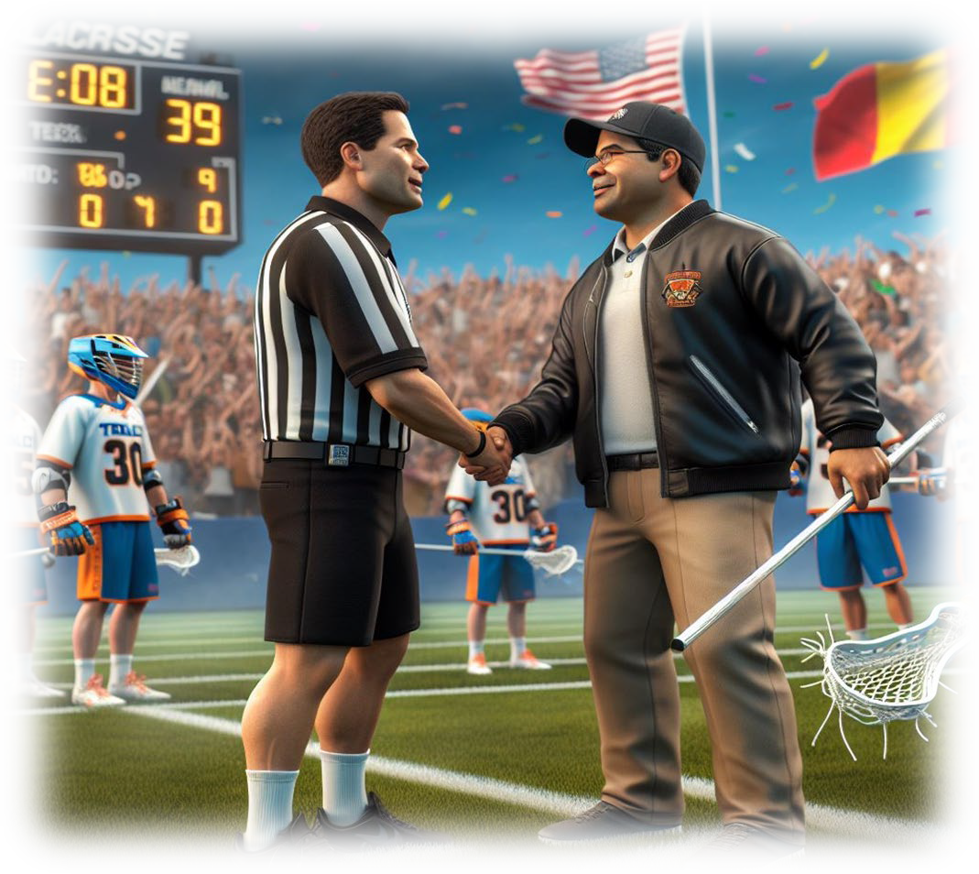
Welcome!
2026 Annual Meeting
Xaverian Bros High School
March 1, 2026

Slide 3
Annual Meeting
AGENDA
Opening Remarks 8:30AM – 10:00AM
Recognition/Remembrance – Bill Doherty
Business Updates – Fran Tarpey
Organization Updates – Randy Wong
Compliance Requirements – Doug Davenport
New Rules/Points of Emphasis– Jim Carboneau
Keynote Speaker – Bobby Benson
You Make the Call – Chris Arouca/Bill Doherty

Slide 4
Annual Meeting
AGENDA
At 10:00 AM
Break Out Sessions for Veterans in Auditorium and Classrooms
New Candidates to Classroom for brief Arbiter Overview and then Main Gym for Stations
At 12:25 PM All Back to Main Theater for Raffle and Q&A
At 12:45 Adjourn

Slide 5
Annual Meeting
RECOGNITION
Dave Pinciaro – Eastern Mass Hall of Fame Inductee Class of 2026
NILOA – 2026 Frenchy Julian Award Winner
MIAA -- George Shaheen Game Official of the year
WMLOA

Slide 6
Annual Meeting
RECOGNITION
Eric Campbell – Alternate for Division 1 NCAA Semifinals and Division 1 NCAA Championship
Tom Kitterick – Alternate for Division 2 & 3 NCAA National Championship

Slide 7
Annual Meeting
RECOGNITION
Executive Board for their ongoing service and contributions to our success
Many Volunteers who have helped in many ways in the off-season and in-season
Many Volunteers who helped with the planning and execution of our Annual Meeting
50+ New Candidates
Our Members – 380+

Slide 8
Annual Meeting
Business and Other Updates
Scholarship Program – Submit Applications now to Paul Cinquegrano
2025 Winners
Winner 1
Winner 2
Winner 3
Winner 4

Slide 9
Annual Meeting
Business and Other Updates
Pay for MIAA Schools Varsity $104 Subvarsity $78
Pay for Private HS Varsity $125
Pay for “Town” Youth – MYL, CTL, OCLL, TPL $85 for full games, $70 for one-hour games
Pay PYL Youth Games (Fitchburg) – Club spring league $65 per game

Slide 10
Annual Meeting
Business and Other Updates
Observation Program in Development
Associate Officials now under EMLOA
USA Lacrosse Membership now optional
Board and By-Law Updates

Slide 11
Annual Meeting
EMLOA Organizational Update
Fran Tarpey
As Vice President will be filling in for President Darrell Benson
Welcome message for 2026
Overseeing all EMLOA business, concerns and suggestions
In contact with Darrell seeking his guidance as our long-time leader

Slide 12
Annual Meeting
EMLOA By-Law Update
Randy Wong -- Secretary
Randy has assumed the task of reviewing EMLOA’s bylaws
To date
Collected input from existing Board of Directors
Collected input from various veteran EMLOA members
Upcoming
Will be soliciting suggestions from membership
Will accept volunteer help with the project
Plan is to have a re-write complete prior to the 2027 season
39laxref@gmail.com

Slide 13
Annual Meeting
Business and Other Updates
Associate Officials Program
AO’s will now have certification card and master list of AO’s be posted
Over 300 AO’s, many experienced and talented AO’s, some newer and younger not as strong
EMLOA officials need to HAVE THEIR BACK at all times – keep Coaches and Parents away!
If they miss a call, YOU MAKE THE CALL!

Slide 14
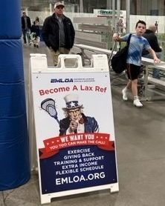
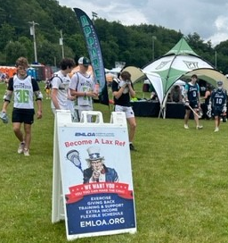
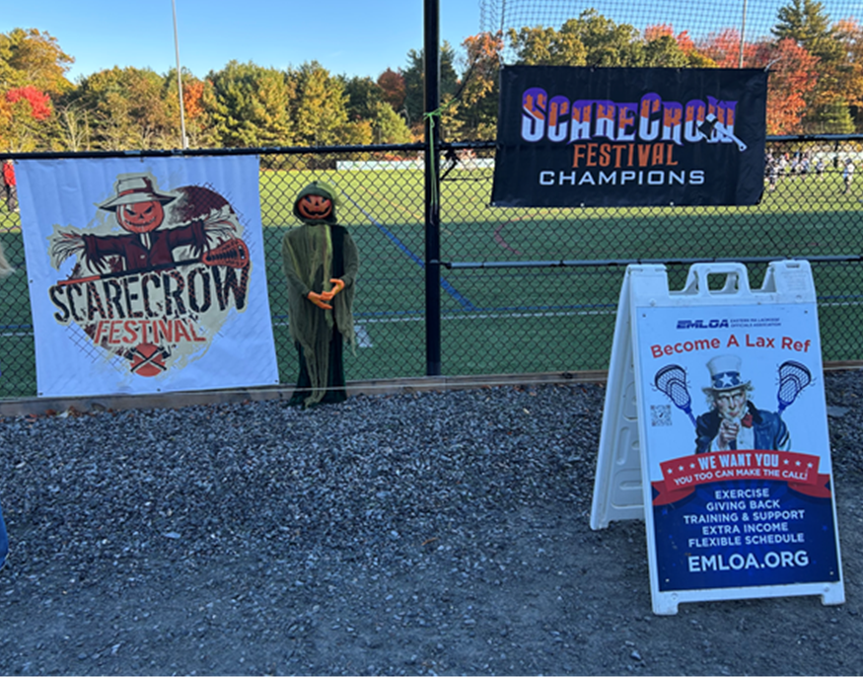
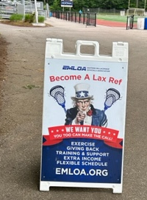
Annual Meeting
Public Relations and Promotions for EMLOA
Ben Forman 3rd year official
formanb.41@gmail.com
www.benforman.com
Stripes Sizzle Reel Work In Progress
EMLOA Vimeo

Slide 15
What’s new for 2026
USALacrosse is no longer a mandated membership.
EMLOA has purchased NFHS rule books for all members.
Liability insurance now purchased by EMLOA for all “compliant”members.
List to be forwarded to Sadler Insurance prior to first scrimmages.
Policy will be in effect for calendar year. Note this policy does
NOT have game fee replacement insurance, but it is available via USLAX or NASO.
Expenses have been streamlined for better tracking and payments. Swag program falls into this category.
EMLOA is now an approved non-profit by Mass. This means a sales tax exemption of just under $500 yearly.

Slide 16
Annual Meeting
NEXT UP
Compliance
Doug Davenport

Slide 17
Compliance
Pre-Season Requirements (Yearly)
Dues – Increased to cover cost of Insurance & Rule Book and general expenses (Xaverian)
MIAA Background check/Registration
Passing of EMLOA NFHS Rules Test
All must be complete by Sunday, March 15th to be considered a “Member in Good Standing”

Slide 18
Compliance
Rules Exam
Rules Exam to be sent via email from ClassMarker to all members on March 2st
Test needs to be completed by Sunday, March 15th
Test will be completed on Classmarker
80% passing score
Thanks to Steven Steinsaltz for creating the test!!

Slide 19
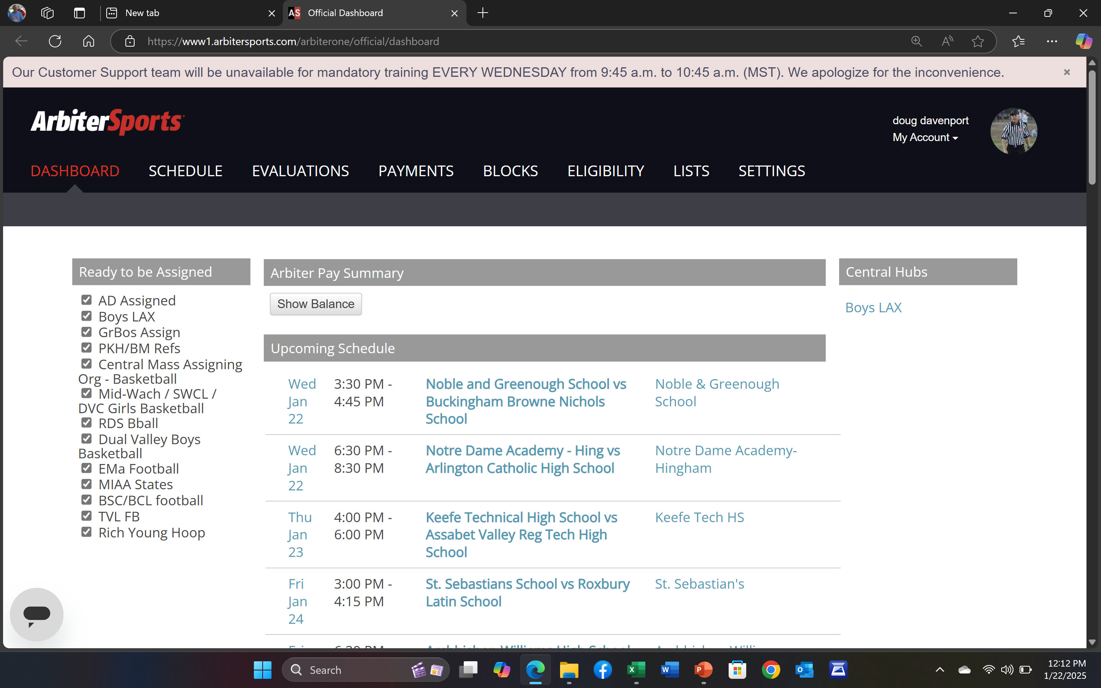


To access your profile, click on your picture, or where the picture should be.
Below popup will appear

Slide 20
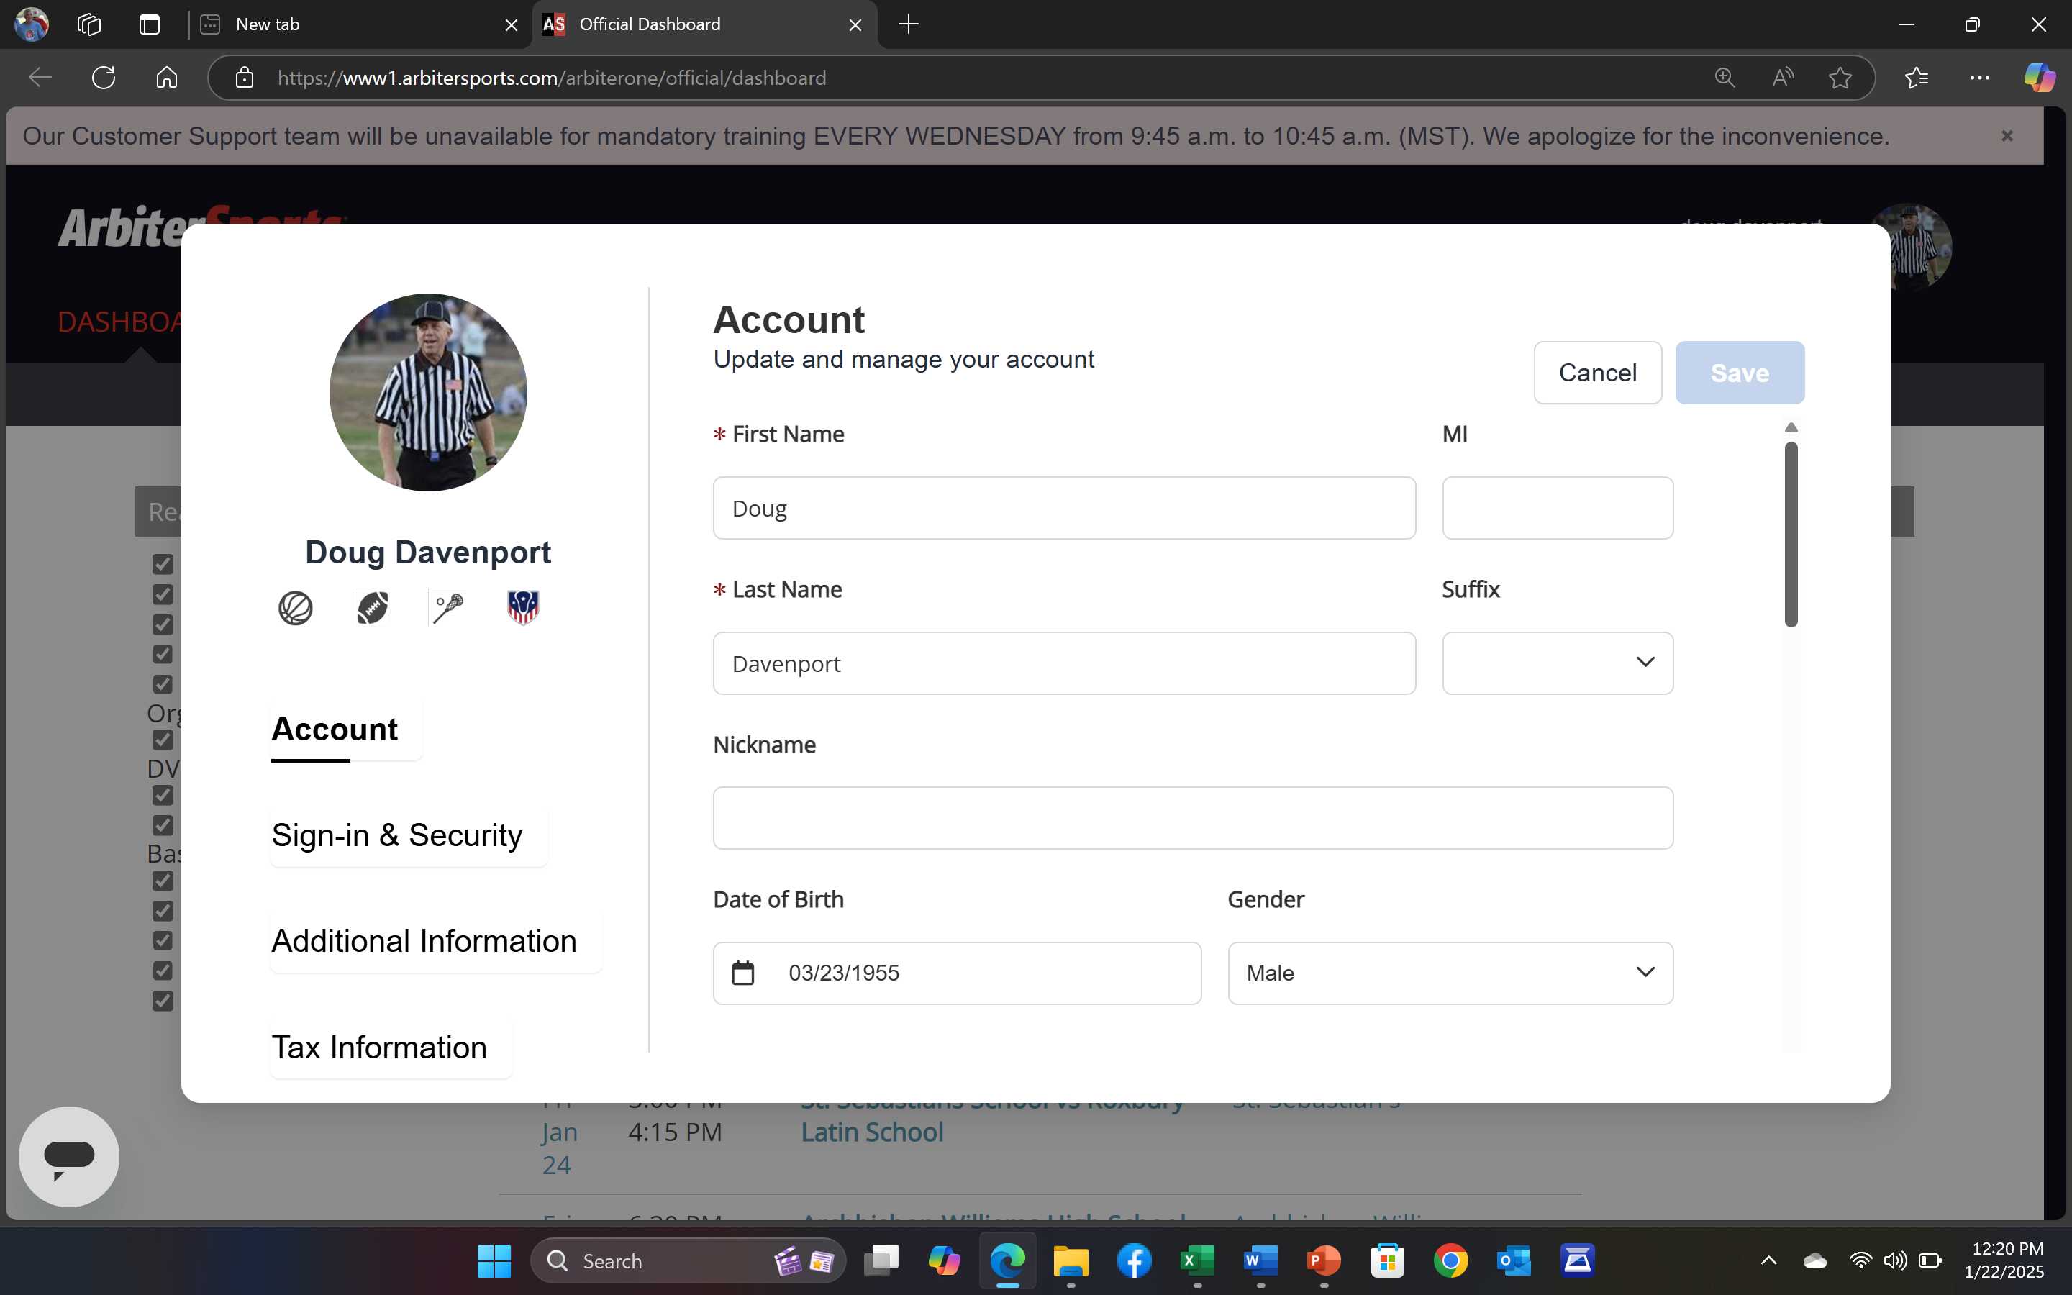
Picture
Icons

Slide 21
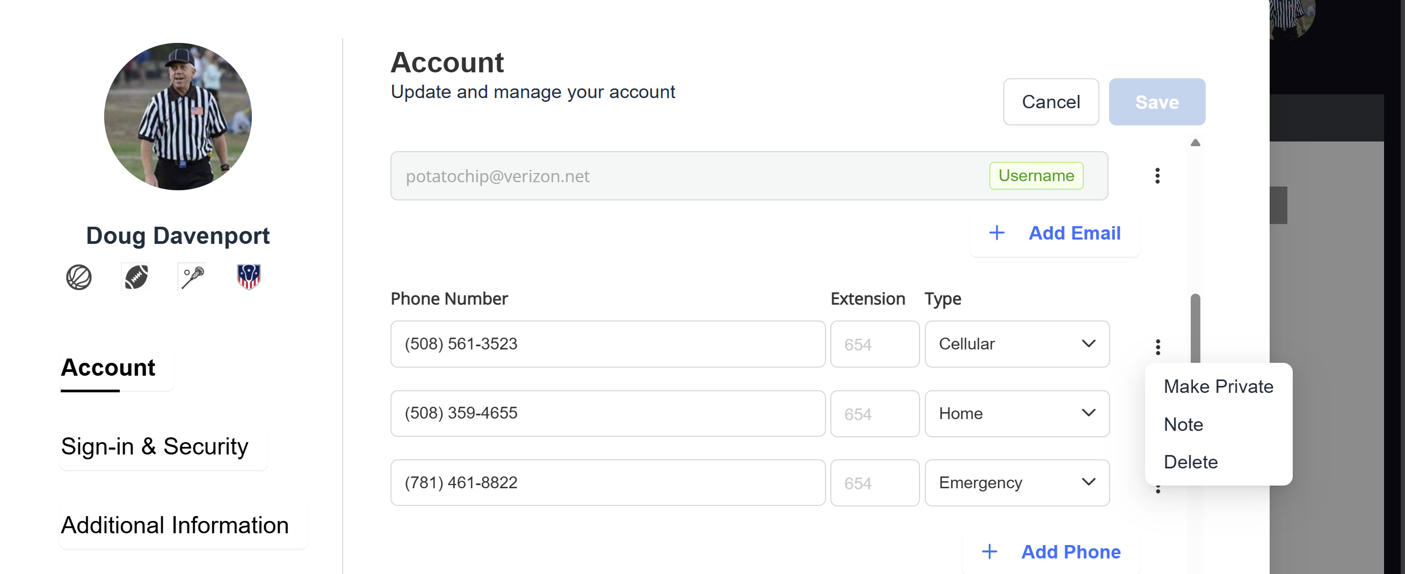

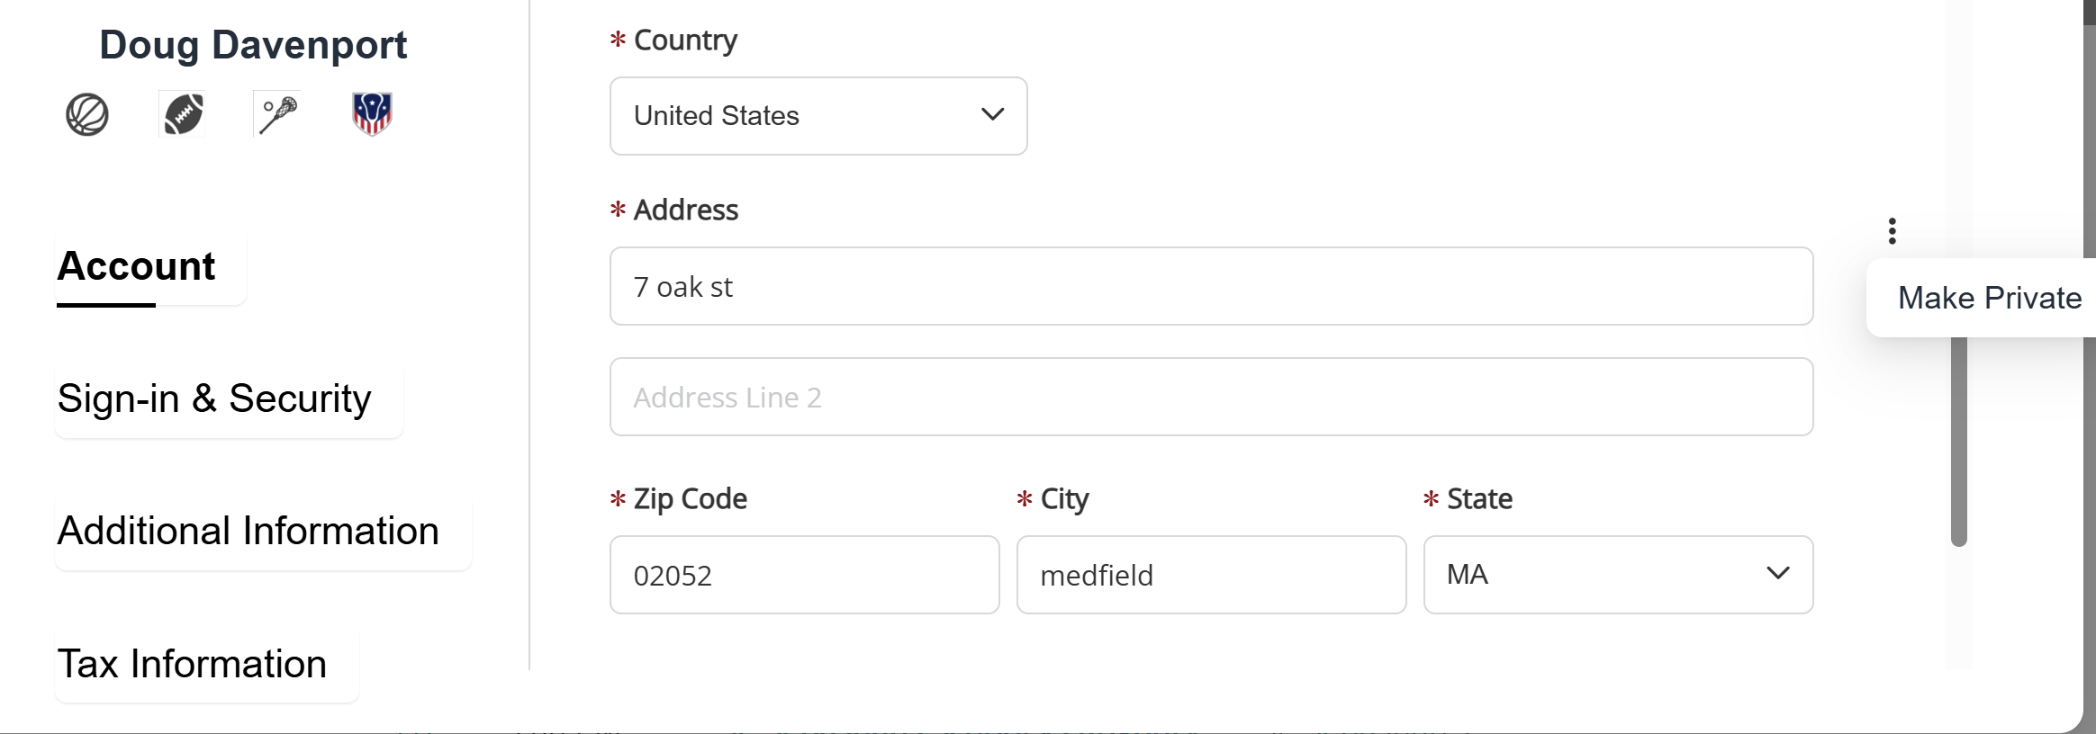

Click on the 3 dots to
make info PUBLIC

Slide 22
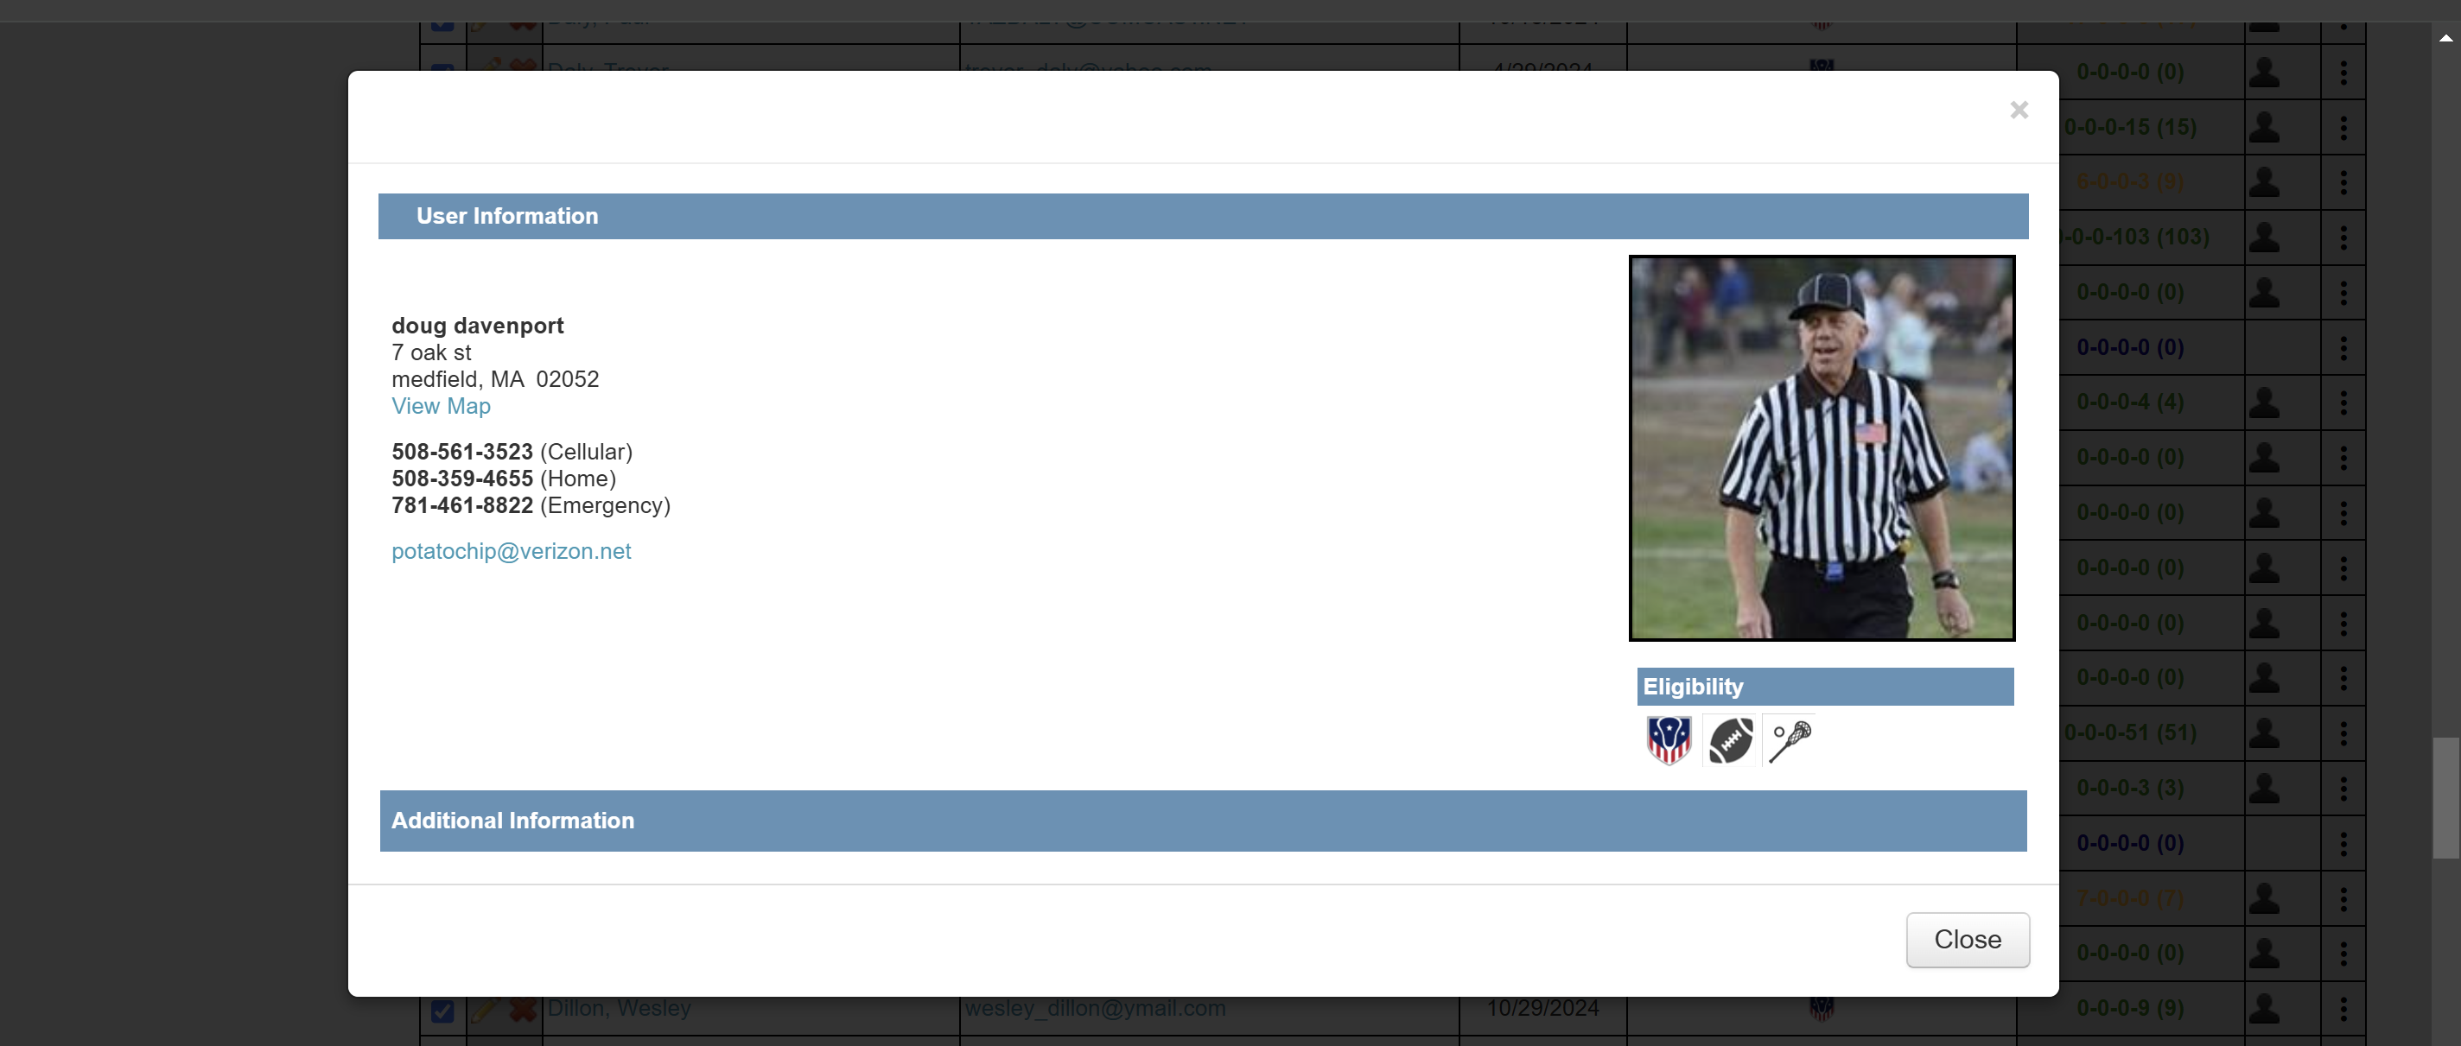
By making information public, your partner, coaches, and AD’s will have the information they need.

Slide 23
2026 Meeting Schedule
March 1 Annual Meeting 8:30 am
WO March 15 Regular meeting #1 7:30 pm
WO March 29 Newbie meeting (members 1-5 years) 7:30 pm
WO April 5 Regular Meeting #2 7:30 pm
April 27 GoToMeeting (on line) 7:30 pm
WO May 10 Regular Meeting #3 7:30 pm
WO June 14 Regional Socials (times and locations TBA)
Notes:
New meeting schedule for 2019 Newbie Go to meeting total number of meetings reduced

Slide 24
2026 Meeting Locations
Monday’s – Marlboro Forekicks
Tuesday’s – Upper Cape Cod Tech
Wednesday’s – Dedham American Legion
Thursday’s – Woburn High School
Notes:
New meeting schedule for 2019 Newbie Go to meeting total number of meetings reduced

Slide 25
Compliance
Annual Meeting 3 live (2 makeup)
Regular season meetings 2 live
GoToMeeting 2 live (1 recorded)
Newbie Meeting 1 live
Recorded absence for regular meetings A
7 points must be accumulated to be eligible for post-season assignments
Example: Annual meeting 3 Annual Meeting recorded 2
2 regular season 4 2 regular season live 4
________________ Newbie meeting 1
7 7
Notes:
Absence must email within 1 week of missed meeting

Slide 26
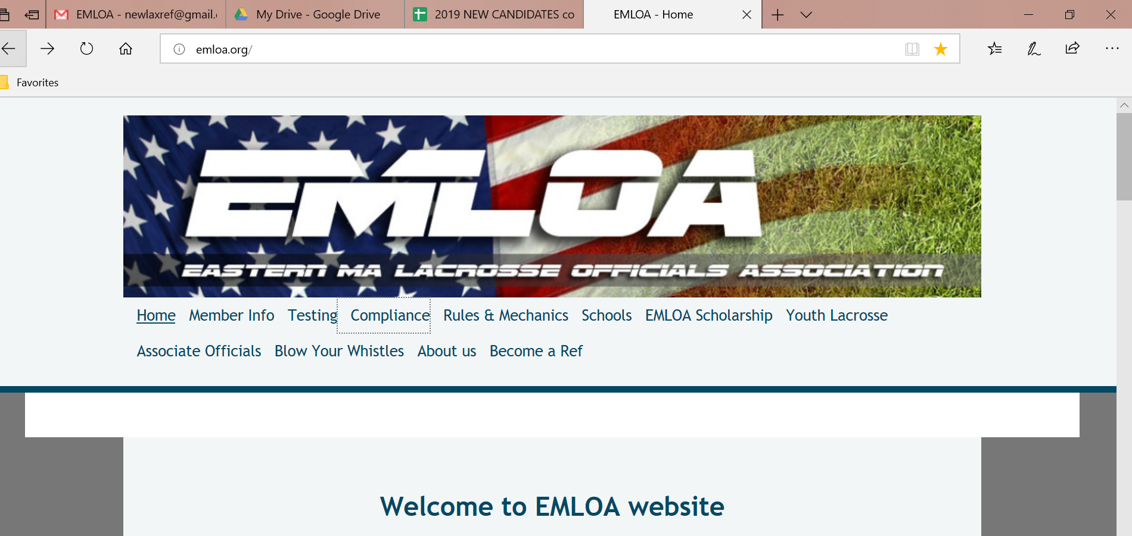
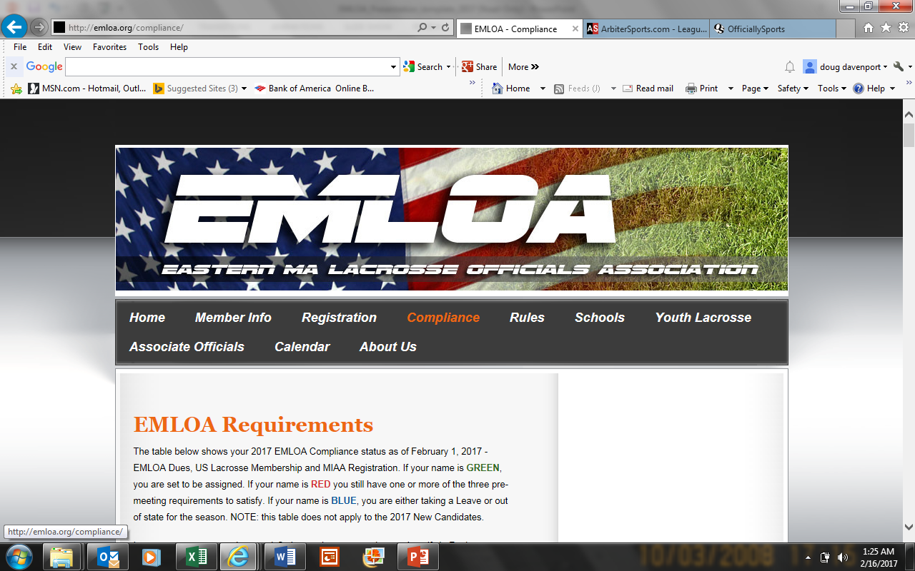
Doug Davenport
potatochip@verizon.net

Slide 27
Compliance
Dues payment $110 yearly ($114) See instructions and Payment tab on home page
USLacrosse membership $60 www.uslacrosse.org
MIAA registration (yearly and for each sport you officate) https://app.arbitersports.com/registration/official?org=8012&role=3&GroupID=110185
Refresher Lacrosse test will be emailed to all via ClassMarker
Website updated after each week’s meeting during the season
If unable to attend meeting, email potatochip@verizon.net to be marked absent either the week before or after
If there is a discrepancy, email me as well. The process is tedious.
Ledgar
Meeting locations C-Cape (Bourne) M-Marlboro D-Dedham W-Woburn
Dues O-On line payment C-payment by check V-Venmo LOA-leave of absence (inactive)
MIAA X-icon visible in Arbiter blank-no icon visible
points must accumulate 7 a-reported absence

Slide 28

Jay Wright
Mentor Coordinator
jwright53@verizon.net
Marlboro Peter Hubbard Jim Keenan
Cape Steve Dipaolo Roger Saraiva
Dedham John Kelley Jim Costelo
Woburn Ed Melaugh Mike Donahue Bill Bryant
Details, pairings will be forthcoming at WO March 15 week 1 regular season meetings

Slide 29
Annual Meeting
NEXT UP
Rule Changes
Jim Carboneau

Slide 30

Approved MIAA Mercy Rule Change
MIAA rule change – handbook item 22. Page 67
Part V, Rule 74: Lacrosse, by: MIAA Lacrosse Committee
Previous Rule:
74.6 - In Boys lacrosse, if a team is leading by 12 goals at the end of the third quarter – the fourth quarter will have running time. There will be no resumption of stop time once running time is started.
Approved Change:
Remove previous rule from the MIAA Handbook and revert to NFHS Rule 3, Section 1 Art. 2
What this means:
NFHS Rule 3 Section 1 Art. 2: After the first half, any time the score differential reaches 12 goals or more, starting with the whistle resuming play, the clock will only be stopped for a team time-out, official's time-out or an injury time-out. All penalties that occur during a score differential situation will be running time. In this situation, running penalty time begins with the next whistle resuming play.

Slide 31

RULE CHANGES 2026
1-12: Requires a working horn be accessible at the sideline table.
Rationale: Allows a coach to call for a double horn from the field without delayed communication to the press box.
3-5-1 & 2 (NEW): Establishes that an interrupted game that cannot be resumed on the same day is considered complete if 75% of playing time has elapsed.
Rationale: Provides a procedure for interrupted play to assist host management while allowing state associations to develop modifications to game-ending procedures.
4-3-3e: Allows an official to assess a delay of game penalty if player positioning on the face off must be adjusted repeatedly.
Rationale: Clarifies the current practice of penalizing faceoff players who need to be repeatedly adjusted.
4-8: Clarifies that a goal is scored if the ball is or becomes loose behind the plane regardless of who caused the ball to cross the line.
Rationale: Creates consistency in awarding a goal when the ball becomes loose behind the plane and when a ball is loose and crosses the plane of the plane of the goal line

Slide 32
4-18-4 PENALTY; 5-6-2 (NEW): Reclassifies the foul for a player, other than the properly equipped goalkeeper, that enters the crease with the intent to block a shot as a personal foul for illegal equipment.
Rationale: Minimizes risk by discouraging players from acting as a goalkeeper by making the penalty more severe and removing the official’s responsibility to remember if it was the first occurrence or subsequent attempts.
4-22-1c: Eliminates the five seconds awarded to a goalkeeper to re-enter the crease on any restart.
Rationale: Aligns treatment of the goalkeeper as a field player when it comes to injury or equipment issues while outside the crease while discouraging goalkeepers from leaving the crease and eliminating the need for an official to judge whether a goalkeeper has left the crease in an attempt to delay the game or for a legitimate purpose.
6-3-2c: Adds hooking, lifting, or pinning an opponent’s body with the crosse in describing illegal actions related to holding.
Rationale: Additional descriptors help define holding and create a clearer understanding of illegal actions trending in the game.

Slide 33
6-5-2y: Establishes that the loss of a helmet is an illegal procedure.
Rationale: Minimizes risk by increasing the penalty for a player losing a helmet during play encouraging players to ensure chin straps are properly worn and helmets are secure during play.
7-3: Establishes consistency in penalty administration by moving the restart to laterally outside the goal area when the ball crosses the end line before or after the penalty occurs.
Rationale: Simplifies all restarts after penalties by administering them at the same restart point, regardless of any conditions.
NCAA – No changes for 2026

Slide 34
Editorial Changes
1-2-9: Requires all equipment to be kept in the bench area at least 6 yards away from the sideline.
1-3-2, 1-4: Recommends a flat-iron goal for all surfaces keeping up with trends in equipment and minimizing risk of injury.
1-7-3 thru 6: Reorganizes crosse construction rules by clearly identifying what is illegal and what must be fixed without penalty.
1-9-2a(1): Allows undergarments on the top or bottom to be white, gray, black or one of the team’s official colors.
2-5-2: Updates the recommended officials’ uniform.
4-3-1 EXCEPTION Adds new note to rule exception for a faceoff clarifying where the ball is
NOTE (NEW): awarded when the offended team has three players serving penalty time.
4-19-1: Clarifies that a goal will be disallowed if a player jumps without possession, catches a pass, shoots and lands in the crease.
4-24: Restructures language for clarity.
7-6: Restructures language for clarity.
Official Lacrosse Adds new signal for Check Involving the Head/Neck or Defenseless Player.
Signals:

Slide 35
Points of Emphasis
Properly Wearing Equipment
Personal Foul – Contact with the Head/Neck
Sportsmanship and Role of Head Coach
Pregame Responsibilities

Slide 36
Annual Meeting
NEXT UP
Keynote Speaker
Bobby Benson

Slide 37
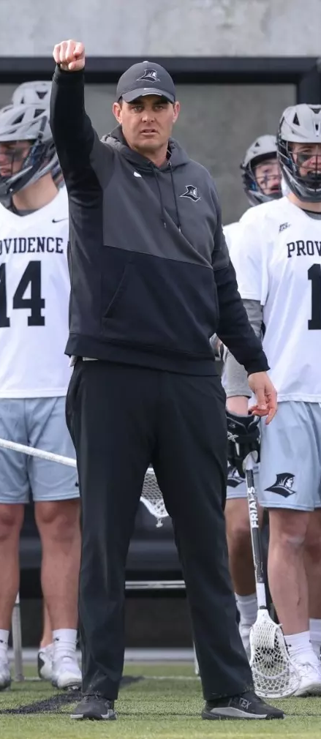
Keynote Speaker – Bobby Benson
Head Coach: Providence College
Assistant Coach: US National Team
Coach: Westwood Youth Lacrosse
Former Offensive Coord: Maryland
Former Offensive Coord: Johns Hopkins
Player – 3x All American at Johns Hopkins

Slide 38
Annual Meeting
NEXT UP
You Make the Call
Bill Doherty
Chris Arouca

Slide 39
You Make the Call
Videos are not meant to embarrass an Official of Team
Will Play the Video 3 times
Discuss with people near you
Vote
Further Discussion

Slide 40
You Make the Call 1

Slide 41
You Make the Call 2

Slide 42
You Make the Call 3

Slide 43
You Make the Call 4

Slide 44
Annual Meeting
NEXT UP
Veterans
Breakout sessions – Auditorium, Rooms 38 & 39
New Officials
Arbiter training – Room 37
Followed by Field Training - Gym
Return to Auditorium – 12:25 PM

Slide 45
Annual Meeting
Raffle
Tips for success….
Closing remarks -- Fran Tarpey

