Slide 1
Regular Season Meeting #2
Week of 4/7-4/11

Slide 2
Agenda
Communication
Videos
Managing Multiple Fouls

Slide 3
COMMUNICATION

Slide 4
You cannot be a Great Official until you learn how to be an effective communicator

Slide 5

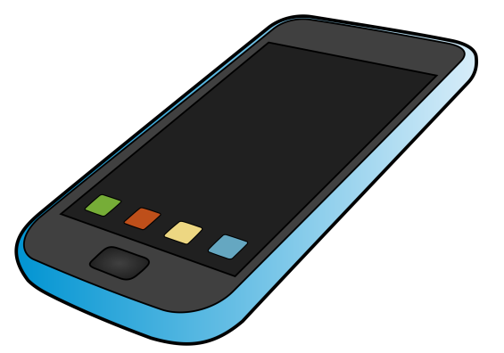
Communication – Before Game
Notes:
Before the game, the referee should email the head coach and the crew to confirm game details.
Time, Location, who the crew is, and contact information.
The referee should then send a separate email to the crew to let them know when to meet in the parking lot and any other details they need to be aware. Make sure you have all cell phone number.

Slide 6
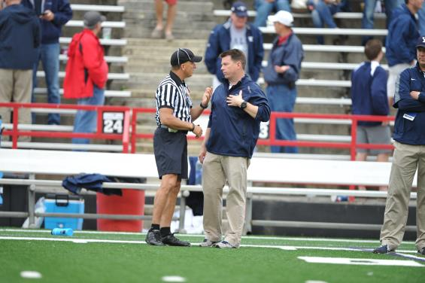
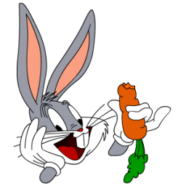
Communication – During Game (Coaches)
Notes:
During the game
Be polite, but firm with coaches and players
If a coach has a question or wants an explanation let him know that as soon there is a stoppage of play, ask him to remind you at that time to visit.
Keep in mind coaches are excitable. The louder and faster they talk, the lower and slower your should talk.
The head coach is the only one that can talk to you. If you have an issue with an assistant coach, remind the head coach that all communication should come from him.
To be overly sensitive to comments made from the stands or sidelines. Don’t have “rabbit ears”
However, if it is personal or in appropriate, handle the situation with the coach and field administrator.
Make sure you back up your crew, don’t throw them under the bus no matter how bad of a game a crew member may be having.

Slide 7

Phrases for Your Back Pocket
I hear you coach.
From my angle, I did not see that.
Let me find out and get back to you.
Remind me at the next timeout.
Coach, I need your help.
Notes:
Yelling at my partner is not going to make him better today – yell at me not at him.
Not the time to be a comedian

Slide 8
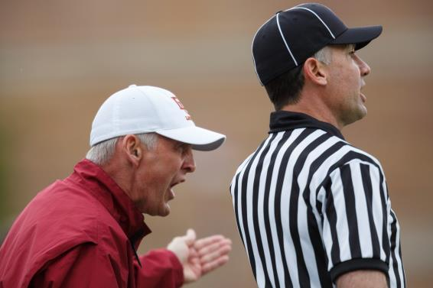
Presence
As the coach gets louder you get quieter
Presence in a crisis
  Calm
  Cool
  Collected
  Controlled
Notes:
Jedi Mind Trick
Get quieter as the coach gets louder. You bring the coach down to your calmer level as a result and no on sees you shout back an angry retort that you’ll regret.

Slide 9

Silence Cannot be Misquoted
Notes:
Don’t talk yourself into trouble
Tell them what they need to know and no more

Slide 10
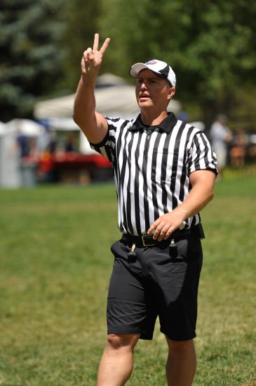
Communication – During Game (Partners)
Perfect Signals
Time Outs(Get together to talk)
Eye Contact/Ready Signal
Help Situations
Notes:
Communication between the officiating crew is critical.
Most of your communication will be hand signals during the game. Be bigger and hold them longer than you are comfortable doing
Make sure they are clear, visible and well done. - this goes a long way in not having confusion later on
During time outs, quarters and halves, meet as a crew to discuss the game and important points

Slide 11
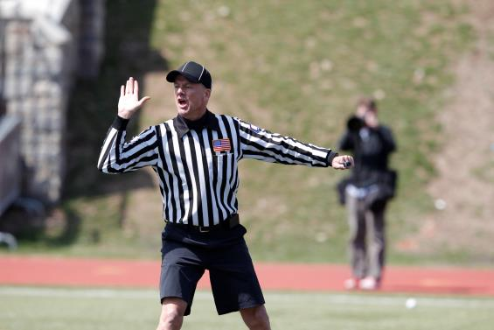
Communication – During Game (Players)
Don’t
  Coach
  Yell Angry
Do
  Encourage good behavior
  Empathize
  Be Firm
  Eliminate emotions
Notes:
You can often manage many game situations by talking to players during the game.
Don’t talk “too much”
Don’t coach, but manage players and situations
Don’t be too loud. Only the players should hear you. You don’t want the stands or coaches to hear you.
Don’t be a officious, but be firm. Players need to respect you and your authority.
Look for teachable moments. Players don’t know all the rules and you can help them better understand and learn from their mistakes.

Slide 12
Other thoughts..
Be You when communicating
Not just about the message, but the way the message is delivered
Will change with the momentum of the game
Same approach does not work for all players or game situations
Portray all emotions in a positive manner
Notes:
Its great to strive to officiate like someone, but only if that’s your personality
If you can’t be positive then be emotionless - The games might be the best part of a child’s day
People use these times of competition to escape from reality and pressures from the outside world
Don’t bring your bagage to the game and take it out on kids just because you are the authoritatize figure for a moment of time

Slide 13
Threshold
Where do you draw the line with coaches between conduct and unsportsmanlike conduct fouls?
How do you handle a coach who dissents under the guise of coaching, i.e. “keep playing through the helmet slashes”?
How do you handle a coach badgering you about your partner’s calls?
How do you handle a coach who is attending to his injured player and makes pointed comments about the crew's failure to "keep 'em safe!"
Notes:
Discuss as a class – who has been in these situations? How did you handle things?

Slide 14
Never-Ending Commentary
Coach asks distracting questions during games, i.e. “Don’t we get a free clear? Ref, wasn't that a slash?”
Coach says, "That's a slash" or "That's a push" frequently. What is our limit?
Coach hounds an official about a call his partner made earlier in the game. Best way to handle this?
How to deal with snarky comments from a coach said in a negative tone?
Notes:
Discuss as a class – who has been in these situations? How did you handle things?

Slide 15
Dealing with Multiple Fouls

Slide 16
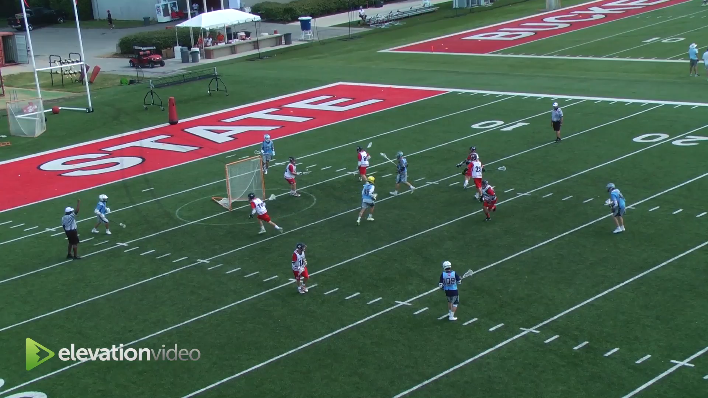

Slide 17
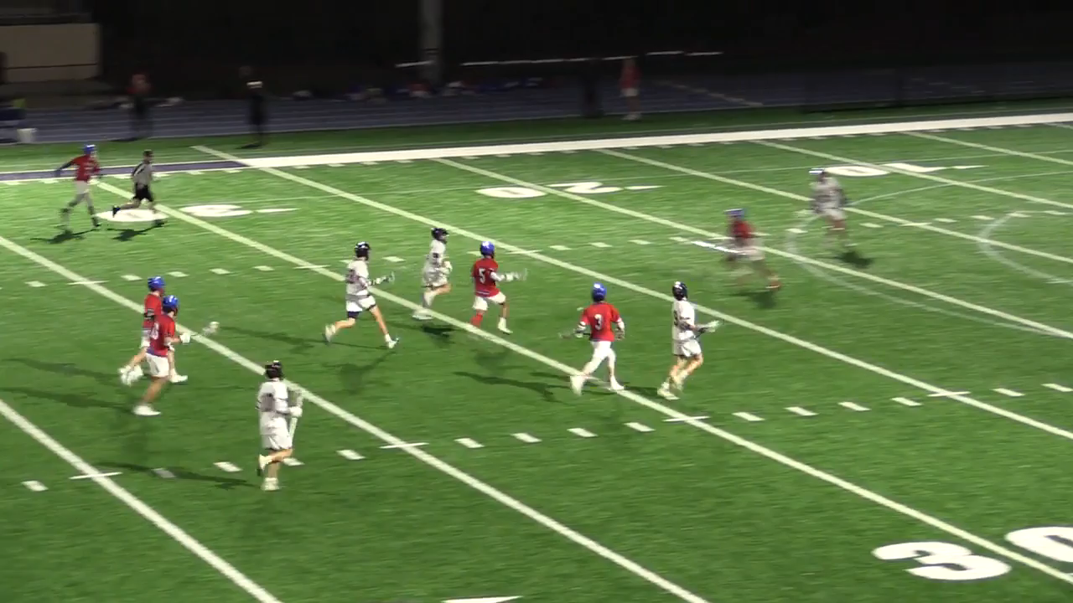

Slide 18
Topics
Definitions
Penalty Time
Awarding the Ball
Situations Similar to Simultaneous Fouls
Situation & Examples

Slide 19
Definition – Rule 7-6, pages 84-86
Simultaneous Fouls are fouls called on opposing teams during:
Live Ball
Dead ball when sequence can not be determined
*When you have simultaneous fouls kill the play immediately

Slide 20
Penalty Time
If there is no play-on in effect or flag down already and both fouls are technical the technical fouls cancel (no penalty time)
If a team has or is entitled to possession commits a technical foul then only the other team serves the penalty (think flag is down and then the team offense has a moving pick)
If a team has or is entitled to possession commits a personal foul then all players serve penalty time.

Slide 21
Award Ball
Team with less penalty time gets the ball
If penalty time is equal then the team with or entitled to the ball keeps the ball
If penalty time is equal and neither team is entitled ball award by AP or Faceoff
Ball restarts where the play was last blown dead

Slide 22
Remember Rule 7-2 D-F (pg. 80)
All time-serving penalties called on players of opposing teams from the time the flag is dropped or the whistle sounds stopping play until the sounding of the whistle resuming play ALL COMMON Penalty time is NON-RELEASABLE.
Basically if they go in the box at the same time the matching penalty time is locked.

Slide 23
Stacking Penalties
A Maximum of three players can be serving penalties at the same time.
If there is an additional player serving penalties they must wait until someone else is released before they can start serving their penalty. They may not participate until they serve.
Typically there will be locked in penalties and this gets confusing. Take your time and explain it.

Slide 24
Live Ball / Dead Ball Fouls
If there is a live ball foul and the after the whistle there is a dead ball foul by the opposing team these are not simultaneous.
Award ball to the team that was fouled last.
Matching penalty time is still non-releasable.

Slide 25
If it is not simultaneous…
Common penalty time is non-releasable
Possession is determined by a toggle (who committed the last foul?)
It is a free clear

Slide 26
Key to Understanding
Read 7-6 Situations and Rulings over and over
Also 7-2 has other similar situations that are related.
Just keep reading it.

Slide 27
Next Meetings
Go-to-Online Meetings: Wednesday 4/24
In-Person Week of 5/6 – 5/9

