Slide 1
Regular Season Meeting #1
Week of 3/18-3/21

Slide 2
Agenda
Rule Changes and Points of Emphasis
Crease Play
Videos
Start of the Season

Slide 3
NFHS Rule Changes - Major
Helmet - If helmet comes off during play it is an IMMEDIATE whistle.
Team that had the ball keeps the ball
If the Ball is loose AP
Not the same enforcement as NCAA
Players must wear equipment as designed.

Slide 4
NFHS Rule Changes - Major
2. Hits the Head
Indirect contact to head/neck (slides up):
1 minute non-releasable
Direct Contact to head/neck
2 minutes non-releasable
Direct Deliberate/Violent Contact to head/neck
3 minutes non-releasable possible ejection
Hitting a defenseless player is still min. 2 non-releasable

Slide 5
NFHS Rule Changes - Major
3. Faceoffs
It is illegal to hit a hit a body check player in a crouched position. Faceoff players must “play the ball”
Other rule changes found on EMLOA Website

Slide 6
NFHS Points of Emphasis
1. Cross Prohibitions - Do stick checks and call penalties
2. Eye Black - same every year
3. Checks Involving Head/Neck
4. Properly Worn Equipment

Slide 7
Mouthpieces
NCAA put a memo 2 weeks ago regarding calling mouth pieces. NFHS/Youth should be no different
When you certify coaches: Mention that all players equipment must be worn properly including mouth pieces and helmet
Check during opening line-up. If they don’t have one send them off.
If a player doesn’t have one or it in call the foul

Slide 8
Crease Play
If you watch any game on TV crease rules are not the same in NFHS!
There is no diving! Diving includes jumping or leaping. If you determine a player dives and they land in the crease. NO GOAL!
If there feet are grounded and they fall in the crease after the ball is in goal, then GOAL

Slide 9
Goalie Interference - Loose Ball
Outside Crease
Goalie’s body is protected if touching crease
If Goalie’s stick is outside of the cylinder that portion of the stick can be checked
Inside Crease
Goalie’s Body is protected
Goalie stick is protected inside the crease
Play-ON: Award ball to goalie/defense

Slide 10
Goalie Interference - Possession
If the goalie has possession of the his body and stick are protected.
Goalie is also protected while making an outlet pass.
If there is interference while goalie has possession…Play-On - If pass is completed or goalie leaves the crease play-on is over. If the ball is dropped, free clear award possession at center X.

Slide 11
Other Crease Plays
Illegal Re-Entry: Defensive player/goalie can’t run with possession from outside crease into crease
Field Players can possess the ball in the crease. Still 4 second count but no possession.
If the ball is possessed outside the crease and the opposing team runs through the crease flag down.

Slide 12
Defender in the Crease
Defender can not enter the goal with the purpose of acting as goalie.
Immediate whistle (unless shot is in flight): Technical foul on the defender
Repeated Offenses will be considered unsportsmanlike fouls.

Slide 13
Tips for Crease Calls
Quicker Whistles tend to help
Be Loud
Be Confident
Understand the rules
Sometimes this area needs a little showmanship…goals are important

Slide 14
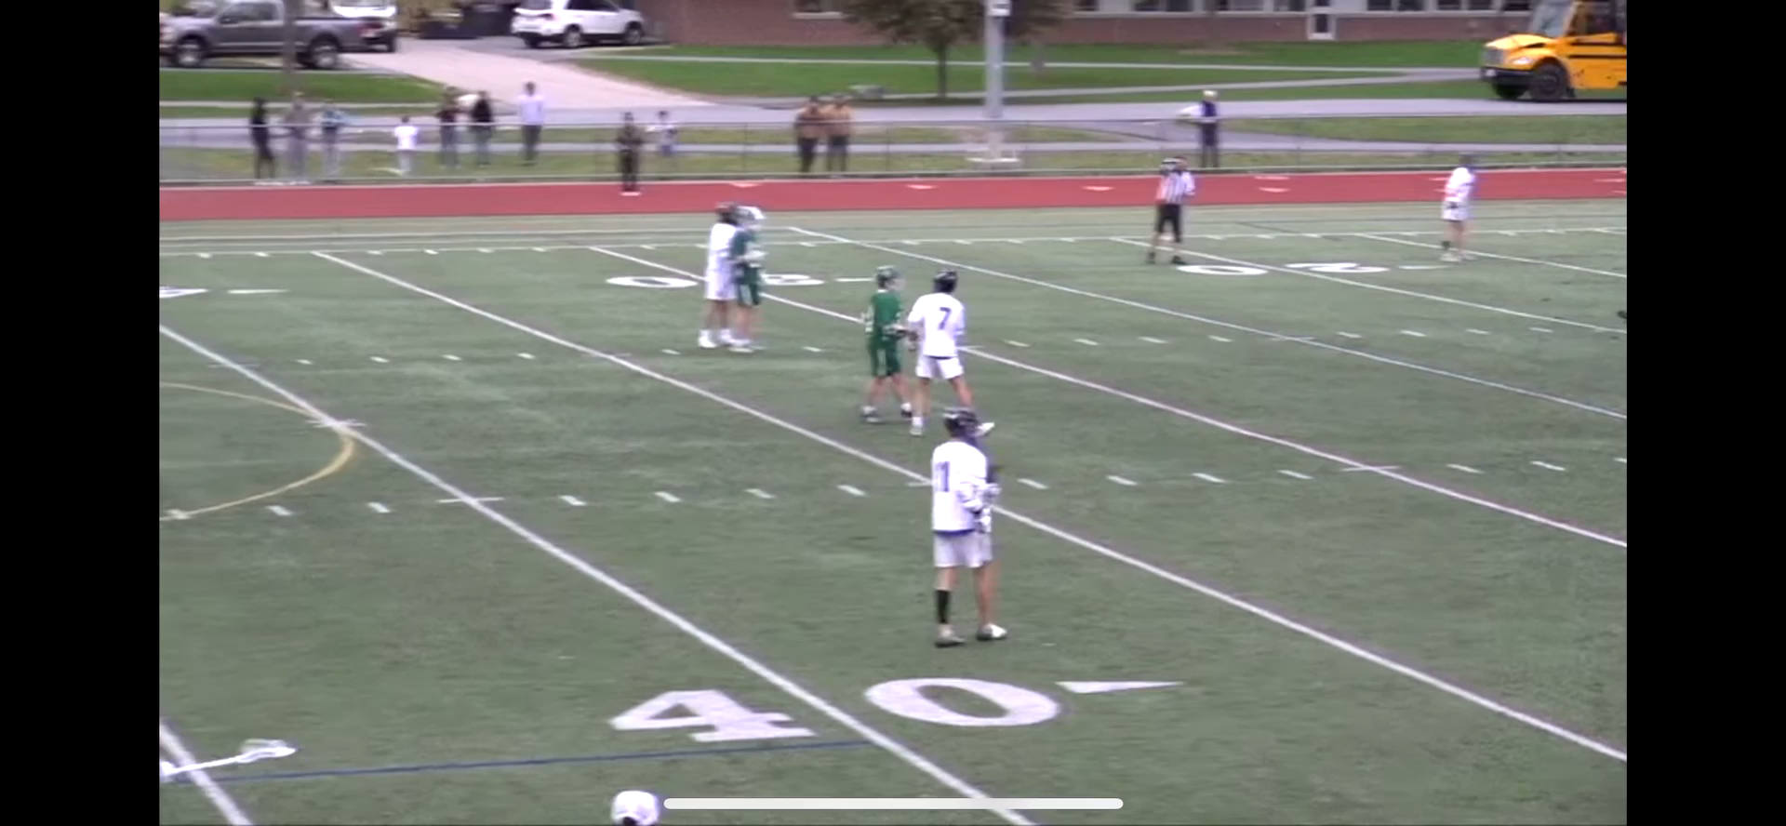

Slide 15
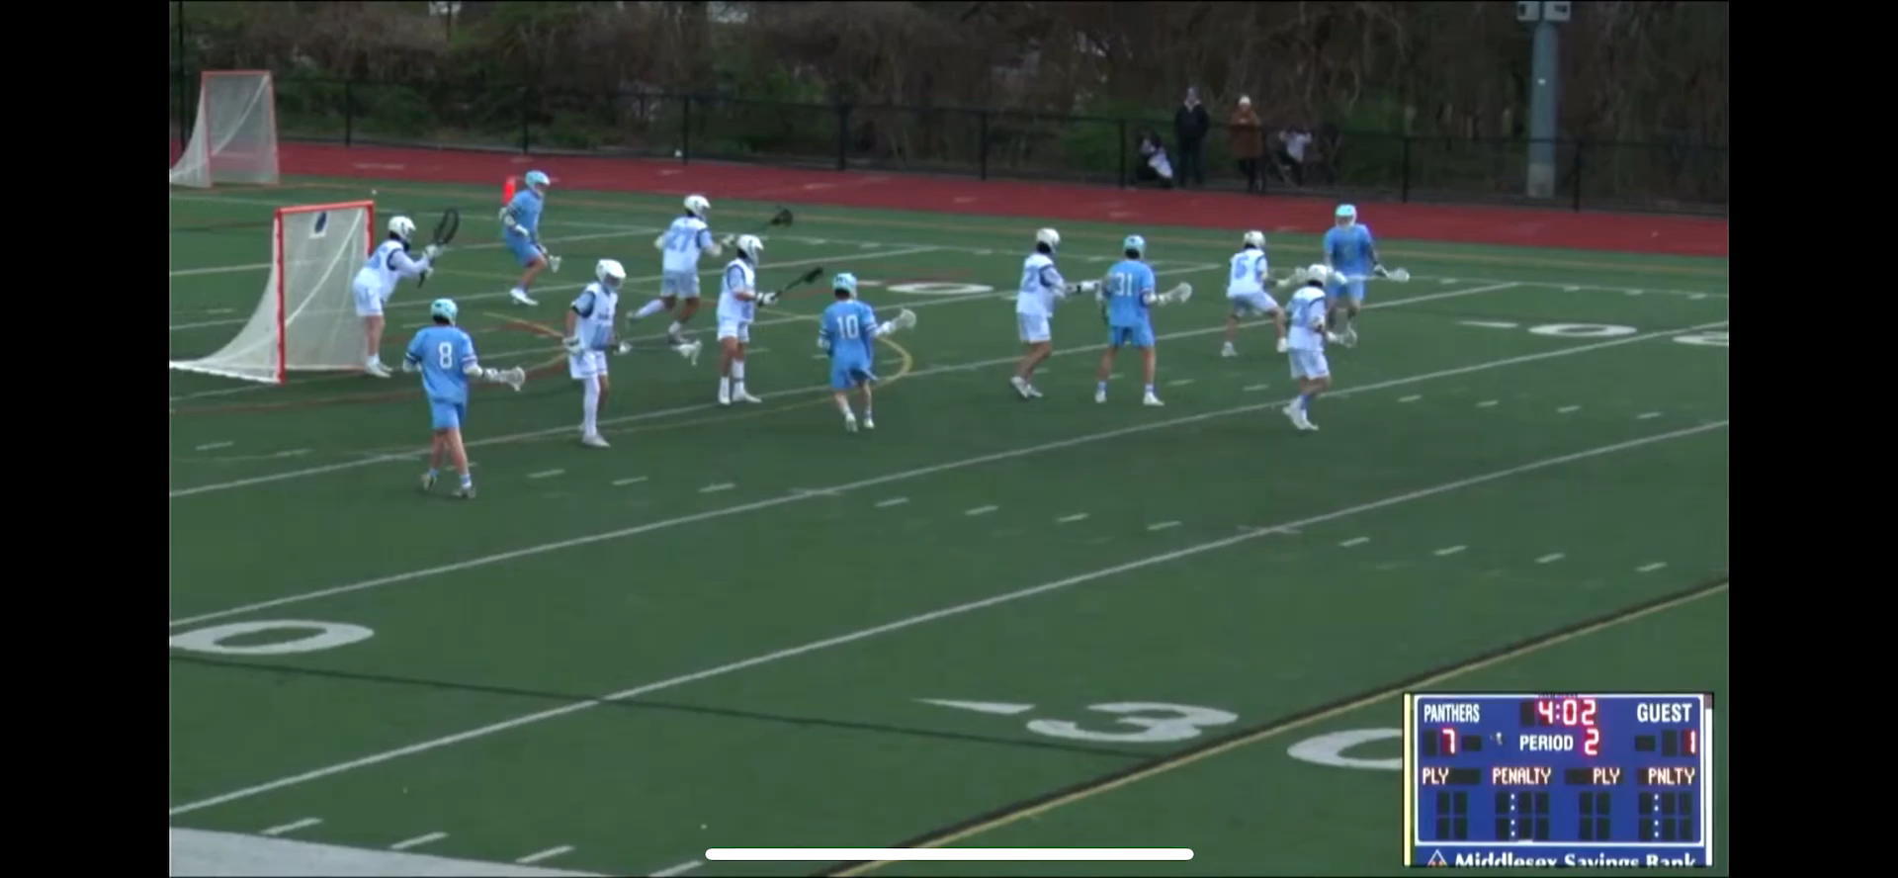

Slide 16
Beginning of the Season Tips
Set the tone for the season. Call the fouls, enforce mouth pieces, do face offs right
Don’t screw your fellow officials in the next game by not doing it right in your game
Arrive on-site 20-30 minutes early and be on the field at least 15 minutes prior to game
Be flexible – It is likely not the coaches fault that the bus was late

Slide 17
Beginning of the Season Tips
Conduct coaches meetings at the youth level and understand the rule differences for different age groups and leagues
You only get one chance to make a first impression, so make sure your first impression is a good one.
Enjoy it – we are not getting rich doing this but we are compensated well for our time.

Slide 18
Mentoring Officials
If you are a veteran official make it a goal to help make someone else better.
You don’t need to formally assigned as a mentor to help someone out.
Do things the right way, teach them one needed, and give feedback when appropriate.
We need to do a better job helping first and second year officials get better.

Slide 19
Newer Officials
ASK for HELP!!!
Introduce yourself
Watch a varsity game or half and ask questions at halftime or after the game
There are lots of resources…use them!

Slide 20
General Guidelines
Ignore Criticism, Answer questions, penalize outrageousness.
Know the rules to the extent you would be comfortable teaching them.

Slide 21
Assignors/Assignments
Same Stuff Every YEAR!!!!
Accept/Decline Assignments Timely
Update Availability
Notify your assignor immediately if there is a fight/ejection/anything they should know about
Some Youth Leagues using Demosphere to assign
Understand payment procedures

Slide 22
Meeting Schedule
WO March 18-21 Regular meeting #1
WO April 1-4 Newbie (members 1-5 years)
WO April 8-11 Regular meeting #2
April 24 7:30 Go To Meeting Meeting #3
WO May 6-9 Regular Meeting #4
WO June 16-20 Socials
Full Schedule on Website

Slide 23
Q&A

