Slide 1
2024 EMLOA Remote Class
Sunday, March 24, 2024 7 pm
Presenters
Darrell Benson
Rick Catalano
Jon Izzo
Doug Davenport

Slide 2
Agenda
Intro
Professionalism
Player Safety
Play of the Game
Personal and Technical Fouls
Wrap-up – Next Steps

Slide 3
Intro
History of Associate Officials Program
20 Years, over 3,000 AO’s
Referee Magazine Article
KEEP UP THE GOOD WORK!!
Requirements for each level
Associate (High School aged officials)
Apprentice (college aged officials)
Adult
Resources – Rules, Contacts, Presentations, Uniform vendor, etc

Slide 4
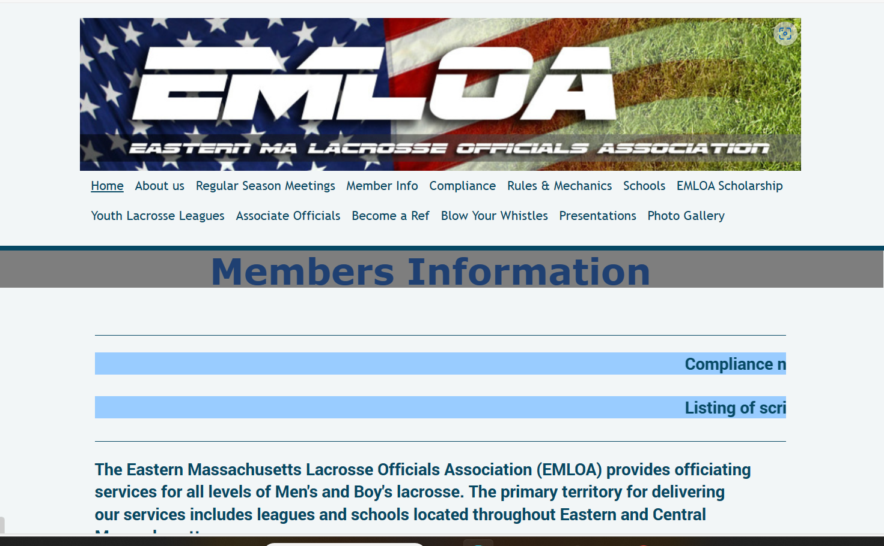
Intro
www.emloa.org

Slide 5
Professionalism
Appearance
Timeliness
Rules and Mechanics Knowledge
Game Management

Slide 6
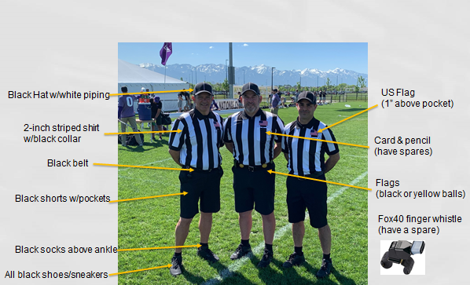
Professionalism - Appearance

Slide 7
Professionalism - Timeliness
Being on time means being early.
Always show up early and get comfortable.
Meet with partner
Meet with Coaches
Coin Toss
Get the game started on time

Slide 8
Professionalism – Rules and Mechanics Knowledge
It takes a long time to fully understand all the rules. Continually review the rules and their application to help you develop more quickly.
In addition to knowing the rules, officials need to know where to go on the field and what their responsibilities are at any given time.

Slide 9
Professionalism – Game Management
Game Management tools are tools we can use to help control a game.
Good tool to use are your “people skills”
There are opportunities in every game when an official can keep a game running smoothly without using a flag or whistle.
Talk players out of fouls
Be aware of when a player may be getting frustrated

Slide 10
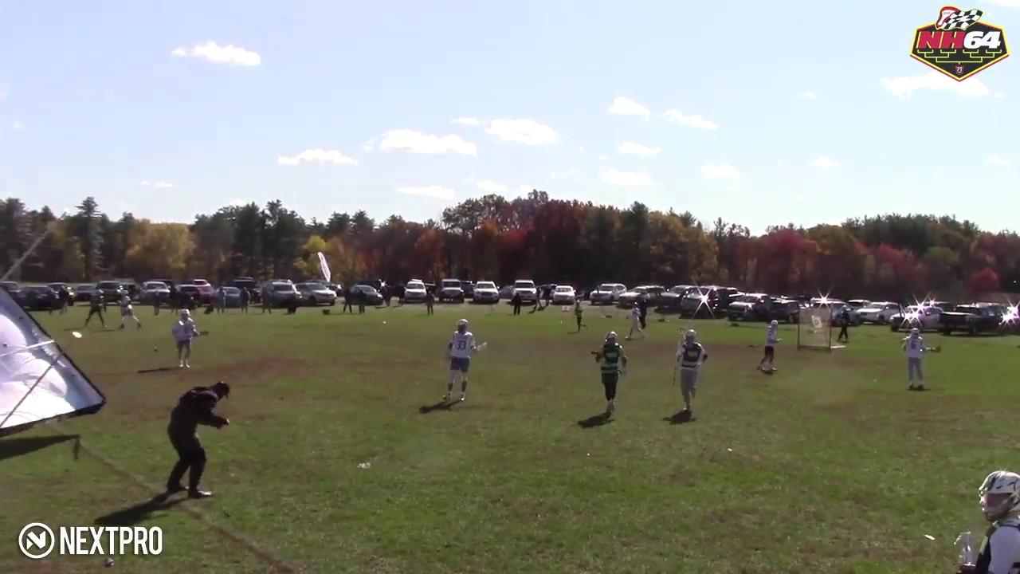
Expect the Unexpected

Slide 11
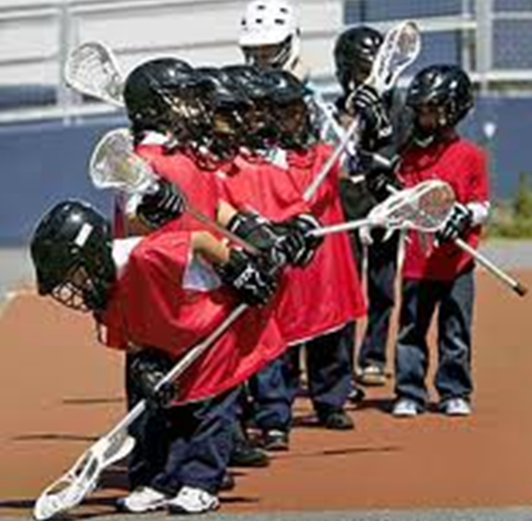
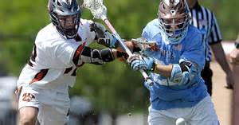
Level of Game
Notes:
The level of lacrosse skill, physical ability, size of players as well as the importance of the game (playoff, arch rival etc.) will inform how you call the game. Discuss this with your partner before the game.

Slide 12
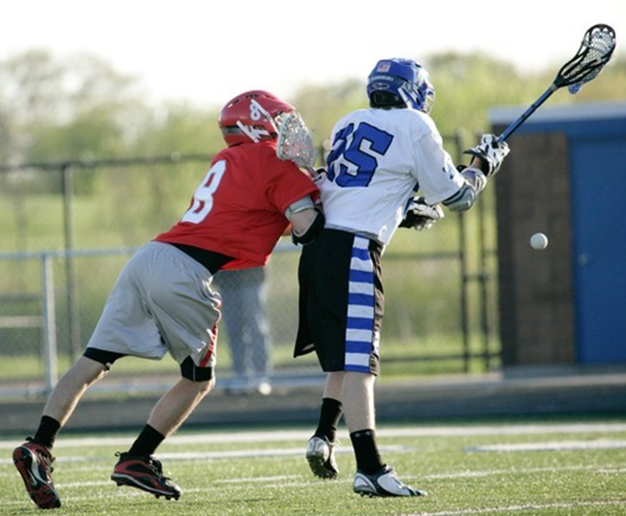
Controlling a Game
You need to assert control of a game before it escalates to a point where you are throwing a lot of these flags after the fact.
Loose Ball Technical Fouls :
Announce your presence.
Get the ball off the ground.
Push, Hold an Conduct.

Slide 13
Dealing with a difficult coach
Undivided attention
Be non-judgmental
Focus on feelings
Allow for silence
Clarify message
Develop a plan
Use a team approach
Use positive self talk
Recognize personal limits
Debrief

Slide 14
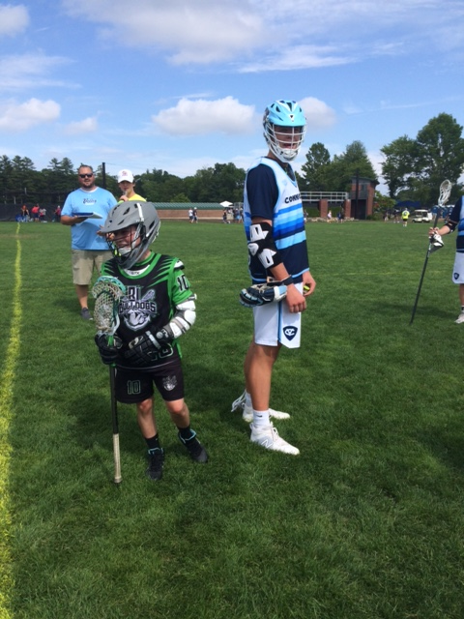
Player Safety
#1 Responsibility of Game Officials
Can’t miss these
Player gets knocked over, probably need a call
Set the bar early and stay consistent
Be aware of age level
Watch for mismatches – “big kid – little kid”

Slide 15
Player Safety
Examples of Safety situations:
Big Hits – Running head start and take out opponent
High Hits – hits to the head and neck area
Wild Slashes – usually one hand and uncontrolled
Unnecessary Roughness – late hits on shooter/passer
Defenseless Players – players don’t see check coming, vulnerable position (e.g., face-off middie), can be Targeting if hit to head and neck, using helmet
Fighting, punching
Overly Rough Crosschecks – usually high

Slide 16
Play of the Game - Field of Play
Next slide is a Field Diagram
Lines of Note
2 Sidelines (same as sideline on FB field)
2 Endlines (usually 5 yards deep in end-zone on FB field
2 Restraining Lines (usually 30 yard line on FB field)
2 Wing Lines
Midline ((usually 50 yard line on FB field)
Alley Lines
Goal Line Extended (INVISIBLE) – sideline to sideline
Also, 2 Creases
And Faceoff area (usually a square on Midline)

Slide 17
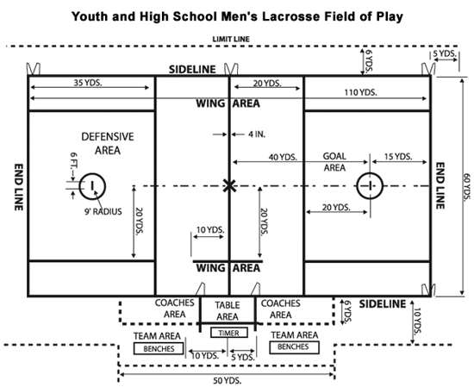
Play of the Game - Field of Play

Slide 18
Play of the Game - Coach Certification
Get Both Coaches together at Wing area
Ask Visiting Coach “Do you certify that all your players are equipped by rule?”
Correct answer is “Yes”
Ask Home Coach “Do you certify that all your players are equipped by rule?”
Correct answer is “Yes”
Don’t move on until both answer in the affirmative

Slide 19
Play of the Game - Coach Certification
After Certification, good time to ask Coaches about anything they want to discuss
Check to make sure one Coach for each team has badge (MYL games). If not, report to Referee Coordinator

Slide 20
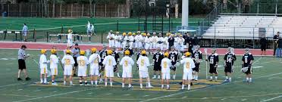
Play of the Game - Coin Toss and Line-Up
Coin Toss: Held with captains, visiting teams have choice for coin toss. Winning team chooses Alternate Possession (AP) or side to defend 1st and 3rd Quarters
Line-up: Starters line-up prior to opening face-off

Slide 21
Coin Toss
Referee conducts the coin toss.
Away calls the toss.
Winner of the coin toss chooses end of A.P.
U
R
A A A
H H H

Slide 22
Line-Up
Referee
Introduces Crew, Brief Talk, Good Luck!
A A A M M M D D D
G
U
R
G
D D D M M M A A A

Slide 23
Play of the Game - FO / W
Faceoff Official
Conducts Faceoff
Waits for Ready for play (Go) signal from partner
Will Call most of the violations on faceoff
Wing Official
Positioned between end of wing line & restraining line
Ensures field is ready for play by holding arm up – points when ready
Watches wing players
Watches big picture

Slide 24
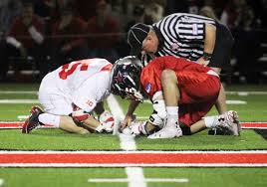
Play of the Game – Face-Off
Faceoff to start each Quarter
Faceoff after goals
Exception – uneven situation or flag down creates an uneven situation - denotes possession
Team must have 4 players in defensive restraining area, 3 players in offensive restraining area and 3 middies
Players are not “released” until possession is called or ball goes into off/def zone or OOB.

Slide 25
Face-Off
Face-Off Official instructs the FO middies while Wing Official counts players – remember “Stop” or “Go” sign from Wing to FO official
Tell middies to go “Down” together, keep knees off ground
Neutral grip (not motorcycle grip), hands off plastic
Instruct them that you’ll say “Set” and then blow your whistle

Slide 26
Play of the Game - Face-Off
More Face-off tips
After “Down” and before “Set” you can adjust players
Line up heads “Top to Stop”
No leaning into Neutral Zone (head or feet)
Both hands on ground
Only hands and feet on ground (no knees)

Slide 27
Play of the Game - Face-Off
More Face-off tips (cont)
After set, no movement allowed
Quick Whistle to prevent early jump
Clamping on ball for over two or three seconds is withholding
Must play ball and not opponent
Once possession is gained, shout “Possession” and that will release players from behind restraining lines.

Slide 28
Face-Off

Slide 29
Faceoff Towards FO Goal
M
M
D A
D A
FO
D A
A D
M
M
Wing Official holds arms up and points toward goal when the field is ready
D A
A D
W
M
M

Slide 30
Faceoff Away from FO Goal
M
M
D A
D A
FO
D A
A D
M
M
D A
A D
W
M
M

Slide 31
Lead / Trail
Lead
Goal
End Line
L
Trail
Shooter
Far Goal
Over and Back
T

Slide 32
Positioning in Settled Situations
As the ball and play moves you should move with it to be in the best position to make the call.
Don’t kill the grass! Move your feet.
Lead get as tight to the goal as play will allow you too.
L
T

Slide 33
Play of the Game - Transition
With the change of the possession the lead becomes the trail and the trail becomes the lead.
New Lead
Stays 1 zone ahead of ball
Responsible for goal
Anticipate
10 seconds count once possessed over midline
New Trail
Goalie 4-second count & 20 second clearing count
Trails the play
Offside/Subs
Late hits

Slide 34
Transition
Lead becomes trail, starts beeper, starts 4 second goalie count
D A
M
M
T
L
D A
D A
A D
M
G
M
G
A D
Goalie Makes Save
M
M
D A
L
T
Lead gets 10 second count into box
Trail becomes lead, new lead stays 1 zone ahead of ball

Slide 35
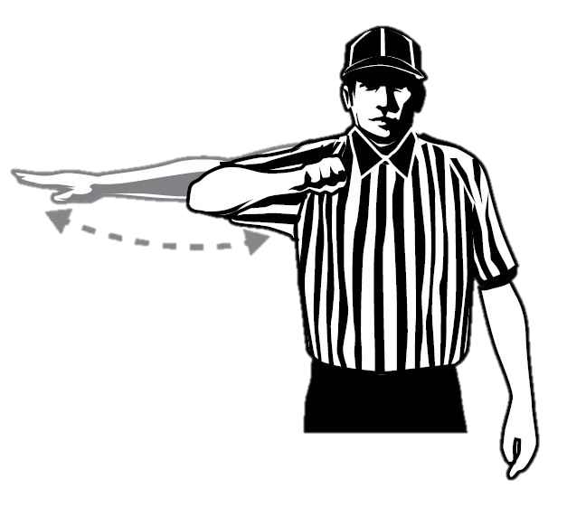
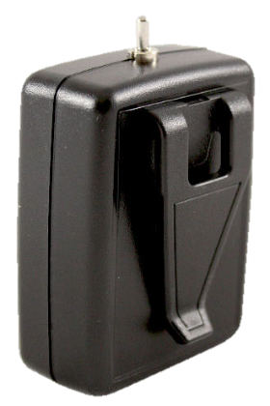
Advancement Counts
20 seconds
10 seconds
Crease: 4 seconds

Slide 36
Play of the Game - Substitutions
Regular Substitutions
Must go through the substitution area (box)
Player on the field must come off first
Player exiting field has right of way
Special Substitutions
“Wholesale” subs may take place:
End of period
After goal
Injury time-out
Time serving foul
Team time out
Equipment adjustment

Slide 37
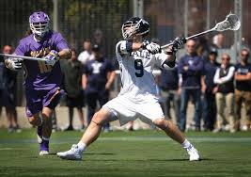
Play of the Game - Out of Bounds
Shot
If the ball goes OOB on a shot the ball is award to the player that was closest to the ball where and when it went OOB
A shot remains a shot until it comes to rest, possessed or goes OOB
Everything else
OOB when a player or loose ball touches boundary line or anything beyond
Award ball to player of the opposing team

Slide 38
Out of Bounds
Each official is responsible for the end line behind the goal they cover as the Lead official and the sideline they run along.
Signaling Out of Bounds:
Sound whistle while signaling dead ball with one hand in the air
Signal direction of play and call out the color of the team
“Blue” or “Blue ball!”
Place hand back into the air.air to signal dead ball
L
T

Slide 39
Play of the Game - Restarts
Sideline/Endline
Must come to “rolling stop”
Play restarted where ball went OOB
Field of Play
Offense - can’t start in attack box
Defense - can start in box/crease
Substitution Box
Slower Restart
Move ball in 5 yards from box
Offensive Players: No offensive player may be within 5 yards of player restarting ball
Defensive Player: May be within 5 yards but may not play ball carrier without gaining 5 yards of separation

Slide 40
Restarts
Slow Restart:
Count the players
Look to partner for ready signal
Don’t blow through the Stop Sign (“not ready” signal)
Quick Restart:
Don’t need to count and should make eye contact with partner
In settled play the official closest to the ball usually takes the restart
L
All restarts near the substitution box should be slow and the ball should me moved in 5 yards!
T

Slide 41
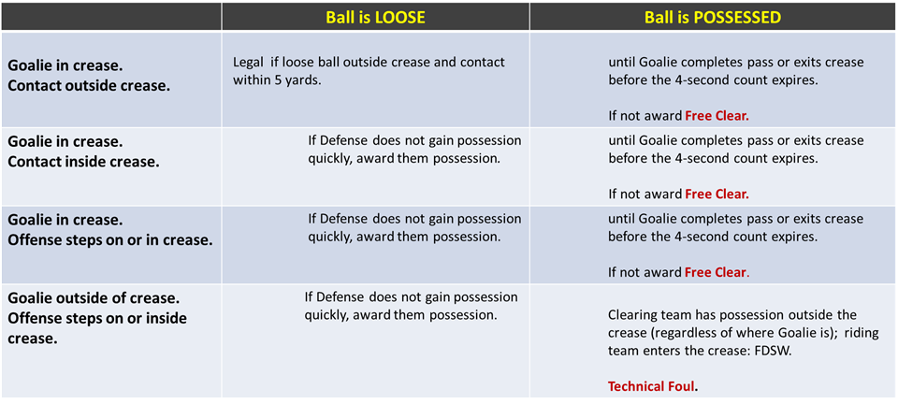
Goalie Crease Privileges

Slide 42
Play of the Game - Crease cont.
Cannot Carry ball into the crease
Goalie can bat ball but not pick up or catch with hand inside crease
Field players cannot jump into the crease with perceived intent of blocking shot
Strike 1 – Conduct Foul
Strike 2 – Releasable Unsportsmanlike Conduct

Slide 43
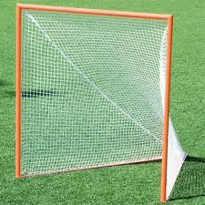
Play of the Game - Goal
A goal is scored when a loose ball passes from the front completely through the imaginary plane formed by goal post.
Ball can be thrown, kicked or directed with part of the body by either team.

Slide 44
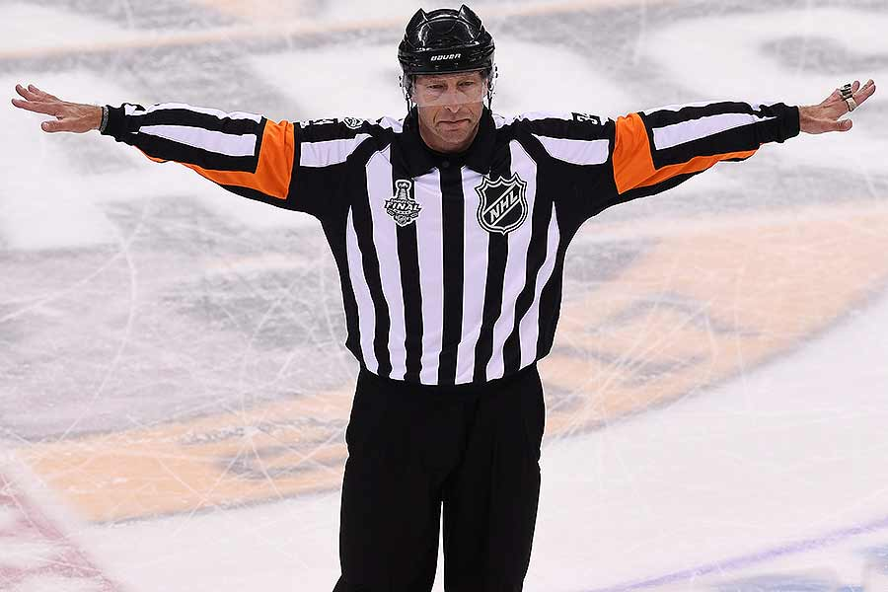
When a Goal Doesn’t Count
Ball is shot after time expired
Any part of an offensive player’s body is in crease
Official blows their whistle
Head comes off stick on shot of shooter
A player “dives” and lands in crease
Attack team is offside or too many men
A foul on scoring team prior to goal
Time-out recognized

Slide 45
After Goal
Lead gets the ball, jogs to restraining line and becomes wing official.
Makes sure field is ready
Lead runs to crease
Signals goal
Gets ball
KEEP OFFICIATING
W
L
L
FO
Trail Meets Lead and gets the ball.
Jogs to FO and conducts the next FO
Trail watches shooter!
Watches big picture
T

Slide 46
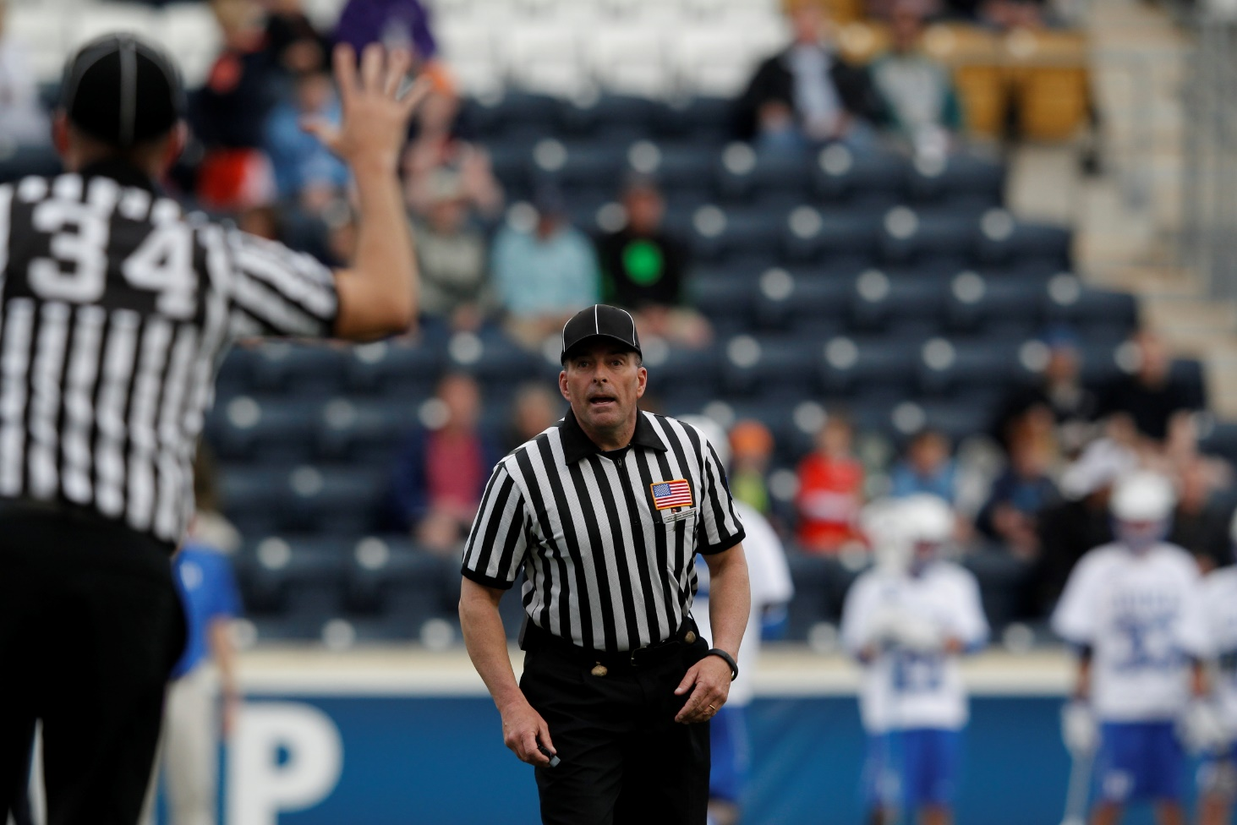
Penalty Relay
Get’s the Field Ready
Blue, 27, push.
Got it!
L
Trail always reports foul.
Uses C-NOTE
T
C-Note
Color, Number, Offense, Time, Explanation
Blue 27, Push, 30 Seconds
White 14, Slash, 1 Minute

Slide 47
Penalty Relay
TRAIL still reports fouls from the far side.
Move Closer to box, don’t yell across field
T
L

Slide 48
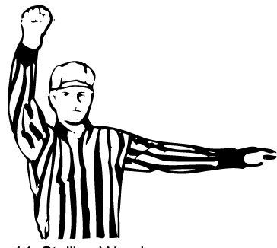
Play of the Game - Get it In/Keep it In!
Required to Get it in the Box (10 secs)
and Keep it in the Offensive Box
Last 2 Minutes: Required by team winning by 4 of less goals
Any other time: Can be required by officials if offense isn’t creating offense

Slide 49
Play of the Game - Official’s Time Outs
Injury
Goalie equipment becomes broken
Player loses equipment in scrimmage area
If ball is loose AP
If ball is in possession the team retains possession
***Try to have some with possession***

Slide 50
Play of the Game - Team Time Outs
May be called by head coach or player on the field
Team must have possession during live ball
Either team can call a timeout during dead ball
2 timeouts per half

Slide 51
First Flag
First flag sets the bar.
Discuss this in your pregame.
Reassess throughout the game with your partner. Be consistent as a crew.

Slide 52
Mistakes by Officials
Rule 7:13
Confer with you partner and correct the mistake before it has an impact on the game. Get it right!
Pointing in wrong direction
Inadvertent whistle/flag
Blown call
Misapplication of rule.
If a mistake is made – don’t make it worse with quick restarts.

Slide 53
Personal vs Technical Fouls
Personal Fouls
Technical Fouls
More serious in Nature
Always serve penalty time
Can be 1-3 minutes
Can be locked in or releasable
Flag is thrown
5 minutes of Personal Fouls is a foul out
Less Severe
Advantage/Disadvantage
30 seconds penalty time, award (loose ball) or change of possession
Releasable
Flag or Play-ON

Slide 54
Penalty Enforcement
Personal Fouls
-Always a flag
-Can be 1-3 minutes
-Can be releasable
-Can be non-releasable
-Serves after goal scored
Technical Fouls
-Offense - Turnover
-Loose - Play-ON!
-Defense - Flag Down
-30 second releasable
-Goal scored slow whistle wipes out foul

Slide 55
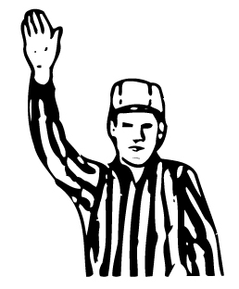
Play-ON!
Used during loose ball technical fouls
If team commits a technical foul while ball is loose the official yells Play-ON!
If offended team gets the ball play-on is over
If there is no advantage or team that commits the foul gets the ball, blow your whistle and award the ball

Slide 56
Flag Down/Slow Whistle
When a penalty is recognized official shall yell “Flag Down” and throw their flag in the air.
If the ball is loose or foul is committed by offensive team when penalty occurs it is an immediate whistle.
If foul is committed against the team in possession then it shall be a slow whistle.

Slide 57
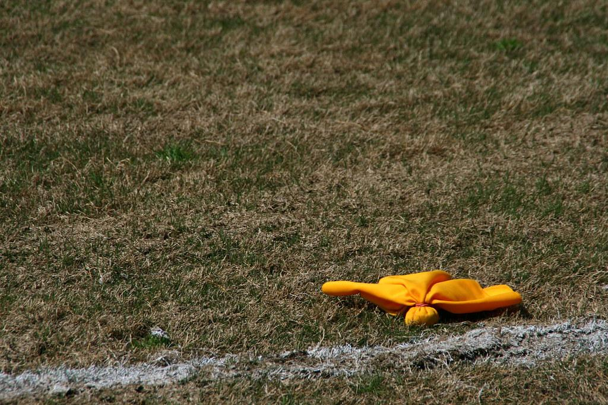
Slow Whistle: When to End
GOODIES
Goal
Out of Bounds
Offense Commits Penalty
Defense gains possession
Injury in Scrimmage Area
End of Period/Game
Second Defensive Foul*

Slide 58
Restarts after Penalty
No Flag - restart at the approximate spot of where the ball was when the foul occurred.
Flag - Occurred in defensive end. Free clear at the midfield. Except Simultaneous
Flag - Occurred offensive half. Outside box
Offensive team can never restart in the box unless OOB.

Slide 59
Personal Fouls
Slashing
Illegal Body Check
Unnecessary Roughness
Cross Check
Targeting Head/Neck
Tripping
Unsportsmanlike Conduct

Slide 60
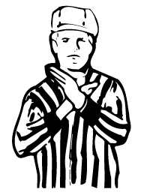
Slashing
Swinging a crosse at an opponent’s cross
or body with deliberate viciousness or
reckless abandon
Striking an opponent’s body

Slide 61
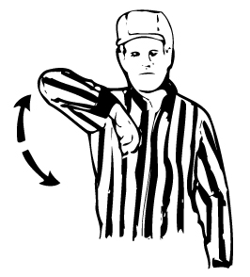
Illegal Body Check
Body-checking player w/out ball or not within 5 yards of loose ball
From the rear or below the waist
Player is on ground
Defenseless or Head/Neck - automatic 2-3 mins locked...possible ejection!
Blindsided, head turned away
Blows to head or neck even on follow through

Slide 62
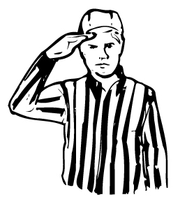
Unnecessary Roughness
Excessively violent push or hold
Deliberately running through screen
Avoidable contact that is deliberate and excessively violent
Check with gloved hand that’s not a punch

Slide 63
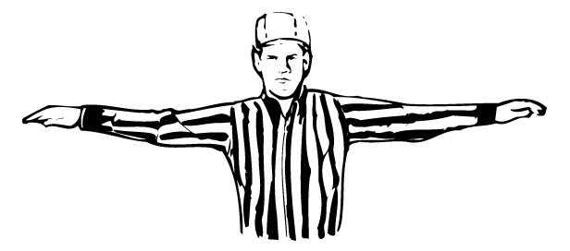
Unsportsmanlike Conduct
Enter in an argument w/ an official
Threatening, profane or obscene language
Deliberately uses fingers on faceoff
All are 1-3 minute locked in fouls
Repeatedly commits same tech. foul
Failure to return to field
Deliberately failing to comply w/sub rules

Slide 64
Ejection
Fighting - striking or attempting to strike opponent
Leaving Bench During fight
Flagrant Misconduct
Second non-releasable unsportsmanlike

Slide 65
Technical Fouls
Play-On, Flag Down or Immediate Whistle and Turnover
Crease/GK Interference
Holding
Illegal Offensive Screen
Illegal Procedure
Conduct Foul
Interference
Offsides
Pushing
Stalling
Warding
Withholding

Slide 66
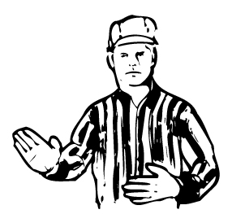
Pushing
Pushing, thrusting or shoving a
an opponent from the rear.

Slide 67
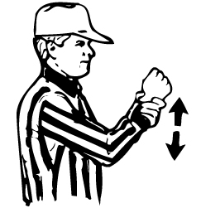
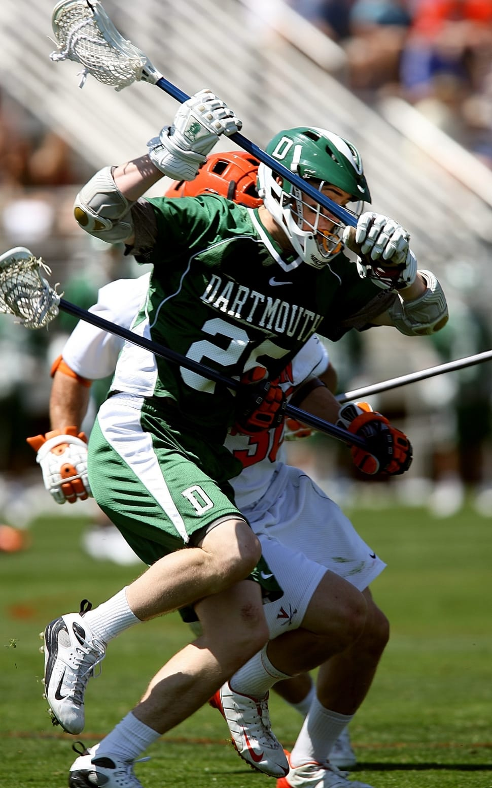
Holding
Player can not restrict the movement
of an opponent or his cross.
Ok to hold cross within 5 yards of loose ball or in possession

Slide 68
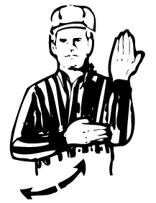
Illegal Offensive Screen
“Moving Pick”
Must be stationary
Feet no wider than shoulder width apart
Stick Inside frame of body

Slide 69
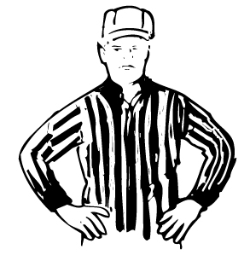
Offsides
More than 6 in offensive end
More than 7 in defensive end
*Includes players in the sub box or serving penalties
*Not a penalty to have too few players

Slide 70
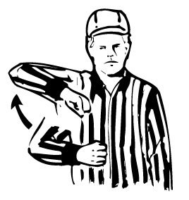
Warding
Using free hand or body part create
space.

Slide 71
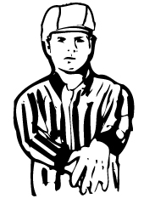
Withholding
Trapping the ball longer than is necessary
to control the ball or lying on the ball
Ball is struck in cross would be considered withholding

Slide 72
Interference
Cannot interfere with the free movement
of an opponent unless player has
possession or ball is in flight or loose and players are within 5 yards of the ball.

Slide 73
Crease/Goalkeeper Interference
Reminders
Loose ball outside crease, no interference if contact with goalie’s stick
Loose ball inside crease, interference if contact with goalie’s stick, Play-on, quick whistle, award the ball to the goalie in the crease
Contact with goalie’s stick with possession will be a Play-on, whistle if team loses possession on outlet pass, Free Clear

Slide 74
Four Keys to Success
Look the part.
Be in the proper position.
Communicate effectively.
Know the rules.
You control these factors!
L
CNOTE
It is assumed you know these! Keep working at it!

Slide 75
Next Steps
Certification Test
Mentoring for New Associate Officials

