Slide 1
2024 Associate Officials Play of Game and Mechanics

Slide 2
Common Terms - Positioning
Lead/Trail
FO/Wing Official
ON/OFF Official
GLE

Slide 3
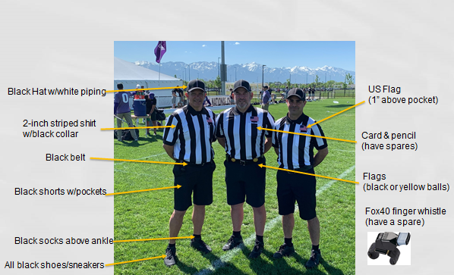
Professionalism - Appearance

Slide 4
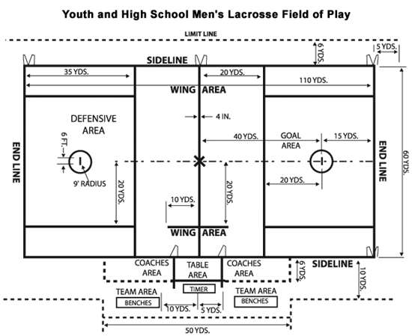
Field of Play

Slide 5
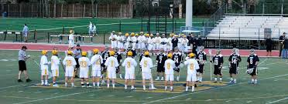
Coin Toss and Line-Up
Coin Toss: Held with captains, visiting teams have choice for coin toss. Winning team chooses Alternating Possession (AP) or side to defence
Line-up: Starters line-up prior to opening face-off

Slide 6
Coin Toss
Referee conducts the coin toss.
Away calls the toss.
Winner of the coin toss chooses end of A.P.
U
R
A A A
H H H

Slide 7
Line-Up
Referee
Introduces Crew, Brief Talk, Good Luck!
A A A M M M D D D
G
U
R
G
D D D M M M A A A

Slide 8
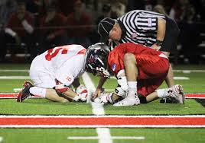
Face-Off
Begin every period w/faceoff and after goals
Unless the there is an uneven situation then team w/possession retains possession
Flag down that creates an uneven situation also denotes possession
Team must have 4 players in defensive area and 3 players in offensive area (except if 3 men down)
Players are not “released” until possession, ball goes into off/def zone or OOB.

Slide 9
FO / W
Faceoff Official
Conducts Faceoff
Waits for Ready for play signal from partner
Will Call most of the violations on faceoff
Wing Official
Positioned between end of wing line & restraining line
Ensures field is ready for play by holding arm up – points when ready
Watches wing players
Watches big picture

Slide 10
Faceoff
Referee conducts the opening faceoff
M
M
D A
D A
U
W
M
R
FO
D A
A D
M
D A
A D
M
M

Slide 11
Faceoff Towards FO Goal
M
M
D A
D A
FO
D A
A D
M
M
Wing Official holds arms up and points toward goal when the field is ready
D A
A D
W
M
M

Slide 12
Faceoff Away from FO Goal
M
M
D A
D A
FO
D A
A D
M
M
D A
A D
W
M
M

Slide 13
ON/OFF Responsibilities
The official closest to the ball is typically the ON official and will be responsible for fouls on the player in possession. Narrow Focus
The OFF official will watch the big picture fouls and for off ball fouls. Wide Focus
Must work together in communicate on overlap.

Slide 14
Settled Situations On/Off
On Official:
Has a narrow focus that is on the player in possession and surrounding 5 yards. Watches for fouls like pushing, holding, tripping, illegal body checks, unnecessary roughness, slashing, and warding.
L
Off Official:
Has a wider view of the play because off ball involves more players in a larger area. Watches for fouls like interference, illegal offensive screens, crease violations (cutters running through the crease), and late hits after passes.
T

Slide 15
Lead / Trail
Lead
Goal
End Line
L
Trail
Shooter
Far Goal
Over and Back
T

Slide 16
Positioning in Settled Situations
As the ball and play moves you should move with it to be in the best position to make the call.
Don’t kill the grass! Move your feet.
Lead get as tight to the goal as play will allow you too.
L
T

Slide 17
Transition
With the change of the possession the lead becomes the trail and the trail becomes the lead.
New Lead
Stays 1 zone ahead of ball
Responsible for goal
Anticipate
10 seconds count once possessed over midline
New Trail
Goalie 4-second count & 20 second clearing count
Trails the play
Offside/Subs
Late hits

Slide 18
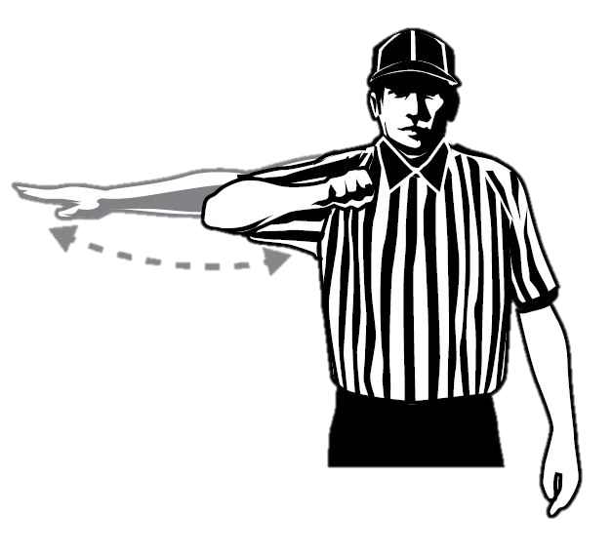
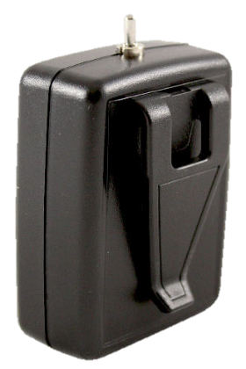
Advancement Counts
20 seconds
10 seconds
Crease: 4 seconds

Slide 19
Transition
Lead becomes trail, starts beeper, starts 4 second goalie count
D A
M
M
T
L
D A
D A
A D
M
G
M
G
A D
Goalie Makes Save
M
M
D A
L
T
Lead gets 10 second count into box
Trail becomes lead, new lead stays 1 zone ahead of ball

Slide 20
Substitutions
Regular Substitutions
Must go through the substitution area (box)
Player on the field must come off first
Player exiting field has right of way
Special Substitutions
“Wholesale” subs may take place:
End of period
After goal
Injury time-out
Time serving foul
Team time out
Equipment adjustment

Slide 21
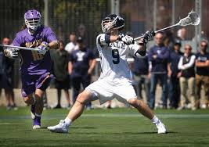
Out of Bounds
Shot
If the ball goes OOB on a shot the ball is award to the player that was closest to the ball where and when it went OOB
A shot remains a shot until it comes to rest, possessed or goes OOB
Everything else
OOB when a player or loose ball touches boundary line or anything beyond
Award ball to player of the opposing team

Slide 22
Out of Bounds
Each official is responsible for the end line behind the goal they cover as the Lead official and the sideline they run along.
Signaling Out of Bounds:
Sound whistle while signaling dead ball with one hand in the air
Signal direction of play and call out the color of the team
“Blue” or “Blue ball!”
Place hand back into the air.air to signal dead ball
L
T

Slide 23
Restarts
Sideline/Endline
Must come to “rolling stop”
Play restarted where ball went OOB
Field of Play
Offense - can’t start in box
Defense - can start in box/crease
Substitution Box
Slower Restart
Move ball in 5 yards from box
Offensive Players: No offensive player may be within 5 yards of player restarting ball
Defensive Player: May be within 5 yards but may not play ball carrier without gaining 5 yards of separation

Slide 24
Restarts
Slow Restart:
Count the players
Look to partner for ready signal
Don’t blow through the Stop Sign (“not ready” signal)
Quick Restart:
Don’t need to count and should make eye contact with partner
In settled play the official closest to the ball usually takes the restart
L
All restarts near the substitution box should be slow and the ball should me moved in 5 yards!
T

Slide 25
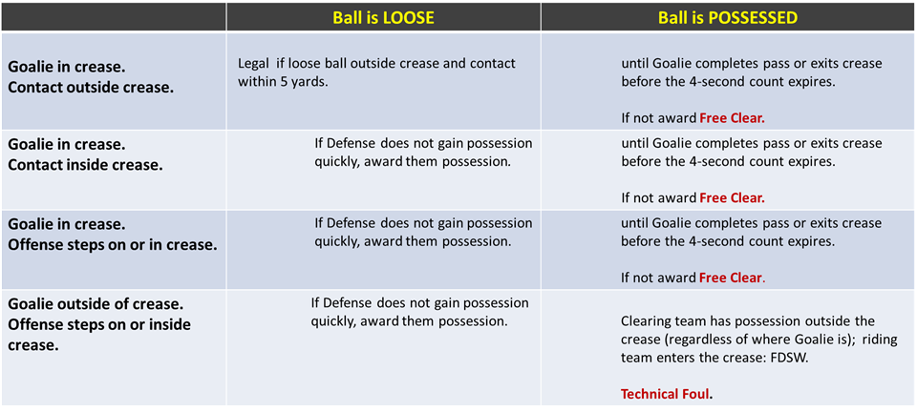
Goalie Crease Privileges

Slide 26
Crease Continued...
Cannot Carry ball into the crease
Goalie can bat ball but not pick up or catch with hand inside crease
Field players cannot jump into the crease with perceived intent of blocking shot
Strike 1 – Conduct Foul
Strike 2 – Releasable Unsportsmanlike Conduct

Slide 27
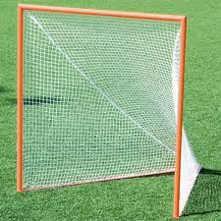
Goal
A goal is scored when a loose ball passes from the front completely through the imaginary plane formed by goal post.
Ball can be thrown, kicked or directed with part of the body by either team.

Slide 28
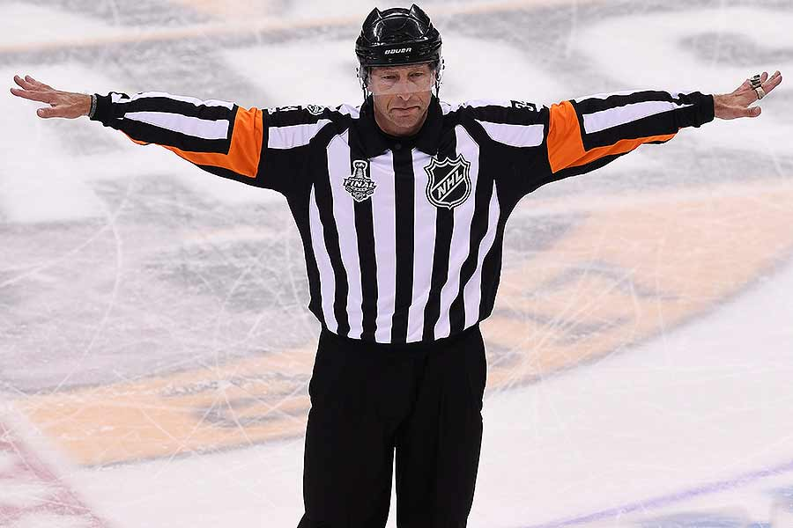
When a Goal Doesn’t Count
Ball is shot after time expired
Any part of an offensive player’s body is in crease
Official blows their whistle
Head comes off stick on shot of shooter
A player “dives” and lands in crease
Attack team is offside or too many men
A foul on scoring team prior to goal
Time-out recognized

Slide 29
After Goal
Lead gets the ball, jogs to restraining line and becomes wing official.
Makes sure field is ready
Lead runs to crease
Signals goal
Gets ball
KEEP OFFICIATING
W
L
L
FO
Trail Meets Lead and gets the ball.
Jogs to FO and conducts the next FO
Trail watches shooter!
Watches big picture
T

Slide 30
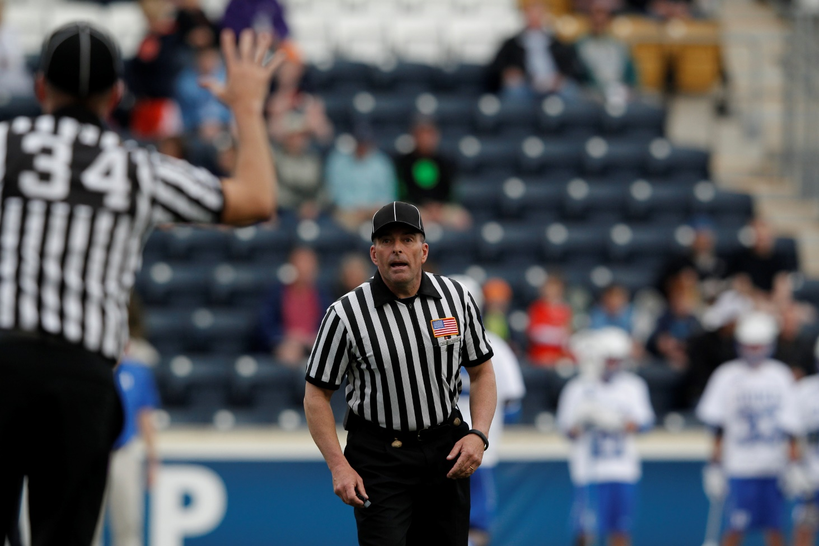
Penalty Relay
Get’s the Field Ready
Blue, 27, push.
Got it!
L
Trail always reports foul.
Uses C-NOTE
T
C-Note
Color, Number, Offense, Time, Explanation
Blue 27, Push, 30 Seconds
White 14, Slash, 1 Minute

Slide 31
Penalty Relay
TRAIL still reports fouls from the far side.
Move Closer to box, don’t yell across field
T
L

Slide 32
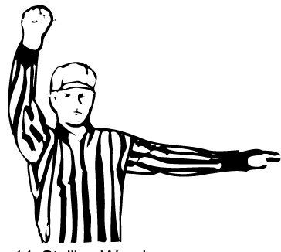
Get it In/Keep it In!
Required to Get it in the Box (10 secs)
and Keep it in the Offensive Box
Last 2 Minutes: Required by team winning by 4 of less goals
Any other time: Can be required by officials if offense isn’t creating offense

Slide 33
Official’s Time Outs
Injury
Goalie equipment becomes broken
Player loses equipment in scrimmage area
If ball is loose AP
If ball is in possession the team retains possession
***Try to have some with possession***

Slide 34
Team Time Outs
May be called by head coach or player on the field
Team must have possession during live ball
Either team can call a timeout during dead ball
2 timeouts per half

Slide 35
Game Management
Tools we can use to help control the game.

Slide 36
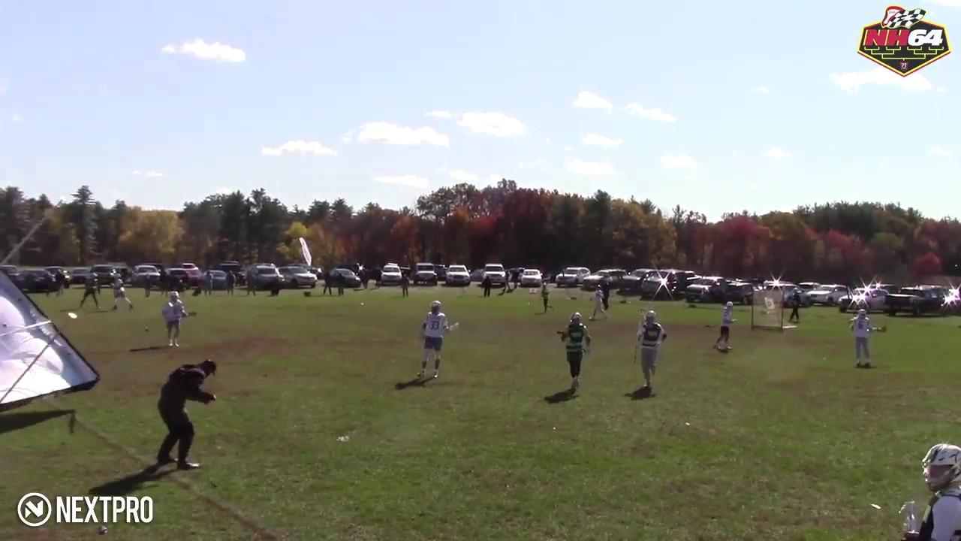
Expect the Unexpected

Slide 37
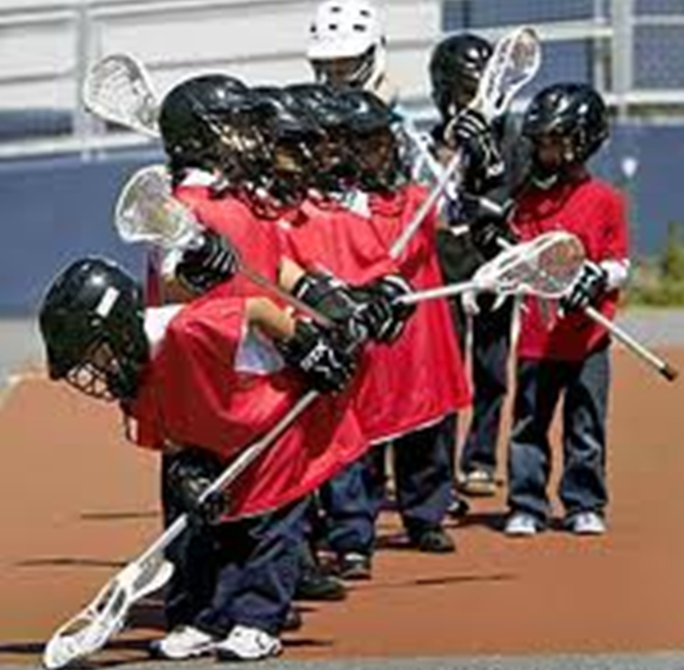
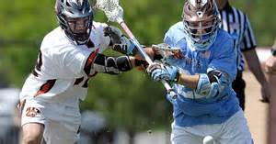
Level of Game
Notes:
The level of lacrosse skill, physical ability, size of players as well as the importance of the game (playoff, arch rival etc.) will inform how you call the game. Discuss this with your partner before the game.

Slide 38
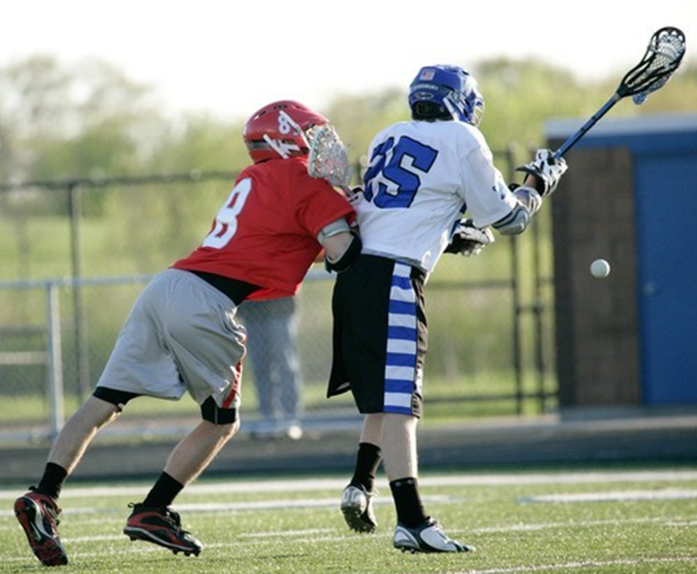
Controlling a Game
You need to assert control of a game before it escalates to a point where you are throwing a lot of these flags after the fact.
Loose Ball Technical Fouls :
Announce your presence.
Get the ball off the ground.
Push, Hold an Conduct.

Slide 39
First Flag
First flag sets the bar.
Discuss this in your pregame.
Reassess throughout the game with your partner. Be consistent as a crew.

Slide 40
Dealing with a difficult coach
Undivided attention
Be non judgmental
Focus on feelings
Allow for silence
Clarify message
Develop a plan
Use a team approach
Use positive self talk
Recognize personal limits
Debrief

Slide 41
Mistakes by Officials
Rule 7:13
Confer with you partner and correct the mistake before it has an impact on the game. Get it right!
Pointing in wrong direction
Inadvertent whistle/flag
Blown call
Misapplication of rule.
If a mistake is made – don’t make it worse with quick restarts.

Slide 42
Four Keys to Success
Look the part.
Be in the proper position.
Communicate effectively.
Know the rules.
You control these factors!
L
CNOTE
It is assumed you know these! Keep working at it!

