Slide 1
Week 3
EMLOA
New Candidates Class

Slide 2
Course Outline
Week 1: Organization, Lax 101, Common Terms & Rules 1, 3, & 4
Week 1A: Annual Meeting
Week 2: Fouls - Personal & Technical
Week 3 - Mechanics, Positioning & Game Management
Test to be completed on-line thru US Lacrosse

Slide 3
Questions?

Slide 4
Common Terms - Positioning
Lead/Trail
FO/Wing Official
ON/OFF Official
GLE

Slide 5
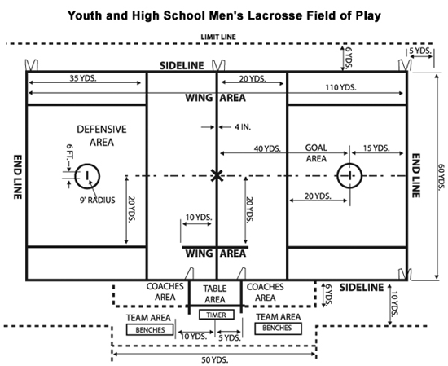
Field of Play

Slide 6
Coin Toss
Referee conducts the coin toss.
Away calls the toss.
Winner of the coin toss chooses end of A.P.
U
R
A A A
H H H

Slide 7
Line-Up
Referee
Introduces Crew, Brief Talk, Good Luck!
A A A M M M D D D
G
U
R
G
D D D M M M A A A

Slide 8
FO / W
Faceoff Official
Conducts Faceoff
Waits for Ready for play signal from partner
Will Call most of the violations on faceoff
Wing Official
Positioned between end of wing line & restraining line
Ensures field is ready for play by holding arm up – points when ready
Watches wing players
Watches big picture

Slide 9
Faceoff
Referee conducts the opening faceoff
M
M
D A
D A
U
W
M
R
FO
D A
A D
M
D A
A D
M
M

Slide 10
Faceoff Towards FO Goal
M
M
D A
D A
FO
D A
A D
M
M
Wing Official holds arms up and points toward goal when the field is ready
D A
A D
W
M
M

Slide 11
Faceoff Away from FO Goal
M
M
D A
D A
FO
D A
A D
M
M
D A
A D
W
M
M

Slide 12
ON/OFF Responsibilities
The official closest to the ball is typically the ON official and will be responsible for fouls on the player in possession. Narrow Focus
The OFF official will watch the big picture fouls and for off ball fouls. Wide Focus
Must work together in communicate on overlap.

Slide 13

Settled Situations On/Off
On Official:
Has a narrow focus that is on the player in possession and surrounding 5 yards. Watches for fouls like pushing, holding, tripping, illegal body checks, unnecessary roughness, slashing, and warding.
L
Off Official:
Has a wider view of the play because off ball involves more players in a larger area. Watches for fouls like interference, illegal offensive screens, crease violations (cutters running through the crease), and late hits after passes.
T

Slide 14
Lead / Trail
Lead
Goal
End Line
L
Trail
Shooter
Far Goal
Over and Back
T

Slide 15

Positioning in Settled Situations
As the ball and play moves you should move with it to be in the best position to make the call.
Don’t kill the grass! Move your feet.
Lead get as tight to the goal as play will allow you too.
L
T

Slide 16
Transition
With the change of the possession the lead becomes the trail and the trail becomes the lead.
New Lead
Stays 1 zone ahead of ball
Responsible for goal
Anticipate
10 seconds count once possessed over midline
New Trail
Goalie 4-second count & 20 second clearing count
Trails the play
Offside/Subs
Late hits

Slide 17
Transition
Lead becomes trail, starts beeper, starts 4 second goalie count
D A
M
M
T
L
D A
D A
A D
M
G
M
G
A D
Goalie Makes Save
M
M
D A
L
T
Lead gets 10 second count into box
Trail becomes lead, new lead stays 1 zone ahead of ball

Slide 18
Out of Bounds
Each official is responsible for the end line behind the goal they cover as the Lead official and the sideline they run along.
Signaling Out of Bounds:
  Sound whistle while signaling dead ball with one hand in the air
  Signal direction of play and call out the color of the team
    “Blue” or “Blue ball!”
  Place hand back into the air.air to signal dead ball
L
T

Slide 19
Restarts
Slow Restart:
  Count the players
  Look to partner for ready signal
    Don’t blow through the Stop Sign (“not ready” signal)
Quick Restart:
  Don’t need to count and should make eye contact with partner
  In settled play the official closest to the ball usually takes the restart
L
All restarts near the substitution box should be slow and the ball should me moved in 5 yards!
T

Slide 20
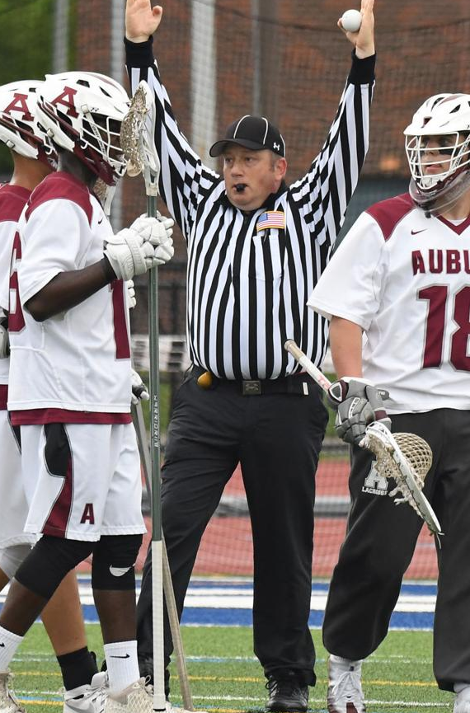
After Goal
Lead gets the ball, jogs to restraining line and becomes wing official.
Makes sure field is ready
Lead runs to crease
Signals goal
Gets ball
KEEP OFFICIATING
W
L
L
FO
Trail Meets Lead and gets the ball.
Jogs to FO and conducts the next FO
Trail watches shooter!
Watches big picture
T

Slide 21
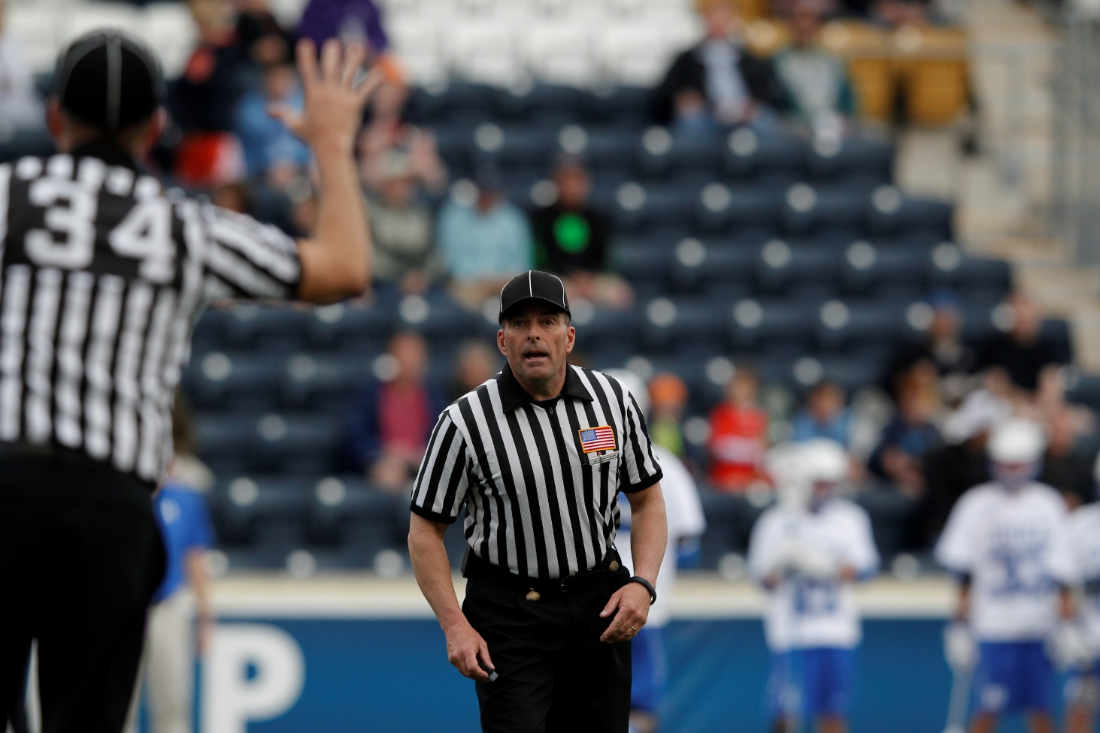
Penalty Relay
Get’s the Field Ready
Blue, 27, push.
Got it!
L
Trail always reports foul.
Uses C-NOTE
T
C-Note
Color, Number, Offense, Time, Explanation
Blue 27, Push, 30 Seconds
White 14, Slash, 1 Minute

Slide 22
Penalty Relay
TRAIL still reports fouls from the far side.
Move Closer to box, don’t yell across field
T
L

Slide 23
Game Management
Tools we can use to help control the game.

Slide 24
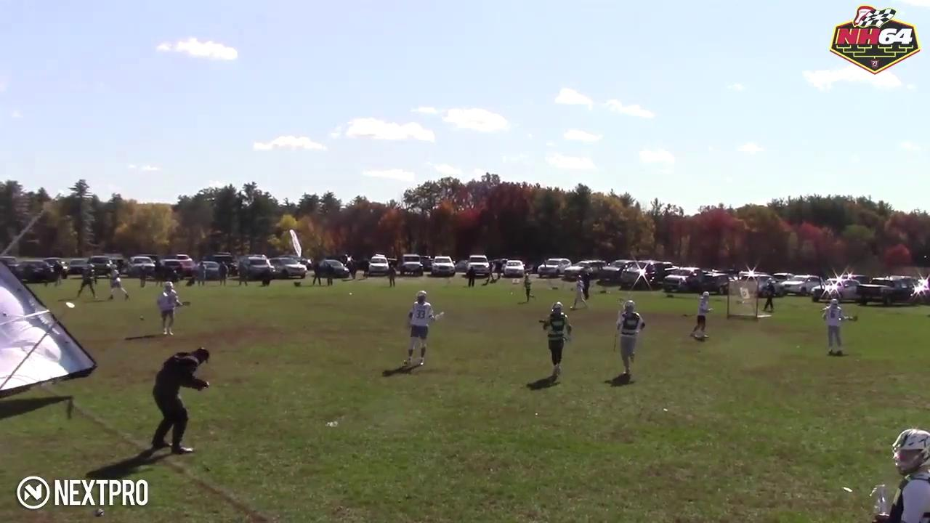
Expect the Unexpected

Slide 25
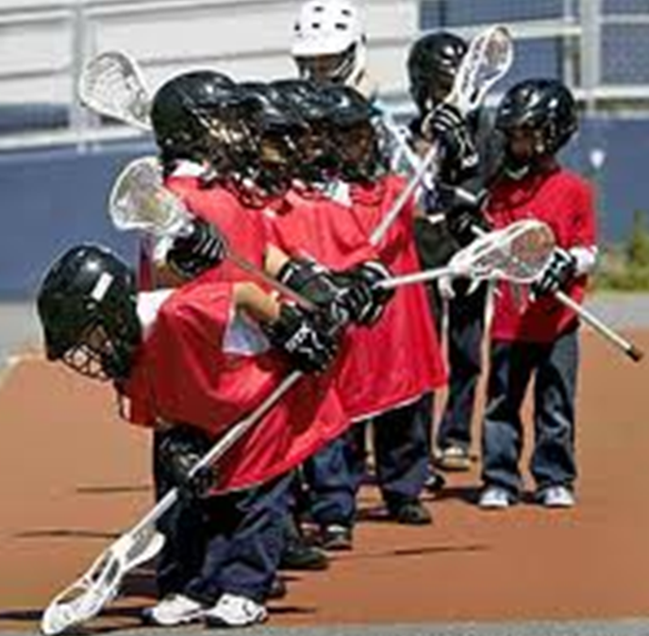
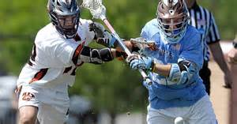

Level of Game
Notes:
The level of lacrosse skill, physical ability, size of players as well as the importance of the game (playoff, arch rival etc.) will inform how you call the game. Discuss this with your partner before the game.

Slide 26
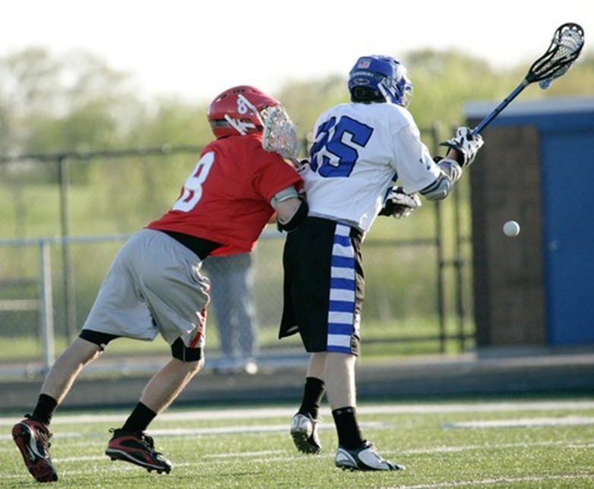
Controlling a Game
You need to assert control of a game before it escalates to a point where you are throwing a lot of these flags after the fact.
Loose Ball Technical Fouls :
  Announce your presence.
  Get the ball off the ground.
  Push, Hold and Conduct.

Slide 27

First Flag
First flag sets the bar.
Discuss this in your pregame.
Reassess throughout the game with your partner.
Be consistent as a crew.

Slide 28
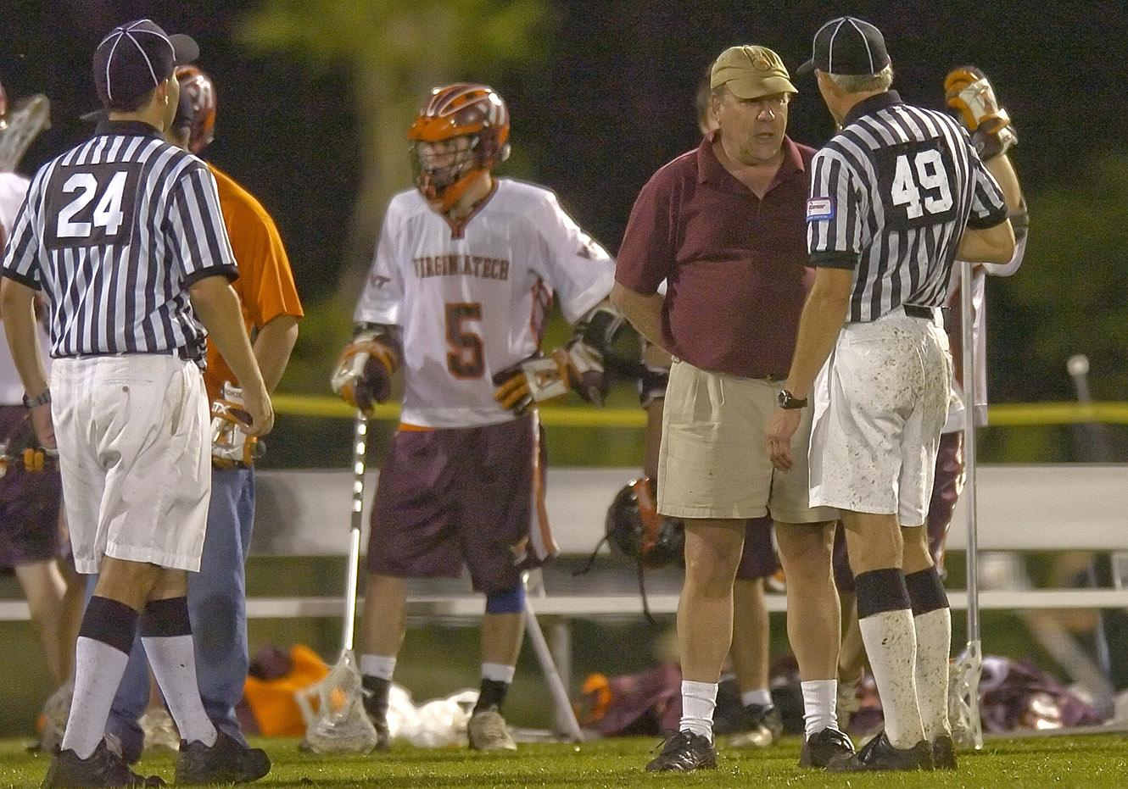
Dealing with a difficult coach
Undivided attention
Be non judgmental
Focus on feelings
Allow for silence
Clarify message
Develop a plan
Use a team approach
Use positive self talk
Recognize personal limits
Debrief

Slide 29
The Ramp
Ejection
Rule 5:12
1 to 3 Minutes
Unsportsmanlike
Conduct
For poor behavior by Team A, options are:
Try to work through these steps in order.
Sometimes you may need to skip steps, especially with taunting and racist behavior.
Rule 5:10
30
Second
Conduct Foul
With B in Possession
Rule 6:6
Award Ball to Opposing Team
Loose Ball Conduct Foul
Verbal Warning
Notes:
Ejection Rule 5:12
3 minute NR USC in addition to ejection: must leave premises unless no school personnel can supervise in which case player is confined to bench area. Ejection can occur after the game has ended!
USC Rule 5:10
Conduct Rule 6:6

Slide 30

Mistakes by Officials
Rule 7:13
Confer with you partner and correct the mistake before it has an impact on the game. Get it right!
  Pointing in wrong direction
  Inadvertent whistle/flag
  Blown call
  Misapplication of rule.
If a mistake is made – don’t make it worse with quick restarts.

Slide 31


Four Keys to Success
Look the part.
Be in the proper position.
Communicate effectively.
Know the rules.
You control these factors!
L
CNOTE
It is assumed you know these!
Keep working at it!

Slide 32
Assignors & Arbiter
Darrell Benson - Southwest & Central Mass
John Hill - Northwest
Roy Condon - Northeast
Bob Maguire - Southshore & Cape
Jim Tighe - Southcoast and Southshore

Slide 33
What is ahead?
Regular Season Meetings
Scrimmages
Mentors

