Slide 1
Week 2
Personal & Technical Fouls

Slide 2
Course Outline
Week 1: Organization, Lax 101, Common Terms & Rules 1, 3, & 4
Week 1A: Annual Meeting
Week 2: Fouls - Personal & Technical
Week 3 - Mechanics, Positioning & Game Management
Test to be completed on-line thru US Lacrosse

Slide 3
Questions

Slide 4
Personal vs Technical Fouls
Personal Fouls
Technical Fouls
More serious in Nature
Always serve penalty time
Can be 1-3 minutes
Can be locked in or releasable
Flag is thrown
5 minutes of Personal Fouls is a foul out
Less Severe
Advantage/Disadvantage
30 seconds penalty time or change of possession
Releasable
Flag or Play-ON

Slide 5
Penalty Enforcement
Personal Fouls
-Always a flag
-Can be 1-3 minutes
-Can be releasable
-Can be non-releasable
-Serves after goal scored
Technical Fouls
-Offense - Turnover
-Loose - Play-ON!
-Defense - Flag Down
-30 second releasable
-Goal scored slow whistle wipes out foul

Slide 6
Personal Fouls
Cross Check
Illegal Body Check
Targeting Head/Neck
Slashing
Tripping
Unnecessary Roughness
Unsportsmanlike Conduct

Slide 7
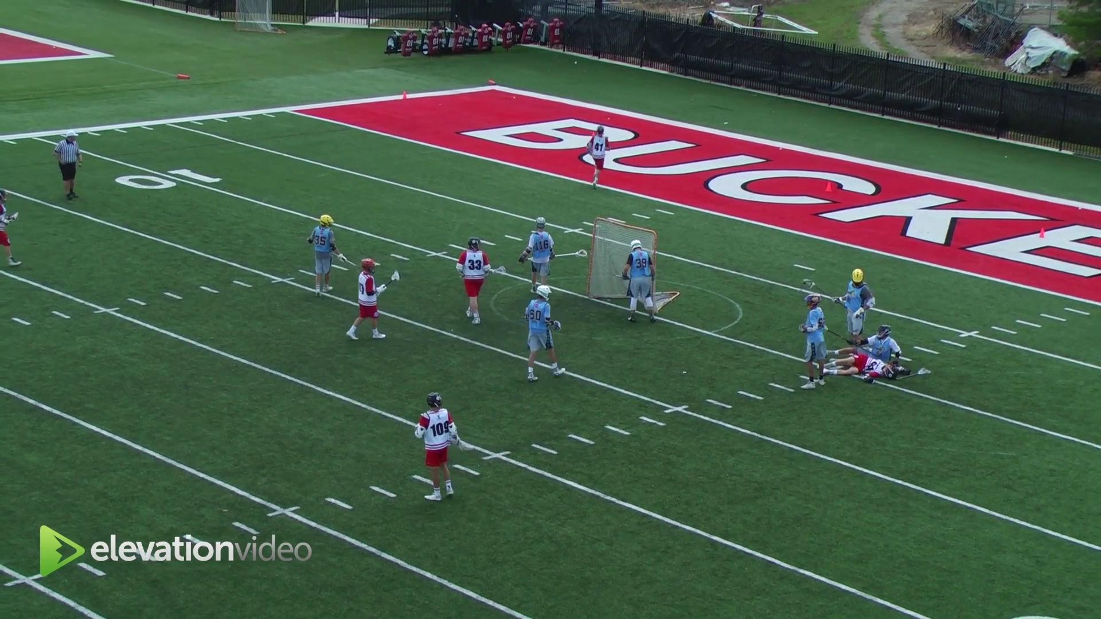
Cross Check
Hands apart, thrusting or arms extended

Slide 8
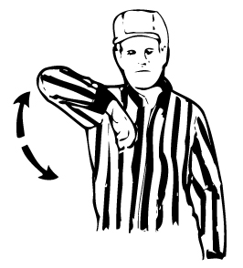
Illegal Body Check
Body-checking player w/out ball or not within 5 yards of loose ball
From the rear or below the waist
Player is on ground
Defenseless or Head/Neck - Increased penalty time
Blindsided, head turned away
Blows to head or neck even on follow through

Slide 9
Illegal Body Check/Defense Player
Illegal Body Check - Contact to the Head
1 Minute Non Releasable - Indirect Contact to Head
2 Minutes Non Releasable - Direct Contact to the Head
3 Minutes Non Releasable or Possible Ejection - Violent or excessive contact to the Head
Hitting a defenseless player is 2 minutes non releasable

Slide 10
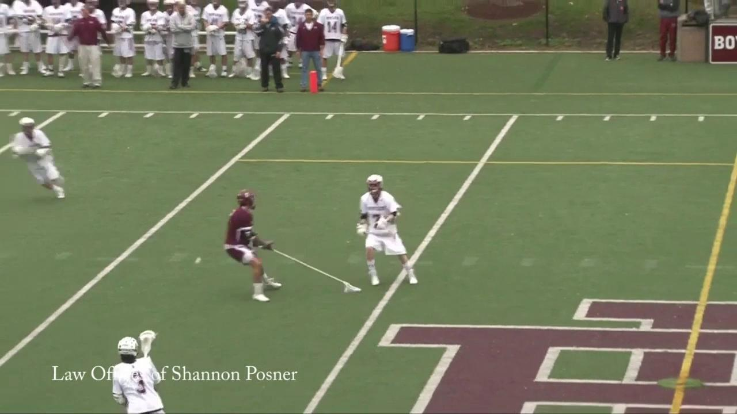
Illegal Body Check

Slide 11
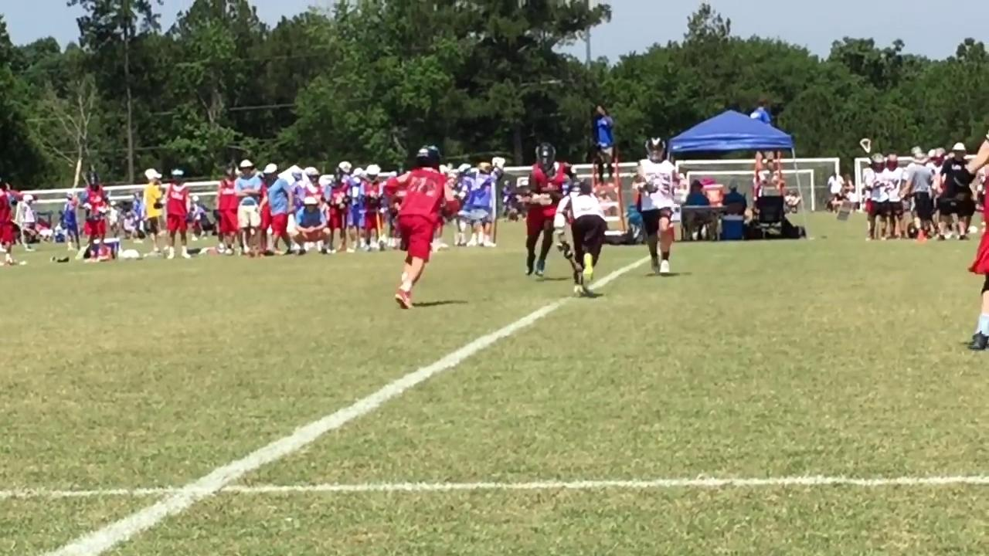
Illegal Body Check

Slide 12
Illegal Cross - 2 minutes locked
Deep Pocket
Pinched Head
Doesn’t meet measurements requirements
“4 inch” shooting strings
Butt end and long strings can be fixed

Slide 13
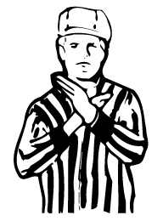
Slashing
Swinging a crosse at an opponent’s cross
or body with deliberate viciousness or
reckless abandon
Striking an opponent’s body

Slide 14
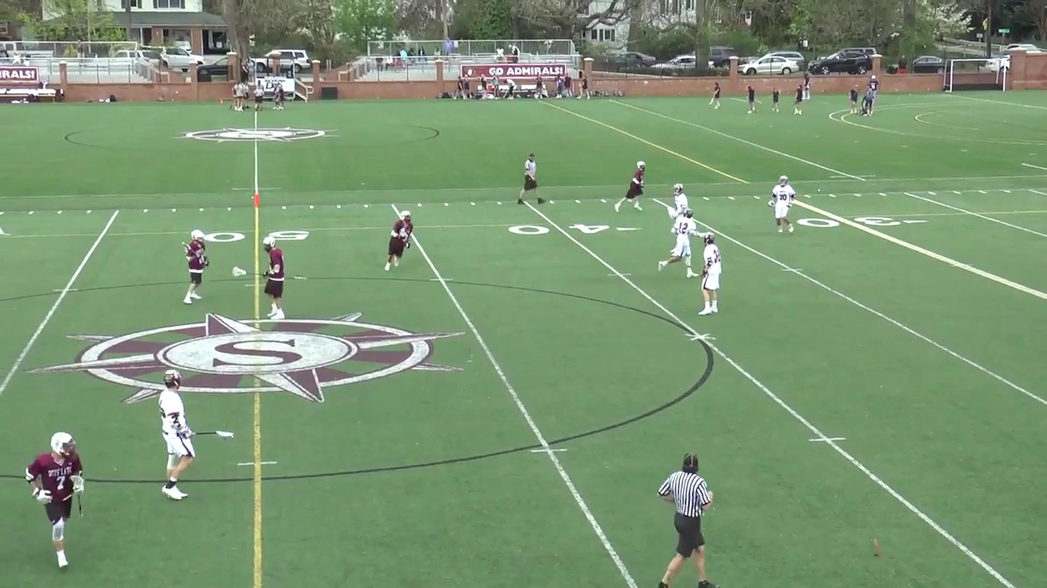
Slash: 1-3 minutes

Slide 15
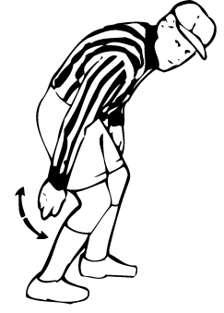
Tripping: 1-3 minutes

Slide 16
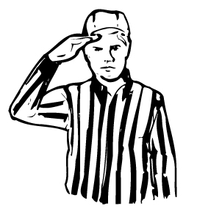
Unnecessary Roughness
Excessively violent push or hold
Deliberately running through screen
Avoidable contact that is deliberate and excessively violent
Check with gloved hand that’s not a punch

Slide 17
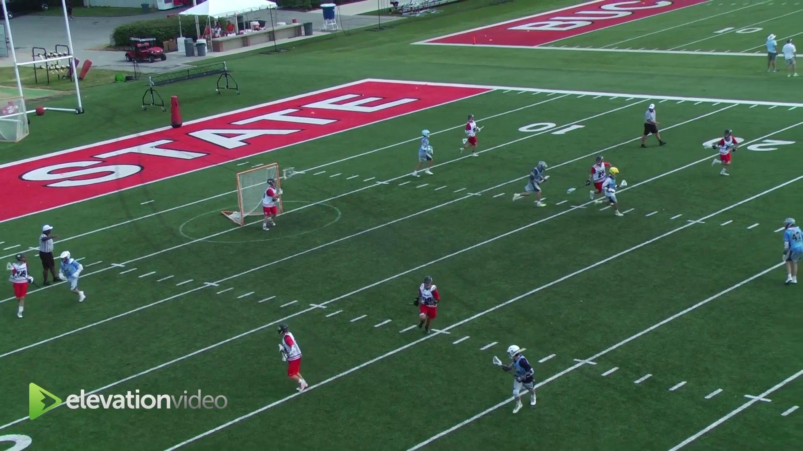
Unnecessary Roughness

Slide 18
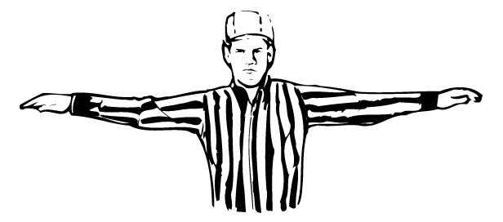
Unsportsmanlike Conduct
Enter in an argument w/ an official
Threatening, profane or obscene language
Deliberately uses fingers on faceoff
All are 1-3 minute locked in fouls
Repeatedly commits same tech. foul
Failure to return to field
Deliberately failing to comply w/sub rules

Slide 19
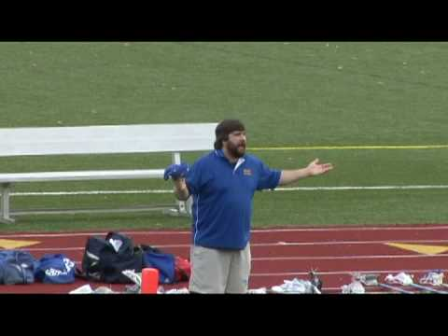
Unsportsmanlike Conduct

Slide 20
Ejection
Fighting - striking or attempting to strike opponent
Leaving Bench During fight
Flagrant Misconduct
Second non-releasable unsportsmanlike

Slide 21
Technical Fouls
Play-On, Flag Down or Immediate Whistle and Turnover
Crease/GK Interference
Holding
Illegal Offensive Screen
Illegal Procedure
Conduct Foul
Interference
Offsides
Pushing
Stalling
Warding
Withholding

Slide 22
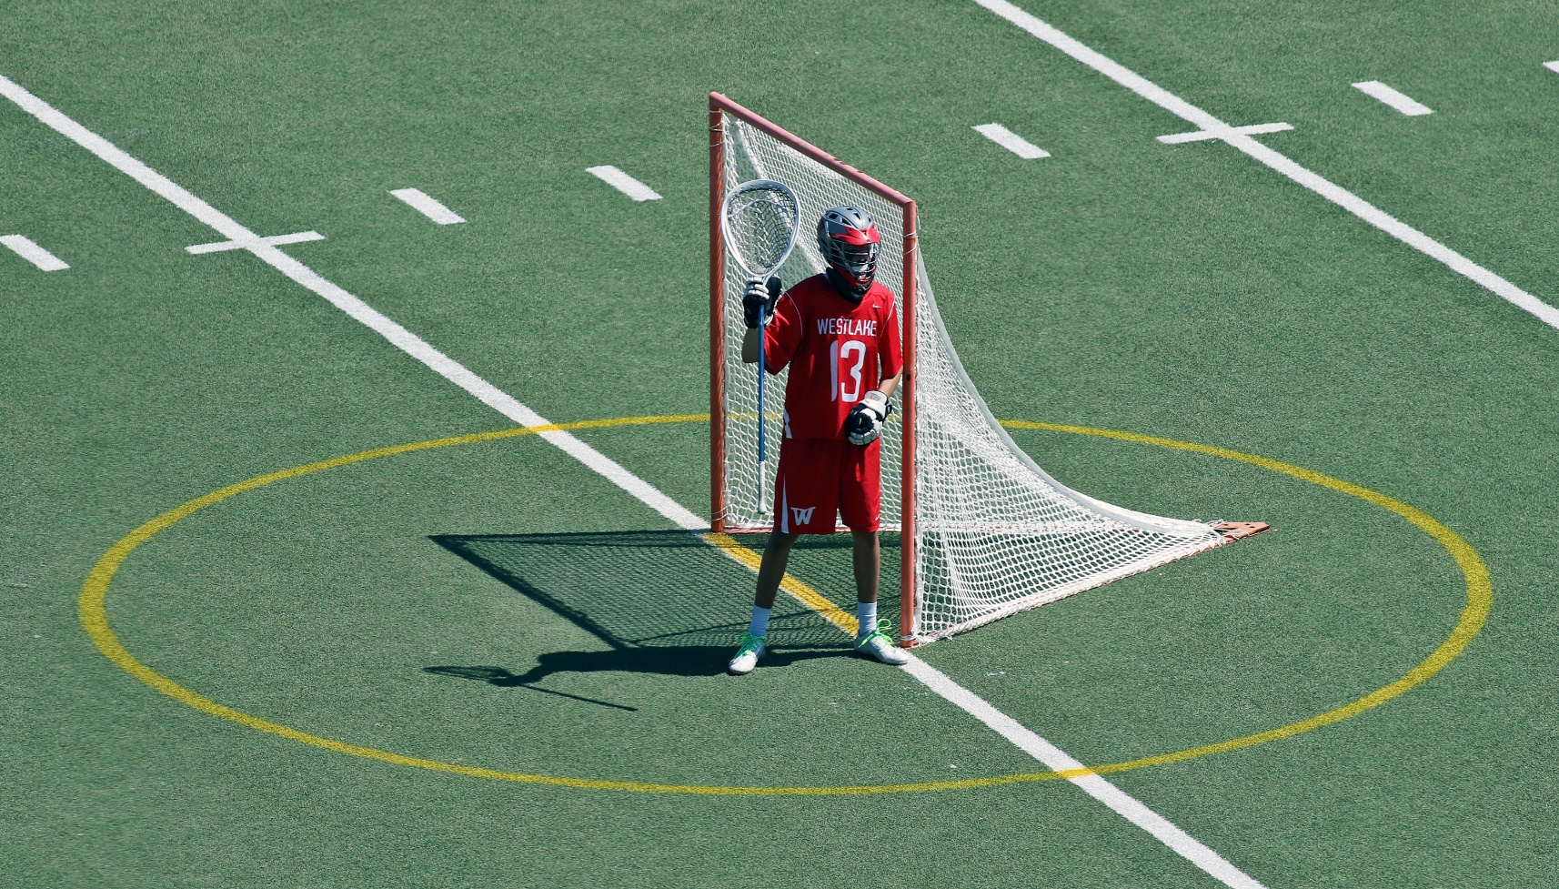
Crease/Goalkeeper Interference

Slide 23
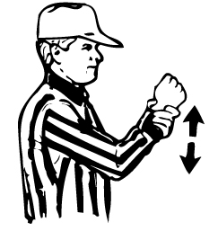
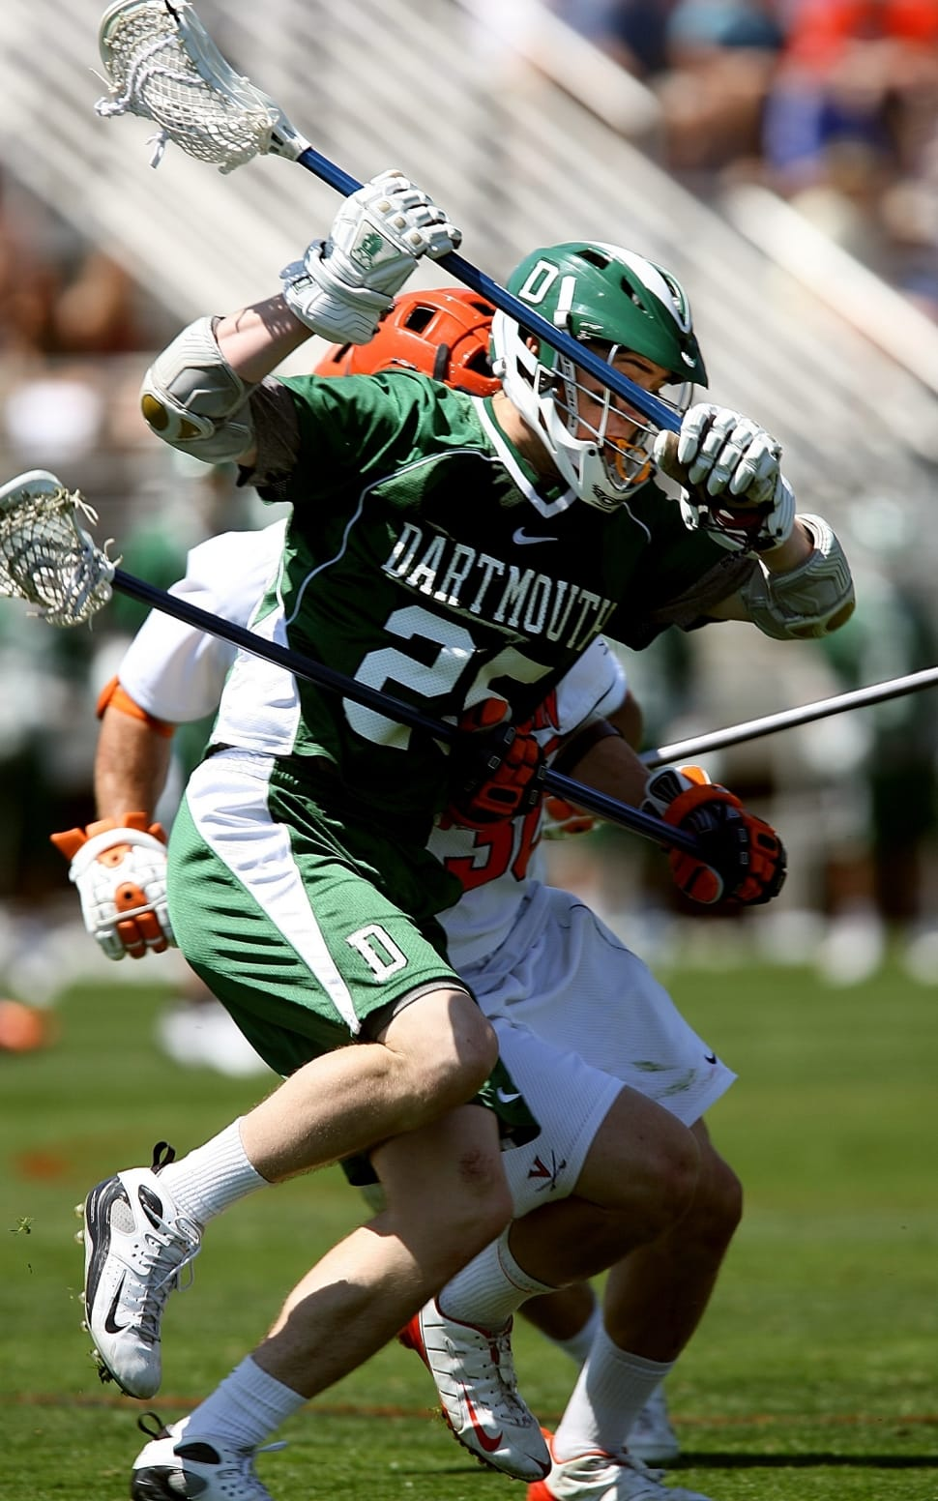
Holding
Player can not restrict the movement
of an opponent or his cross.
Ok to hold cross within 5 yards of loose ball or in possession

Slide 24
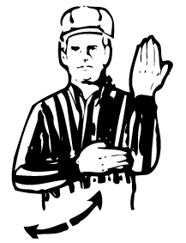
Illegal Offensive Screen
“Moving Pick”
Must be stationary
Feet no wider than shoulder width apart
Stick Inside frame of body

Slide 25
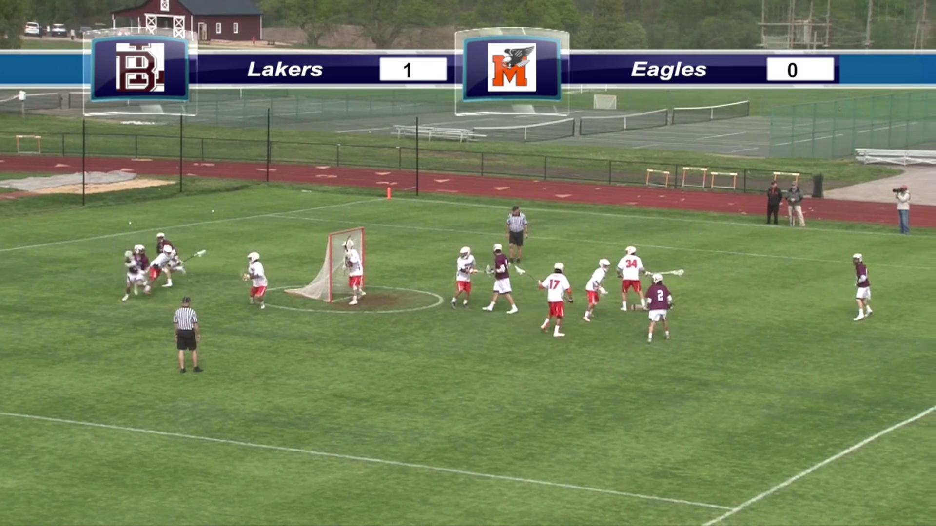
Illegal Offensive Screen

Slide 26
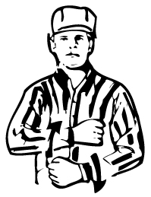
Illegal Procedure
Over 30 of these!
Typically small infractions, if you see something that doesn’t look right and not sure what to call it most likely falls in this category.

Slide 27
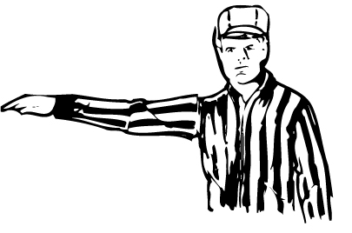
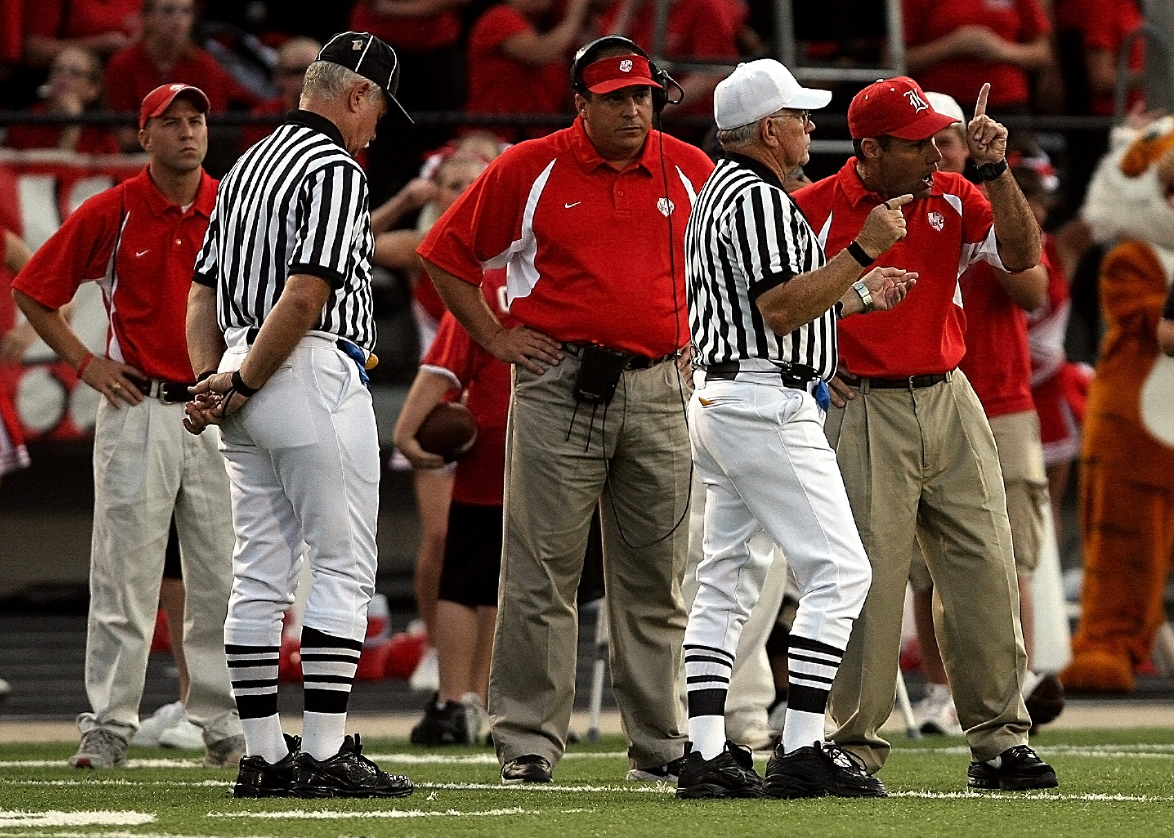
Conduct Foul
Used most as a less severe unsportsmanlike conduct.

Slide 28
Interference
Cannot interfere with the free movement
of an opponent unless player has
possession or ball is in flight or loose and players are within 5 yards of the ball.

Slide 29
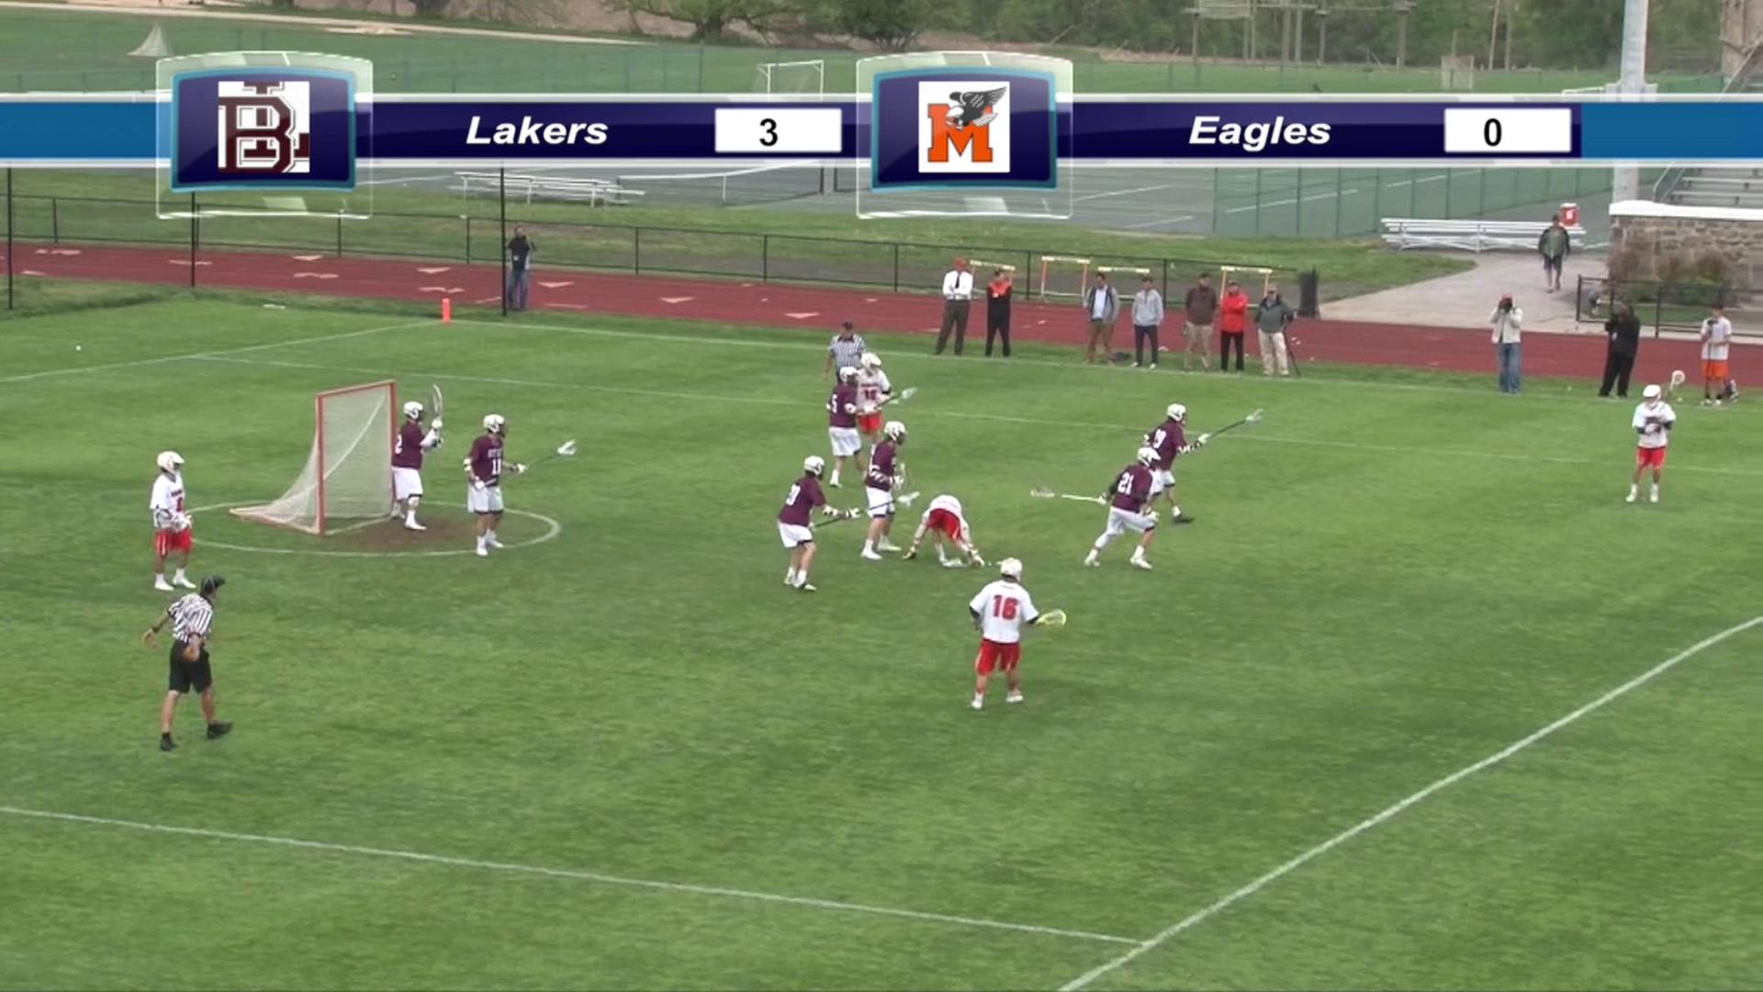
Interference

Slide 30
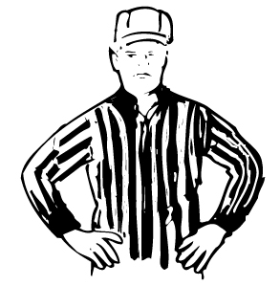
Offsides
More than 6 in offensive end
More than 7 in defensive end
*Includes players in the sub box or serving penalties
*Not a penalty to have too few players

Slide 31
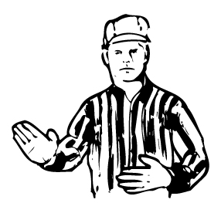
Pushing
Pushing, trusting or shoving a
an opponent from the rear.

Slide 32
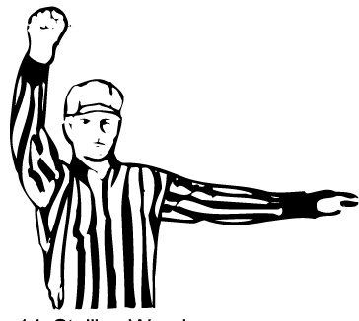
Stalling
Required to “Get it In” & “Keep it in”
Mandatory in winning team (4 goal or less margin) during the last 2 minutes of game.
Officials can also put stall on when the offensive team is not “creating” offense.

Slide 33
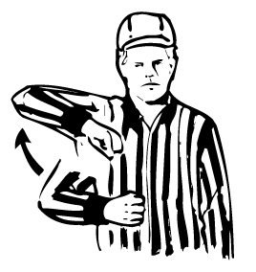
Warding
Using free hand or body part create
space.

Slide 34
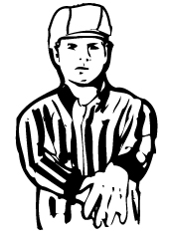
Withholding
Trapping the ball longer than is necessary
to control the ball or lying on the ball
Ball is struck in cross would be considered withholding

Slide 35
Penalty Enforcement
Personal Fouls
-Always a flag
-Can be 1-3 minutes
-Can be releasable
-Can be non-releasable
-Serves after goal scored
Technical Fouls
-Offense - Turnover
-Loose - Play-ON!
-Defense - Flag Down
-30 second releasable
-Goal scored slow whistle wipes out foul

Slide 36
Flag Down/Slow Whistle
When a penalty is recognized official shall yell “Flag Down” and throw their flag in the air.
If the ball is loose or foul is committed by offensive team when penalty occurs it is an immediate whistle.
If foul is committed against the team in possession then it shall be a slow whistle.

Slide 37
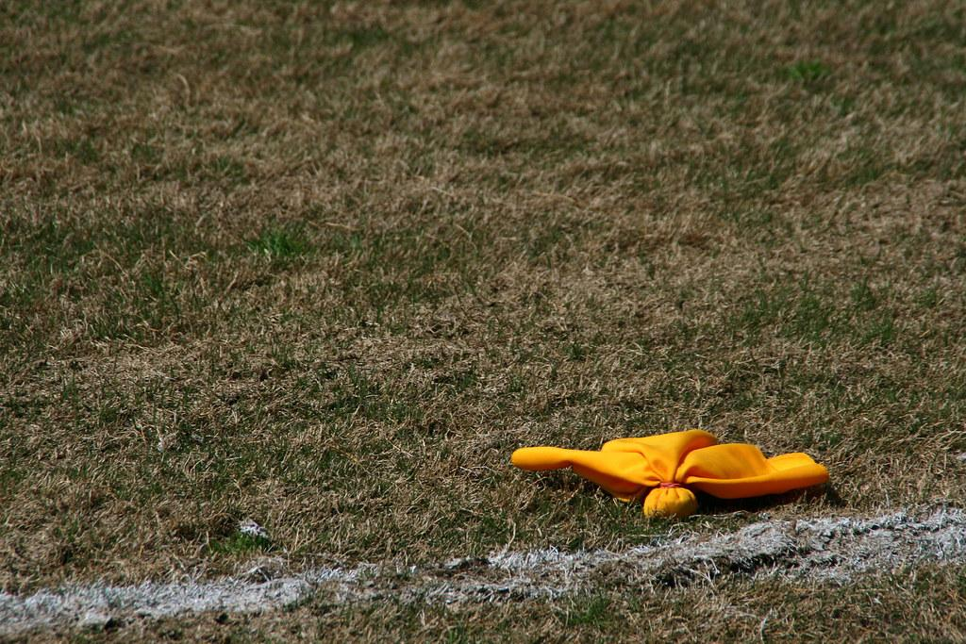
Slow Whistle: When to End
GOODIES
Goal
Out of Bounds
Offense Commits Penalty
Defense gains possession
Injury in Scrimmage Area
End of Period/Game
Second Defensive Foul*

Slide 38
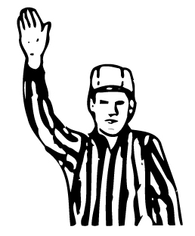
Play-ON!
Used during loose ball technical fouls
If team commit a technical foul while ball is loose the official yells Play-ON!
If offended team gets the ball play-on is over
If there is no advantage or team that commits the foul gets the ball, blow your whistle and award the ball

Slide 39
Restarts after Penalty
No Flag - restart at the approximate spot of where the ball was when the foul occurred.
Flag - Occurred in defensive end. Free clear at the midfield. Except Simultaneous
Flag - Occurred offensive half. Outside box
Offensive team can never restart in the box unless OOB.

Slide 40
Common Penalty Time
When two players of opposing teams commit time serving penalties from the time the flag is dropped until play resumes common penalty time is non-releasable.

Slide 41
Simultaneous Fouls
Fouls called on opposing teams during a live ball or dead ball and sequence can not be determined.
All Technical Fouls - no penalty time
Award the ball to team with lesser penalty time.
If time is equal award the ball to team in possession.
If no possession or equal time award by AP

Slide 42
Penalty Reporting C-NOTE
Blue
1
Offside
30-seconds
Color
Number
Offense
Time
Explanation
If needed

Slide 43
C
Color
Blue.
Number
Offense
Time
Explanation

Slide 44
C-N
Color
Number
Offense
One.
Time
Explanation

Slide 45
C-NO
Offside.
Color
Number
Offense
Time
Explanation

Slide 46
C-NOT
Color
Number
Offense
Time
Explanation
30-seconds.

Slide 47
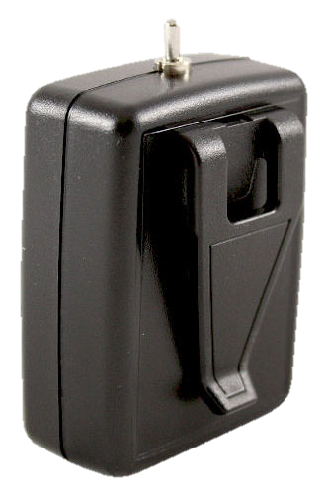
C-NOTE
Color
Number
Offense
Time
Explanation

Slide 48
How to Access US Lacrosse Test
https://www.emloa.org/app/download/7250346633/PP+2024+NFHS+test+via+USALacrosse.pptx
Use above link for directions to test or visit the EMLOA.org website, scroll to bottom of home page to access the same link.
Complete test with a minimum of 90%. You can take the exam multiple times and use your rule book!

Slide 49
Next Week
Mechanics/Positioning
Simultaneous & Other Situations
Game Management & Tips
Scrimmages & Start of the Season!

