Slide 1
Follow these slides to access the NFHS test—Yellow arrows

Slide 3
Be sure to select
2024

Slide 4
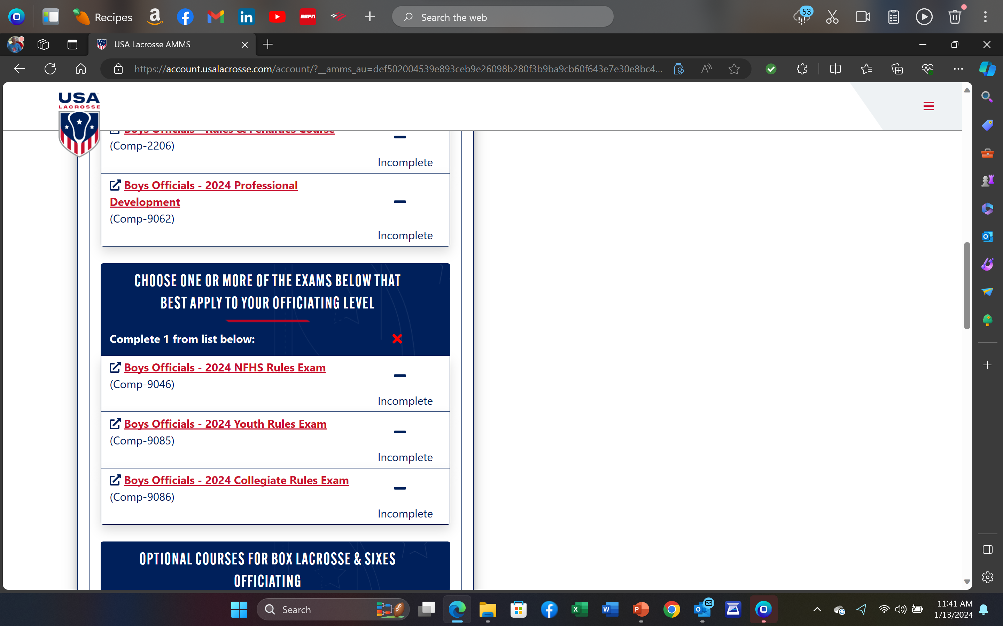
You Must scroll down to find 2024 NFHS Rules Exam

Slide 8
NFHS annual refresher exam
You must get a 90 or better to pass the test.
Once completed with a 90 or better, you will receive a certificate.
There is NO need to forward results. We review them via the USALacrosse portal.
You’ll get two additional chances to get correct answer after first selection.
Best to record your answers as you are taking the test in case you do not get a 90 which will make your second attempt easier.

