Slide 1
Regular Season Meeting
Week of 4/10-4/16

Slide 2
Questions & Unusual Situations
Rules Clarifications?
Unusual Season Trends?
Early Season Trends?
We are in the second full week of the season, make sure we are enforcing eye black, mouthpieces and helmets so we don’t have to do it all season.

Slide 3
6 Reasons that “Calls” have to be made
The Obvious “Big Hit”
The “Lopsided Game”
The “Rivalry Game”
The Call for “Consistency”
The “Playoff Game” call
The Level of Play (safety)

Slide 4
Early Season Trends - Fighting
There have been a number of fights and ejections to start the season including a bench clearing brawl.
On official - Observe, blow your whistle and be vocal.
Off official - Freeze benches then assist.
If you have an ejection: Fill out MIAA paperwork on site and call your assignor from the parking lot. Non-MIAA game call your assignor!
Use your tools that you have in preventative officiating.

Slide 5
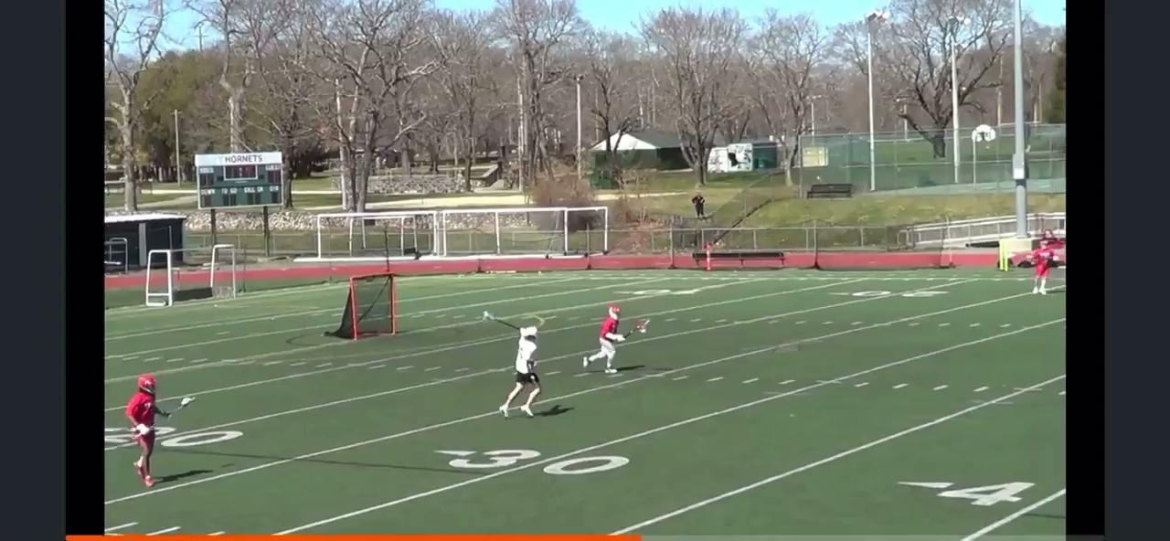
What is You Call?

Slide 6
Discussion
NFHS Rules - Hits to the head and defenseless players is a minimum 2 minutes non-releasable to 3 minutes non-releasable and ejection.
If that is a 2 minute foul for hit to the head, what does it take to get a 3 minute foul?

Slide 7
The Calls You Have to Make

Slide 8
The Obvious “Big Hit”
Everyone at the game saw the Hit, the officials have to make sure that they did also.
Helmet comes off!
Player down on the field, and not moving.
Coach jumping up and down!
Coach coming on the field yelling at the officials.
Parents come down on the field to see what happened to their child.
Notes:
Be sure to walk the coach up the ladder!
Conduct foul and take the ball away!
Conduct foul and apply a 30 second technical
Unsportsmanlike Conduct Penalty! 1 minute

Slide 9
2) The Lopsided Game
One team is clearly better than the other team.
Game is basically over in the first quarter.
Practice your game management skills.
50-50 calls go to the team that is losing.
Be aware of the team that feels they have nothing to lose.
Be aware of players playing out of position.
Try to encourage sportsmanship throughout the game!

Slide 10
3) The Rivalry game
How did this game go last year?
How are the teams doing this year?
Who are the coaches?
Do the schools have a grudge
Are the schools Prep vs Private?
Are the schools from neighboring towns?

Slide 11
4) The Call for “Consistency”
The one favorite call of every coach is “Consistency!”
If we call it at one end, we need to call it at the other end.
The players need to know that what we call early in the game should set the tone for the entire game.

Slide 12
5) The “Playoff Game” Call
The teams usually are pretty good to make it to the playoffs.
The officials should be able to let them play.
The quick penalty in the beginning of the year is probably not called now.
The players can demonstrate that they understand what is at stake.

Slide 13
6) The Level of Play (Safety)
Safety should always be the top priority for every game your officiate.
Know the rules for the level that you are working.
Use the tools that have been provided to you.
Maintain a calm composure.
Enlist the coaches to help if necessary.

Slide 14
How do we make the “Call”
Cover it in the pre-game.
Reinforce fair play during the game.
Meet with your partner between quarters, and during time- outs.
Talk with the coaches.
Hustle on the field.
Be in the proper position to “Make the Call”.
Study the rule book.
Communicate with your partner.
Have Fun!!

Slide 15
Trail in Transition - Best Practices
Give Reset signal, start timer & start goalie count.
Stay even with the ball or just behind.
Don’t have to sprint but you should jog up the field. Coaches look for hustle.
Watch the big picture.
Identify “middies” and count offsides.
Slow restarts near the box.

Slide 16
Trail in Transition
Don’t go looking for coaches but be available if needed.
Count again as you get into your trail position.
Keep moving until you get into position, final position should be about 5-7 yards above the box near the wing line.
Develop a routine or checklist as you come up the field.

Slide 17
Offsides & Over and Back Tips
Offsides
Always Count Forward.
Try to identify pairs.
Count Again when you come into settled play.
If something looks off - point at the guy you think might be offsides and recount to confirm.
Officiate play first, offsides is secondary.
Over & Back
Get to the midline.
Look to your partner for help.
Make clear deflection.
Watch for push/offsides.
Quick whistle on over and back.
Bring the ball back on restart.

Slide 18
Up Next
Online Meeting Monday, 4/24 at 7:00PM
Next in person meetings week of 5/8-5/11

