Slide 1
Regular Season Meeting
Week of 3/20-3/23

Slide 2
NFHS Rule Changes
Rule 1-2-1: The End lines and sidelines shall have continuous lines. Failure to do so will result in illegal procedure.
Rule 1-2-7: Substitution Box will now be 5 yards long on each side from the midfield line
Rule 1-7-1: Illegal stringing techniques. No gaps larger than a golf ball.

Slide 3
NFHS Rule Changes
Rule 1-8: Sticks with protrusions or sharp edges are illegal. “Gait D”
4-3-1: When a team has 3 players in the penalty box and the other team commits a faceoff violation the ball will be awarded to team in defensive side of field.

Slide 4
NFHS Rule Changes
4-24-1: When a goalkeeper is outside the crease and loses required equipment he is treated like a field player
7-2H: During running time and a goal is scored the if the player has time remaining on is penalty they may not release until the faceoff has ended.

Slide 5
NFHS Points of Emphasis
Sportsmanship
Player Safety - Helmets worn correctly
Eyeshade - 1 inch stripe
Faceoffs - Playing the ball
Running Clock Penalty

Slide 6
Pregame Certification
Every game at every level we should be certifying coaches that players are properly equipped.
Remind them about helmets worn properly, mouthpieces and eye black.
Do it right to start the season so it is not an issue all season long.

Slide 7
Mechanics Refresh
Faceoffs
Faceoff Officials Wing Official
-Conduct Faceoff -Watch wings
-Ensure players are lined -The rest of the field
up correctly -Watch the big picture
-Perform quickly and -Be prepared to help
efficiently the faceoff official

Slide 8
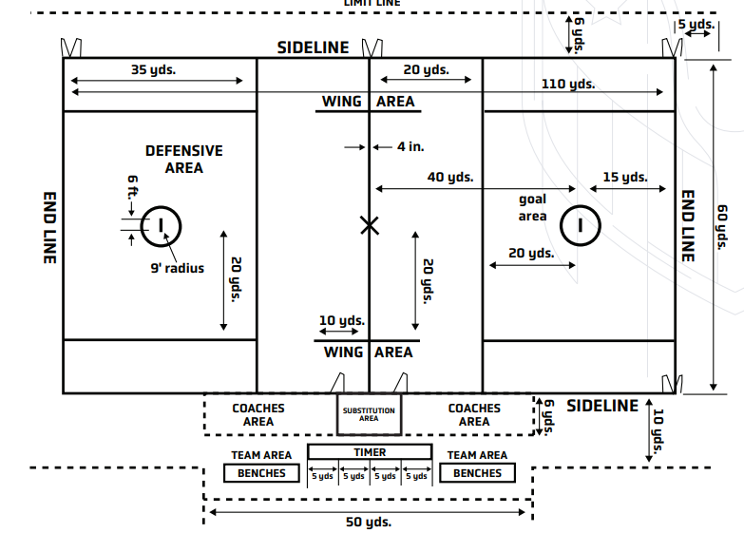

Slide 9
Mechanics Refresh
Settled Situations
Lead Trail
-Positioned at GLE and in -5 to 7 yards above top
as close a play dictates of box near wing line
-Goal -Shooter
-Crease -Off Ball
-Over and back
No one should be a statute.

Slide 10
Mechanics Refresh - Transition
New Lead New Trail
-One zone ahead of ball -Even with ball or just -10 second count behind
-Goal responsibility -20 Sec. & Goalie count
-Offsides
Communicate restarts, most restarts will be the trail.

Slide 11
Mechanics Refresh- Penalty Relay
-Report Primary Signal to Partner
-Trail in most cases then gets reports the foul to the table. Don’t report the foul from 50 yards away
-Lead gets the field set-up and ready for play
-Communicate to you partners and the field.
-Process should be effeciently

Slide 12
Mechanics Refresh - After Goals
Signal Goal
Officiate any crossovers and deadball
Meet other official at the top of the box.
Stop throwing the ball or walking right to center X

Slide 13
Beginning of the Season Tips
Set the tone for the season. Call the fouls, enforce mouth pieces, do face offs right
Don’t screw your fellow officials in the next game by not doing it right in your game
Arrive on-site 20-30 minutes early and be on the field at least 15 minutes prior to game
Be flexible – It is likely not the coaches fault that the bus was late

Slide 14
Beginning of the Season Tips
Conduct coaches meetings at the youth level and understand the rule differences for different age groups and leagues
You only get one chance to make a first impression, so make sure your first impression is a good one.
Enjoy it – we are not getting rich doing this but we are compensated well for our time.

Slide 15
Newer Officials
Shortage of officials nationwide across all sports we all need to work to retain officials
Newer Officials – Use your mentor, find a Vet, be responsive to feedback, ASK QUESTIONS
Veteran Officials – Take the time and help out the new officials. Do it right way so they can learn.

Slide 16
Youth Leagues
Understand what League you are working – MYK, MYL-Select, TPL, CTL…
Contact towns to confirm
Understand payment procedures
Fill Out game report

Slide 17
How to access USA Lacrosse Test
Log On to your USA Lacrosse Account
Additional Directions on EMLOA Website
Complete test with a minimum of 90%. You can take the exam multiple times and use your rule book!

Slide 18
Meeting Schedule
WO March 20-24 Regular meeting #1
WO April 3-6 Newbie mtg.(members 1-5 years)
WO April 10-13 Regular meeting #2
April 25 Time TBA Go To Meeting Meeting #3
WO May 8-11 Regular meeting #4
WO June 5-8 Regional meeting and social

Slide 19
Q&A

