Slide 1
EMLOA 2023
Arbiter Training
March 19, 2023
How To’s & Do’s and Don’ts
Doug Davenport & Darrell Benson

Slide 2
Agenda
Welcome to Arbiter Training, 101
Initial setup
Picture uploads
Availability & Blocks
Travel limits & Leave city
Notifications & Messaging check
Printing your schedule
Game & Crew info.
Arbiter Pay
Q&A

Slide 3
EMLOA 2023 - Arbiter Training
Initial Setup

Slide 4
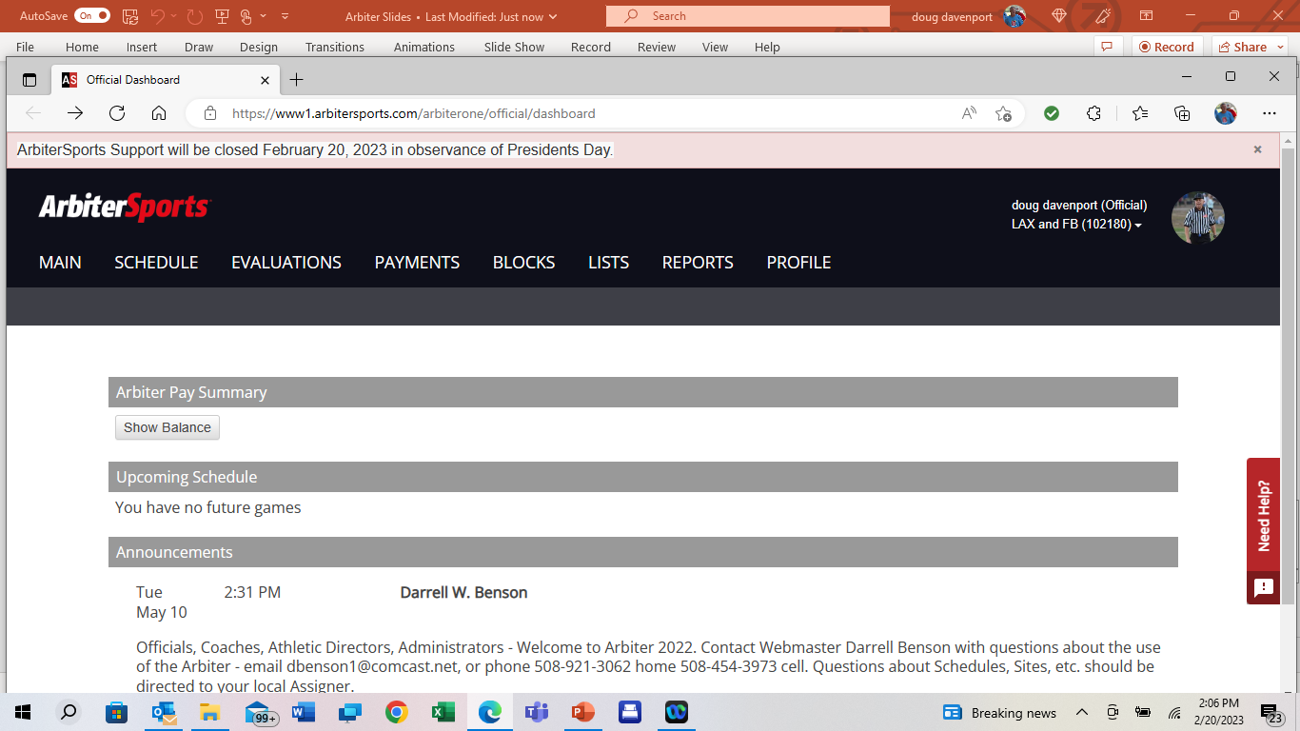
Opening page Step 1

Slide 5
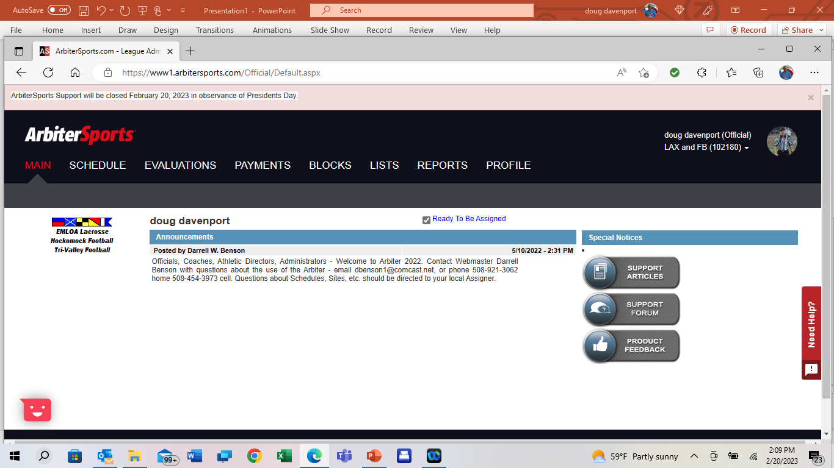
Step 2 Check Box Ready to be Assigned

Slide 6

Next Profile

Slide 7
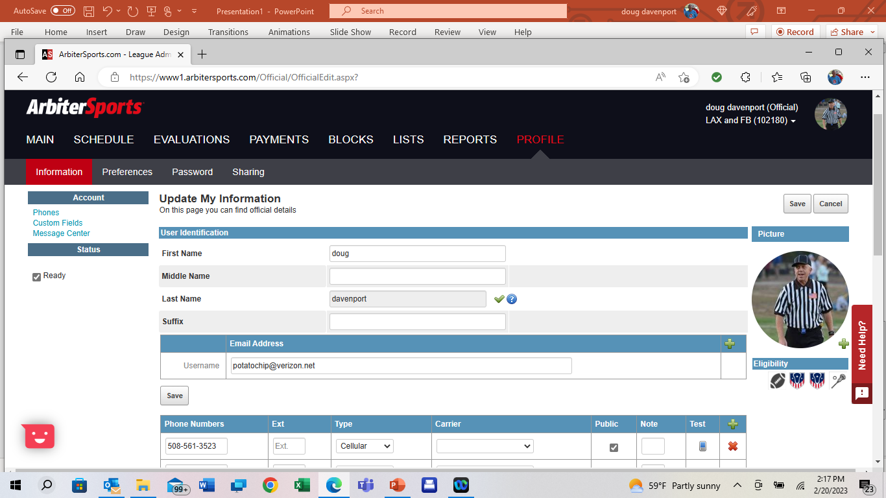
Profile first step phones

Slide 8
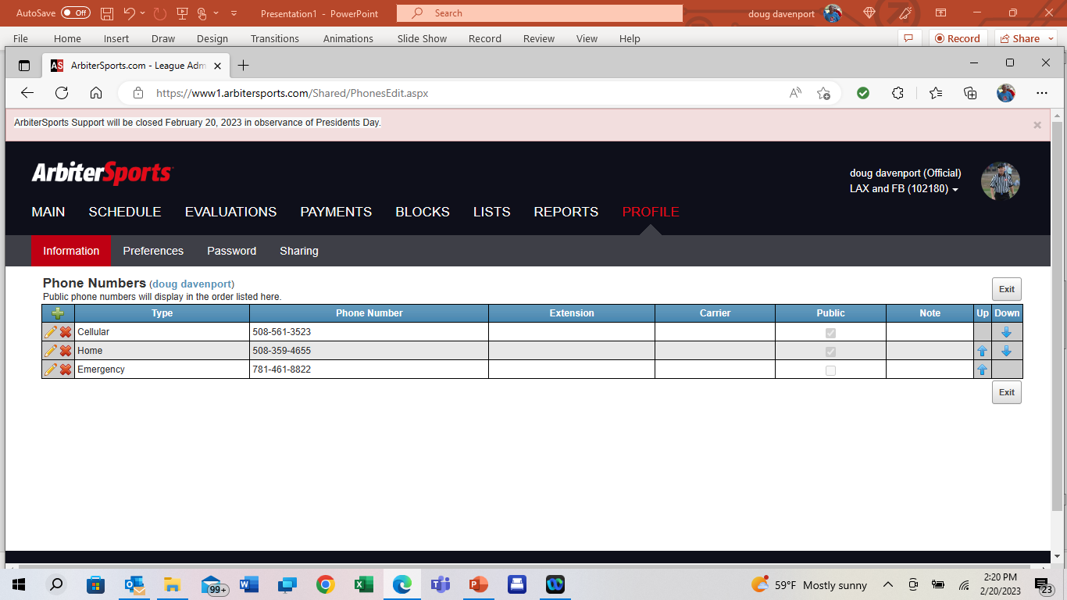
Phone Minimum of 3, cell, land line, emergency
You can list more, use the plus sign to add
Cellular should be listed first, order adjusted by using the up/down arrows
Check box for numbers to be public for all with access to Arbiter to see
Exit when completed

Slide 9
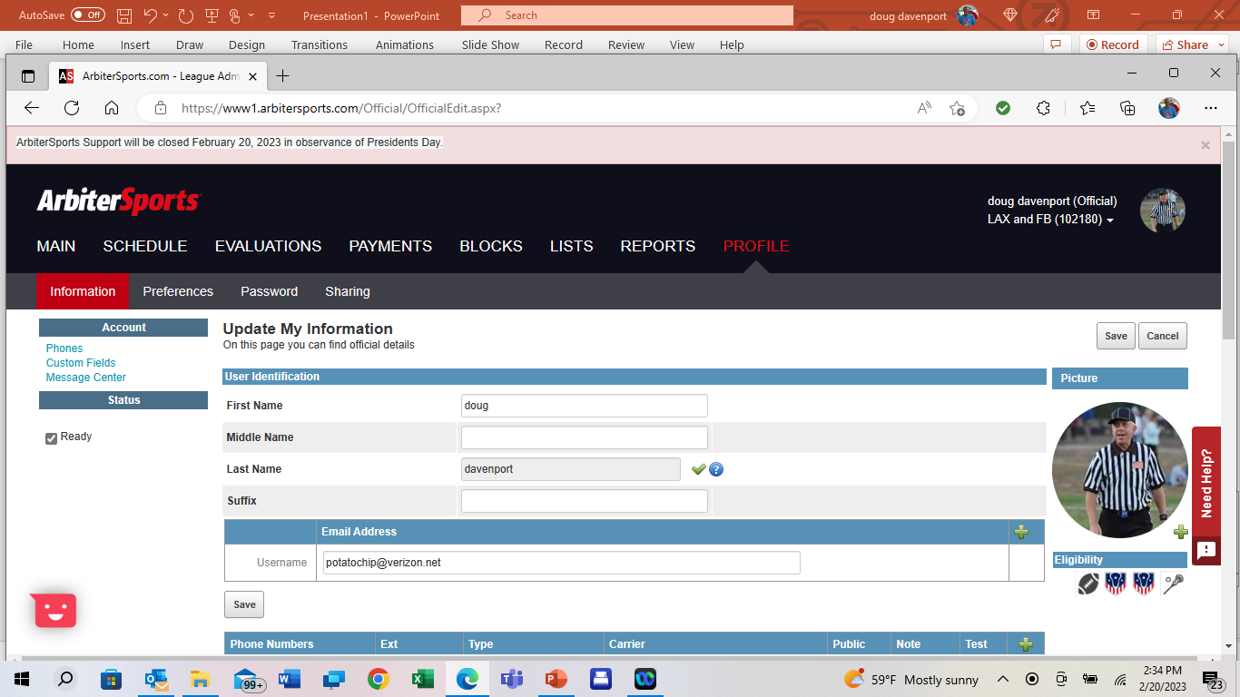
Complete personal info, name, address,email & save

Slide 10
Next Custom Fields

Slide 11
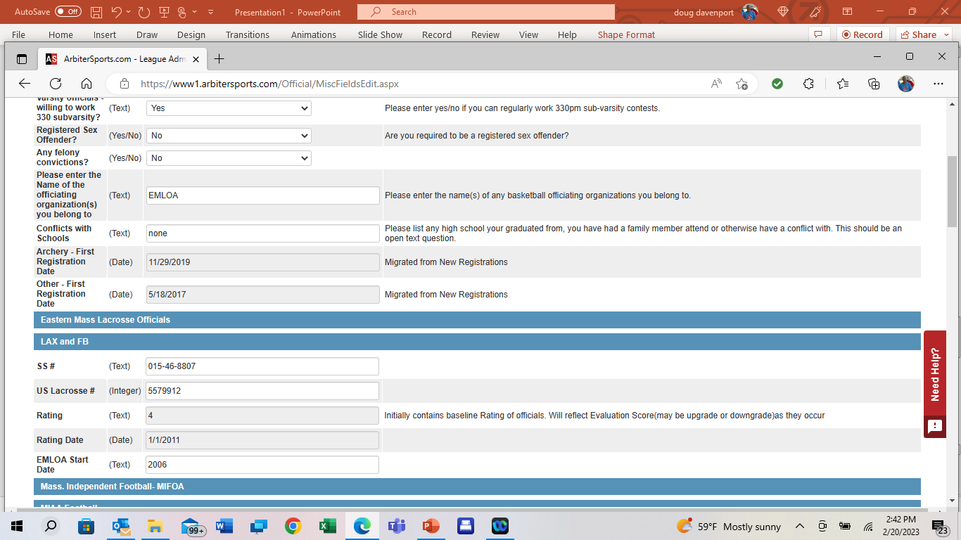
Only item that
needs to be
completed on this
page is your social
security number.
Note: only visible to
school administrators
which will expedite
your payments
Be sure to click save,
bottom right corner
before exiting this
page

Slide 12
EMLOA 2023 - Arbiter Training
Profile Picture Upload

Slide 13
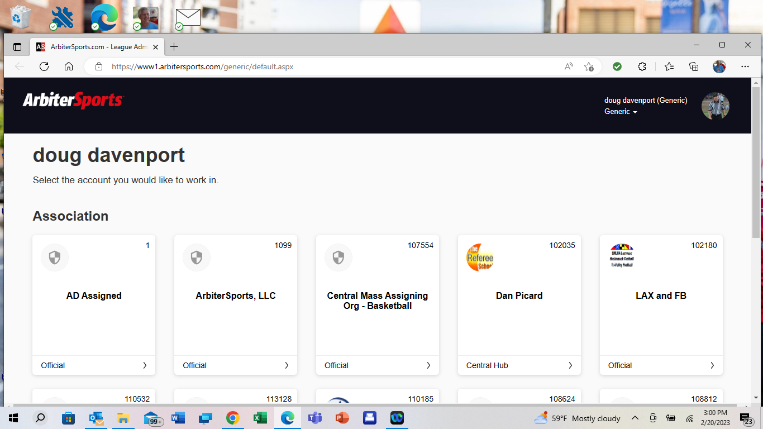

Opening page

Slide 14
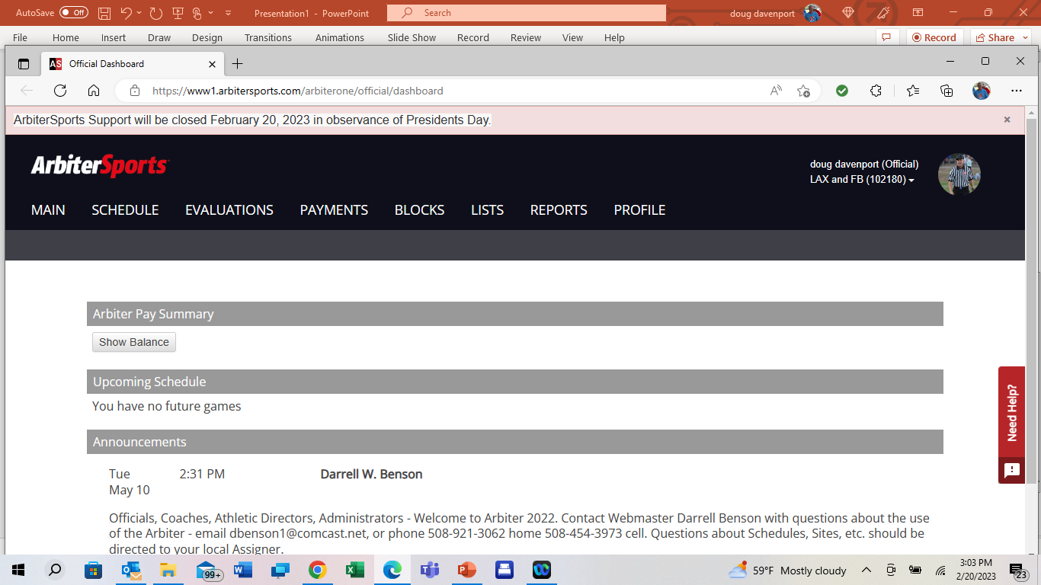
Next Profile

Slide 15

To Upload Head Shot Picture click on plus sign

Slide 16
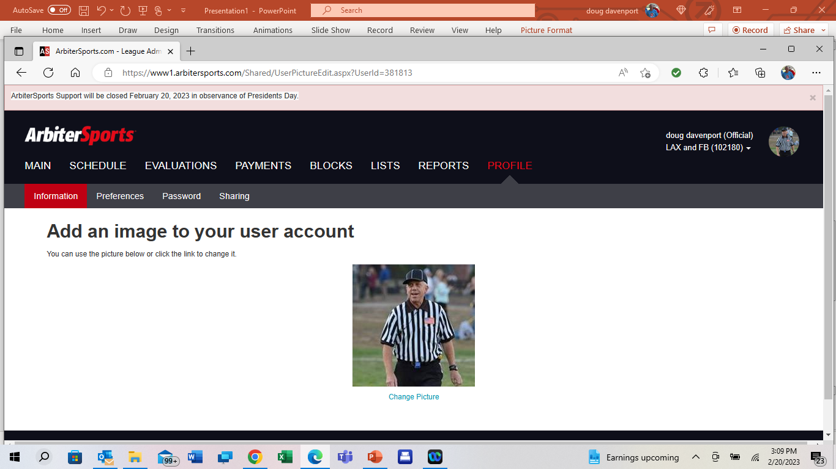
Follow instructions listed on
Arbiter page for upload.
Be patient here, and if need be, reach
out to Arbiter Help Desk
Best to have your picture loaded on
computer before starting here, cropped
to size similar to this example
Very important to complete this task.
It helps assigners, coaches athletic directors
and your fellow officials.

Slide 17
EMLOA 2023 - Arbiter Training
Your availability & Blocks

Slide 18
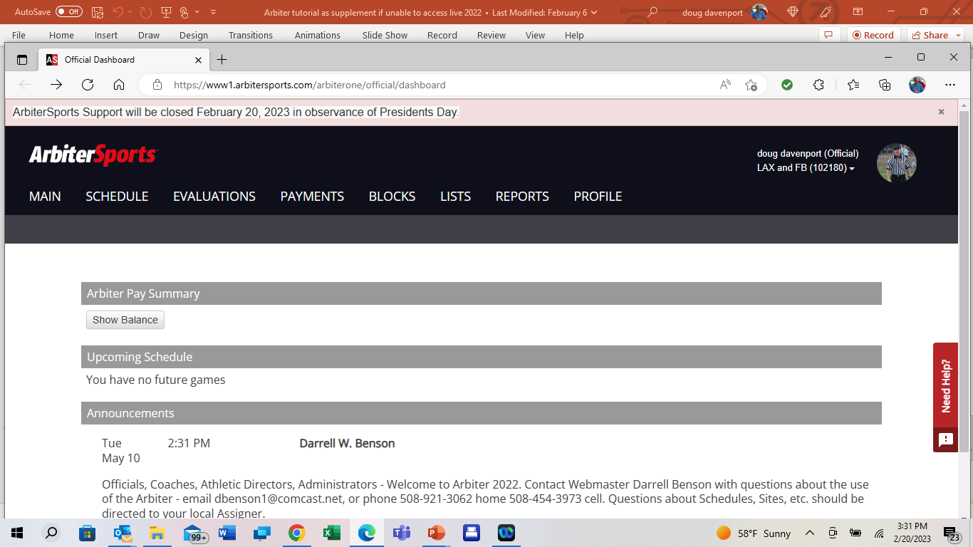
Blocks All Day Part Day

Slide 19
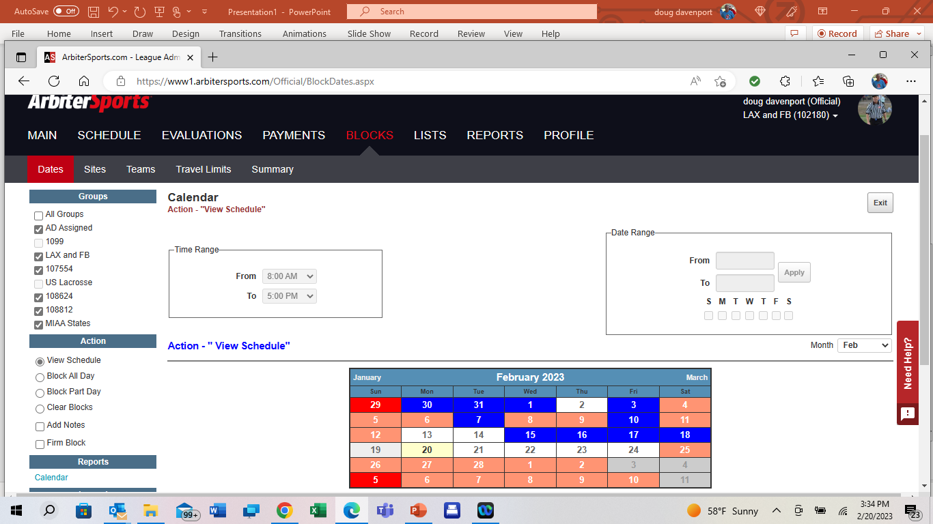
Start by selecting the groups you wish to see your availability

Slide 20
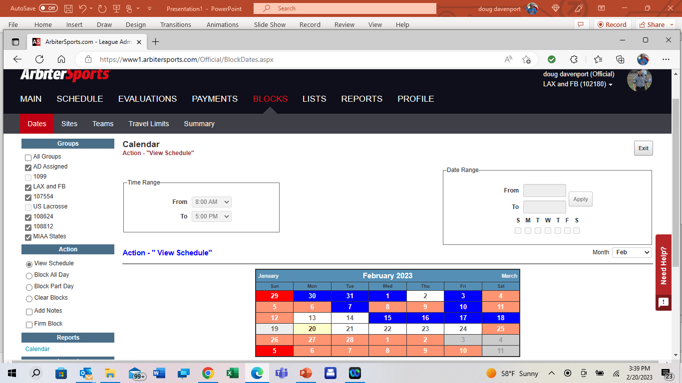
Multiple Options
If you need to block specific days (example all Sundays)
You will use the Date Range option. Once your selection is made, hit Apply
If you need to block each day until after 4:00, you would select the same type of date range, and then select the time range where you would be available
This function
best for multiple
days, or even
months or the
complete season

Slide 21
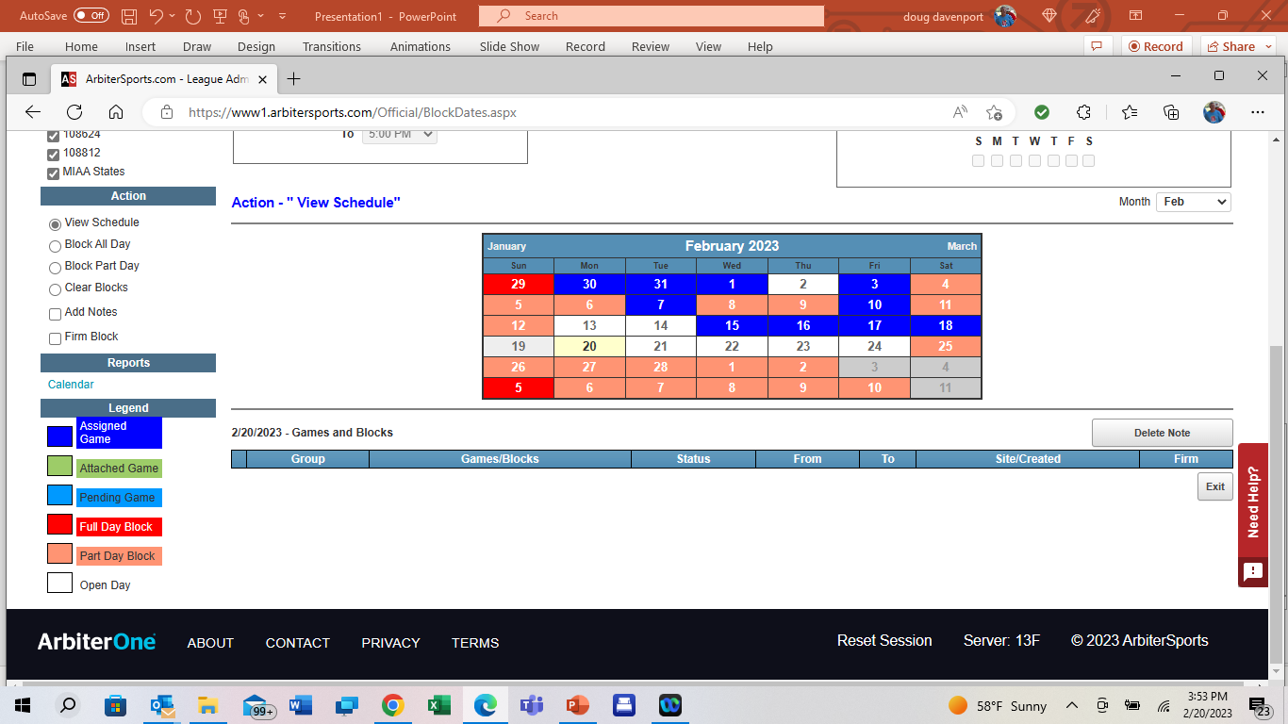
Single Day Blocks
All Day Block
Part Day block
will ask to complete
a time range.
This would be
the time you are
NOT available
Reminder
Blocks include all your
activities, not just your
officiating.
Work, family, parties,
weddings, doctor
appointments all need to
be blocked regarding your
availability.

Slide 22
EMLOA 2023 - Arbiter Training
Travel limits & Leave city

Slide 23
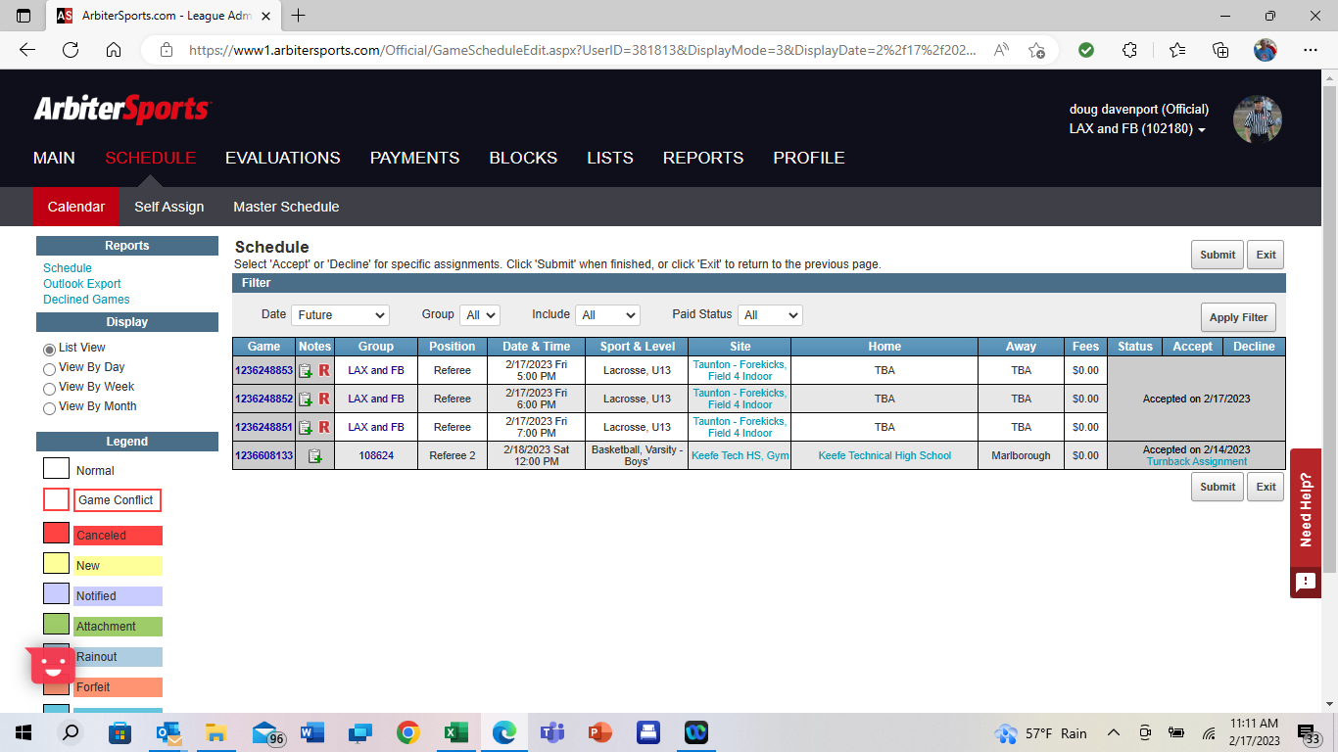
Step 1

Slide 24
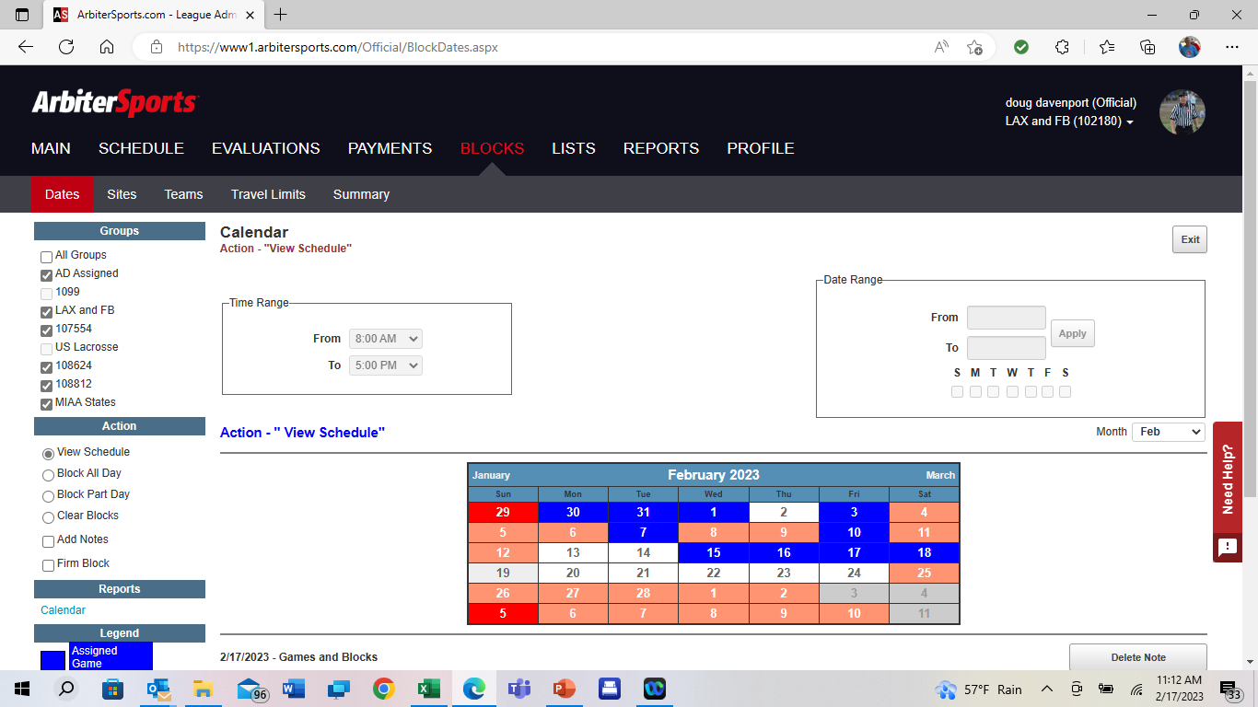

Step 2

Slide 25
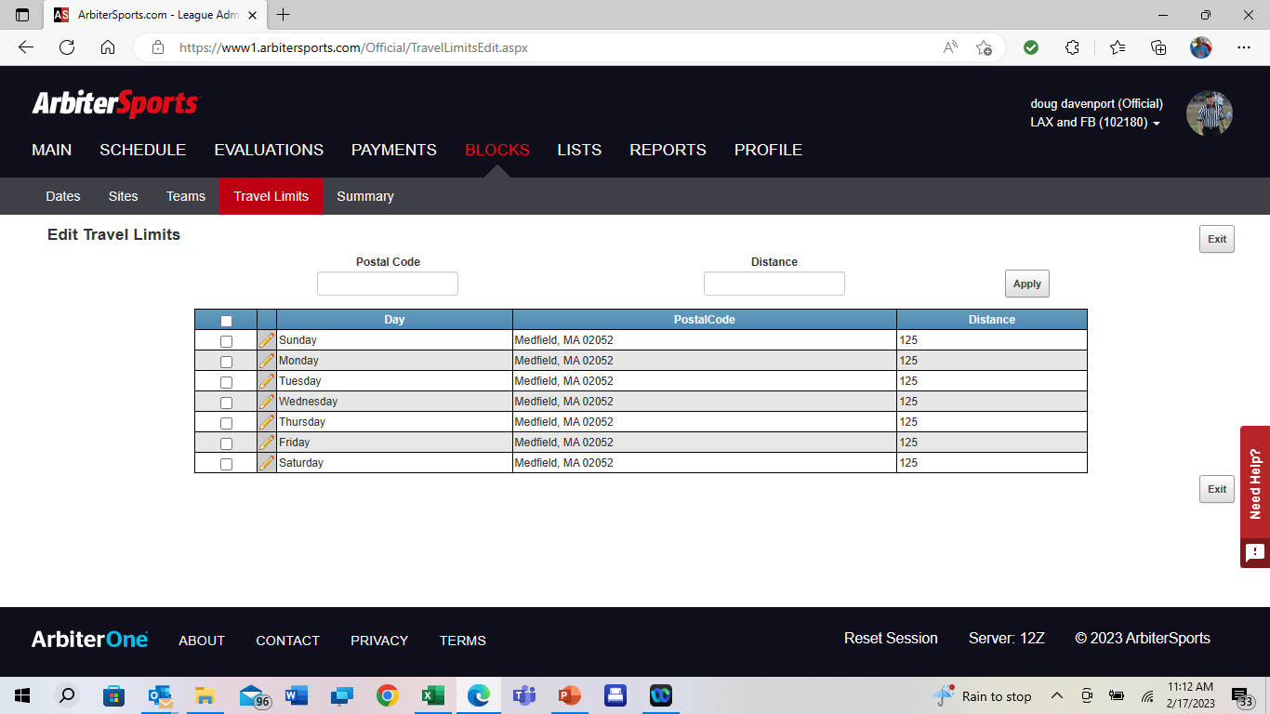


Step 3
Enter distance number
Enter zip code for leave city
Each day
Travel Limits, enter zip code for each day, check box, hit apply
Distance enter number of miles for limit, check box, hit apply

Slide 26
EMLOA 2023 - Arbiter Training
Notifications & Messaging check

Slide 27
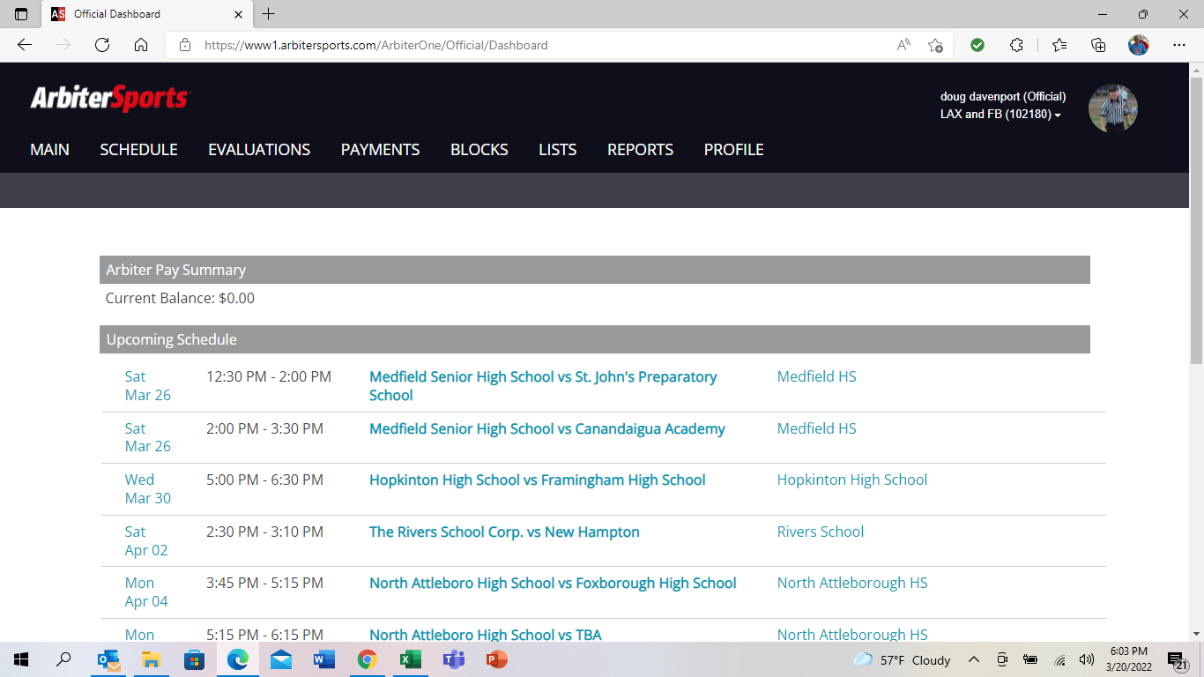

Slide 28
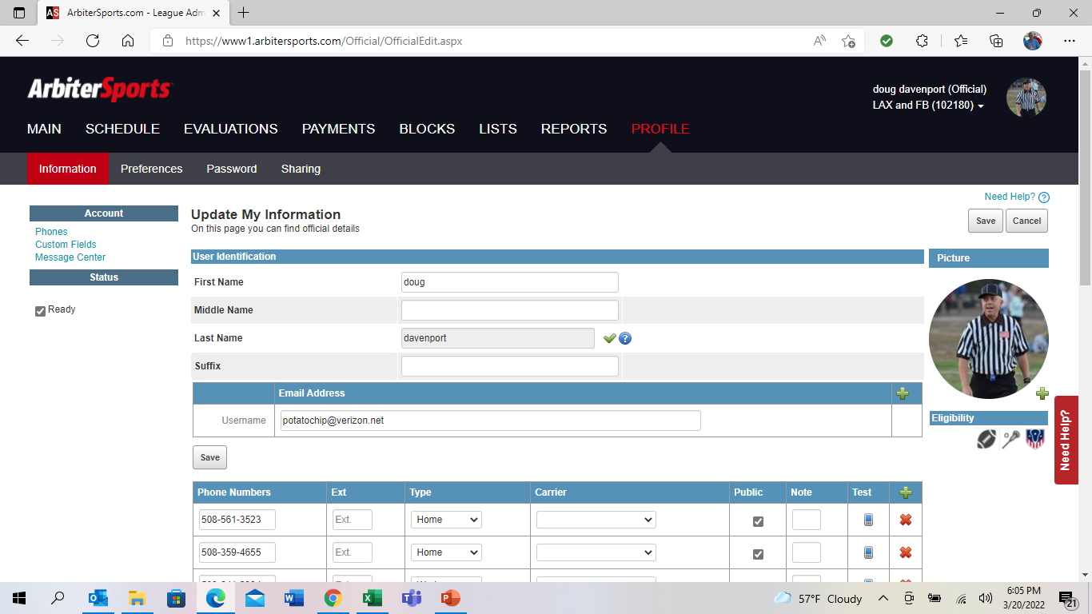

Slide 29
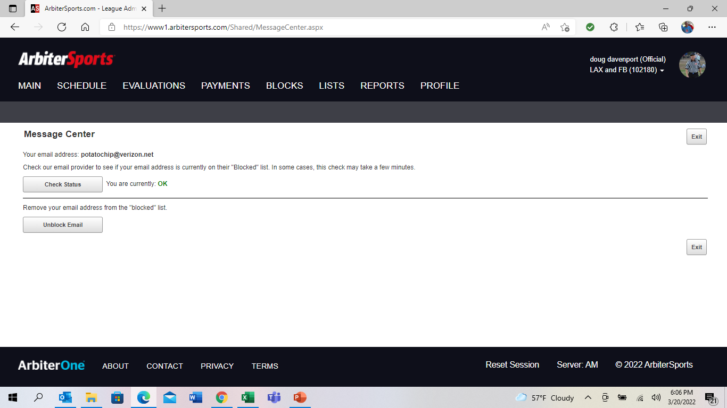

Slide 30
EMLOA 2023 - Arbiter Training
Printing your schedule

Slide 31
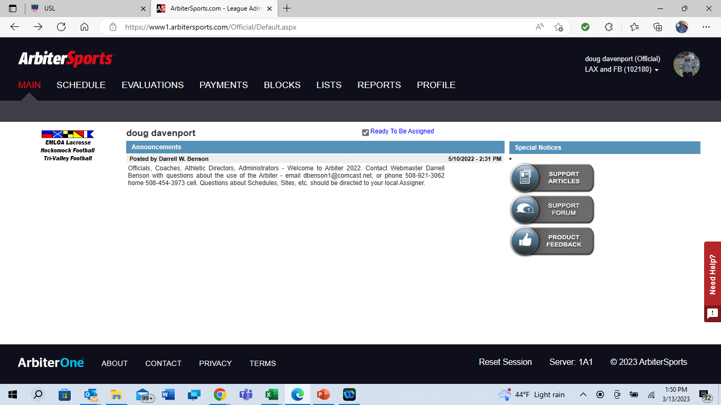

Slide 32
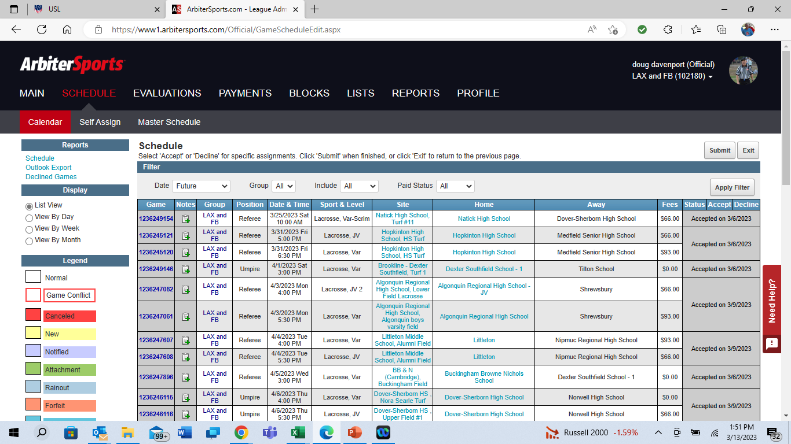

Slide 33
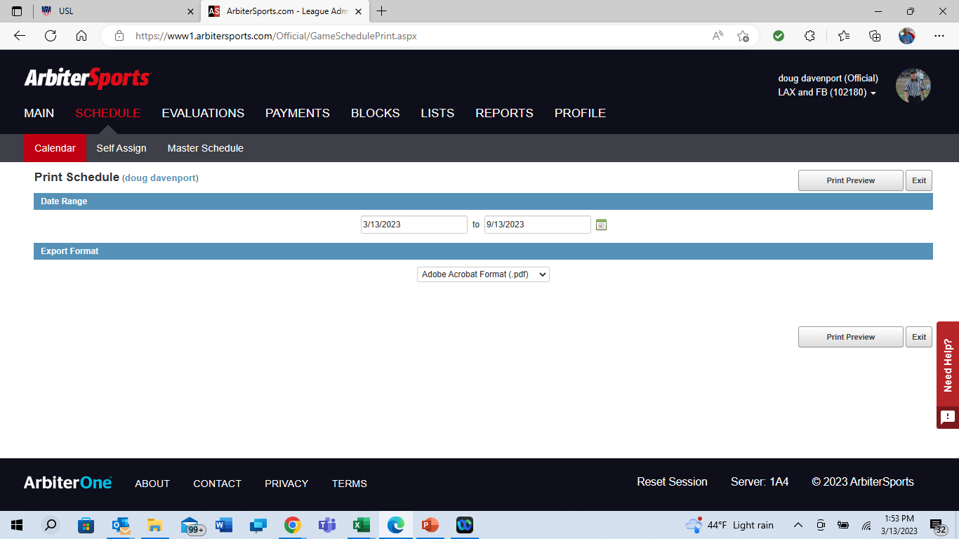

Check and adjust dates
Print format options
3 available

Slide 34
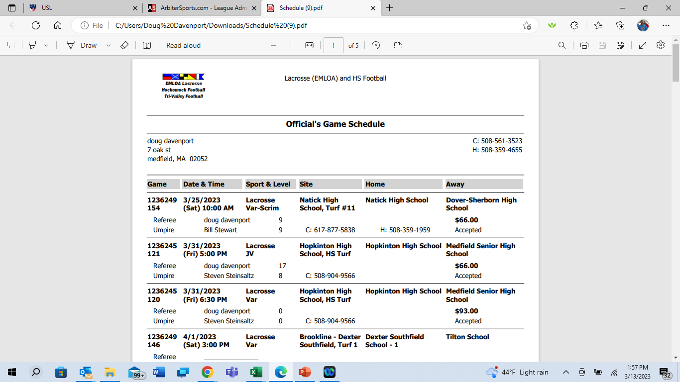
Ready to
Print

Slide 35
EMLOA 2023 - Arbiter Training
Game & Crew information

Slide 36
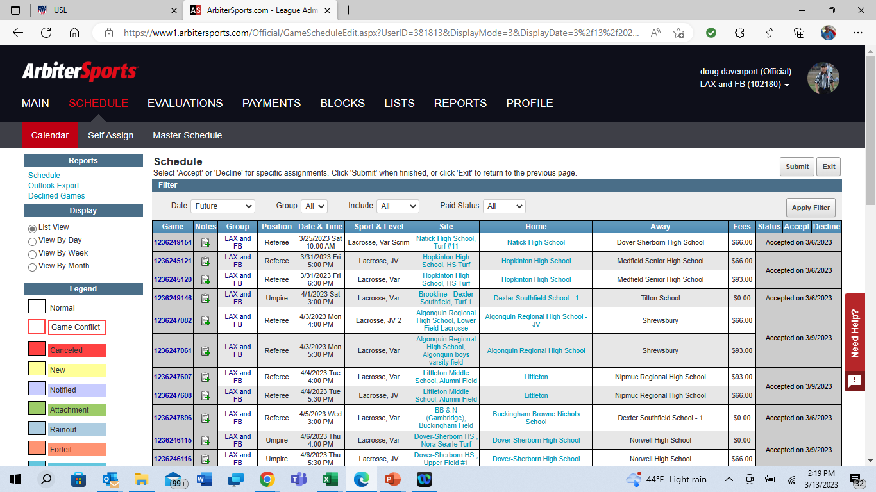

Slide 37
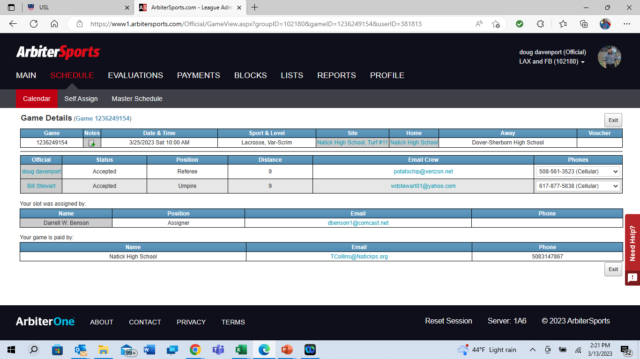
Partner contact information

Slide 38
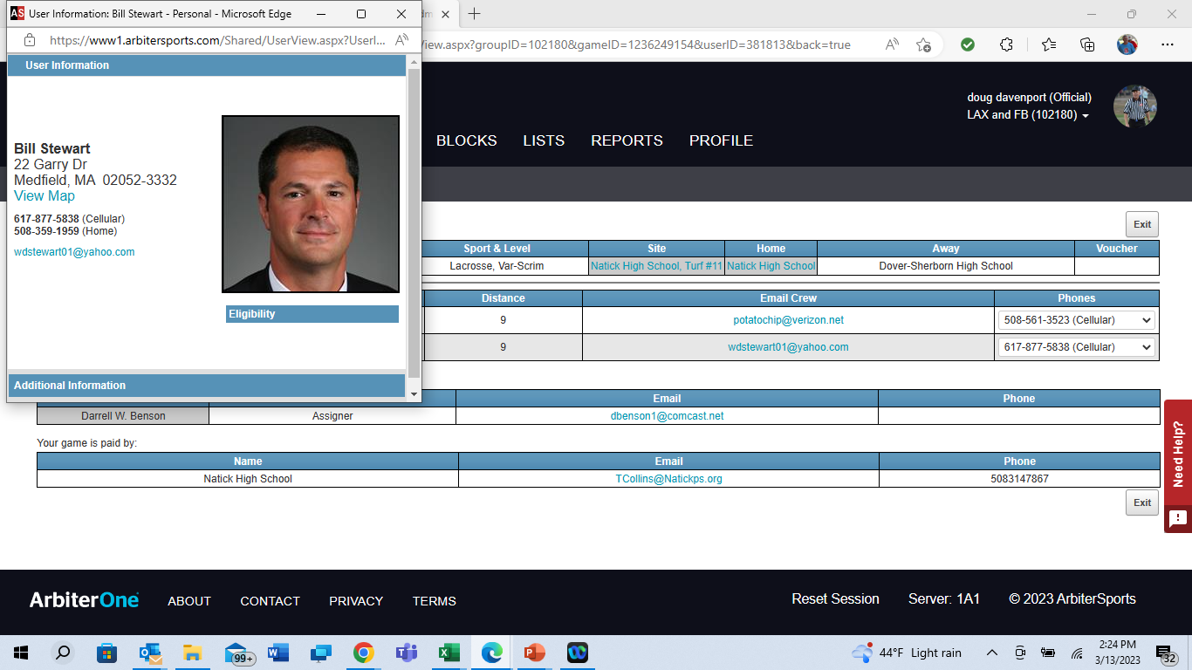

This is just one reason why we need pictures with your profile

Slide 39

Game site and Contact information

Slide 40
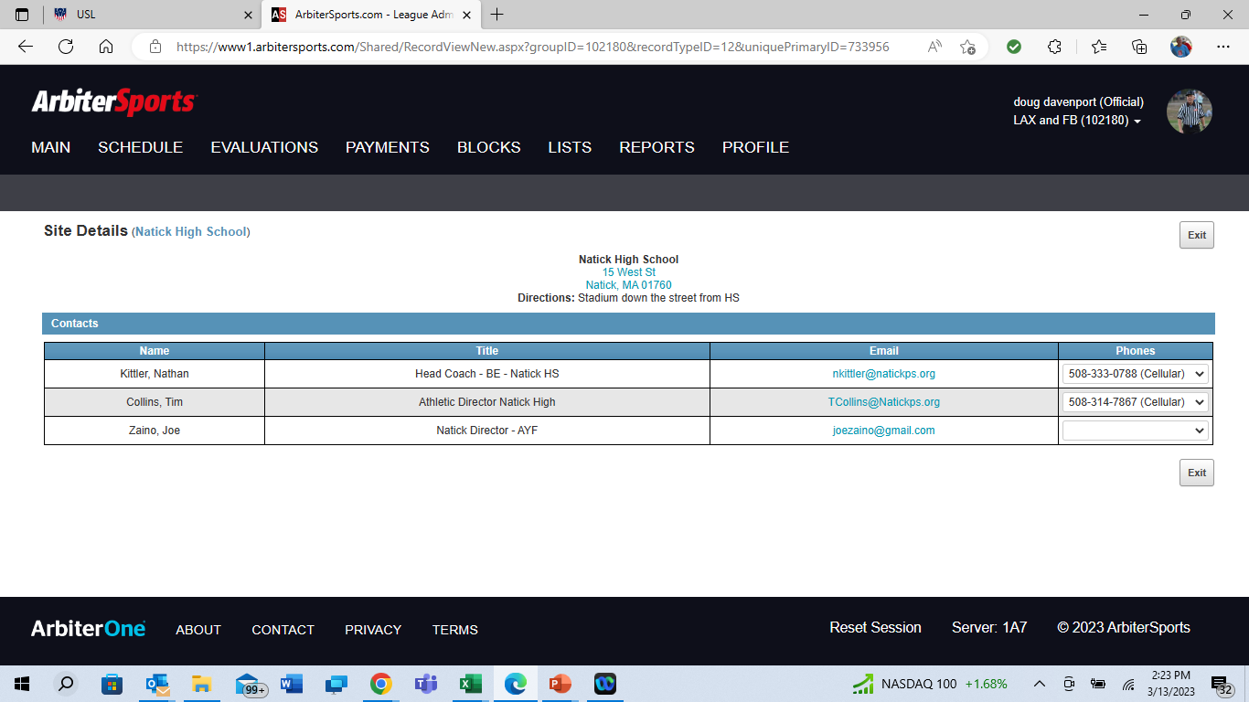
Contact information of the Athletic Director, Head Coach or site director
for confirming game the day before, or the day of if there is a question regarding
weather. Ref generally responsible for game confirmations the day before. If at last minute you
expect to be late, attempt to reach your partner first or home team personnel as a second option.

Slide 41
EMLOA 2023 - Arbiter Training
Arbiter Pay

Slide 42
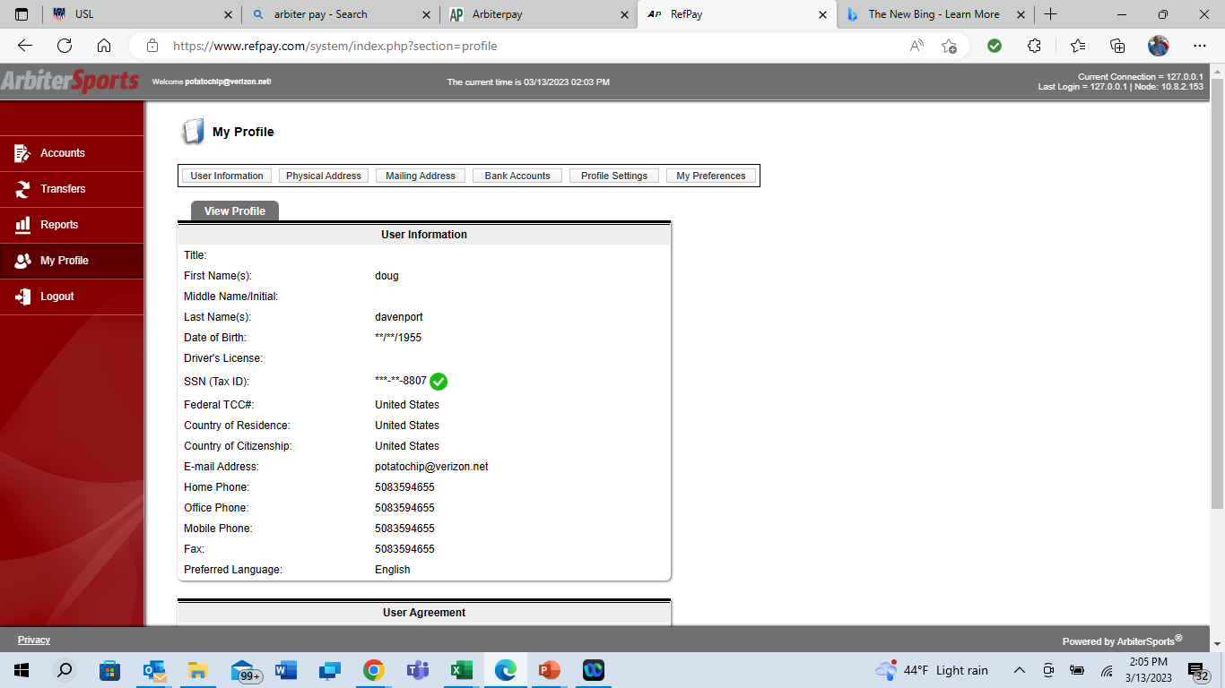
Many schools now pay using this tool
www.refpay.com
Complete user information, addresses
bank account (if you choose EFT)
profile settings
Pay by check option is available, you must
Request for each transaction
Cost per check $8.50
Remaining slides cover the check request
method

Slide 43
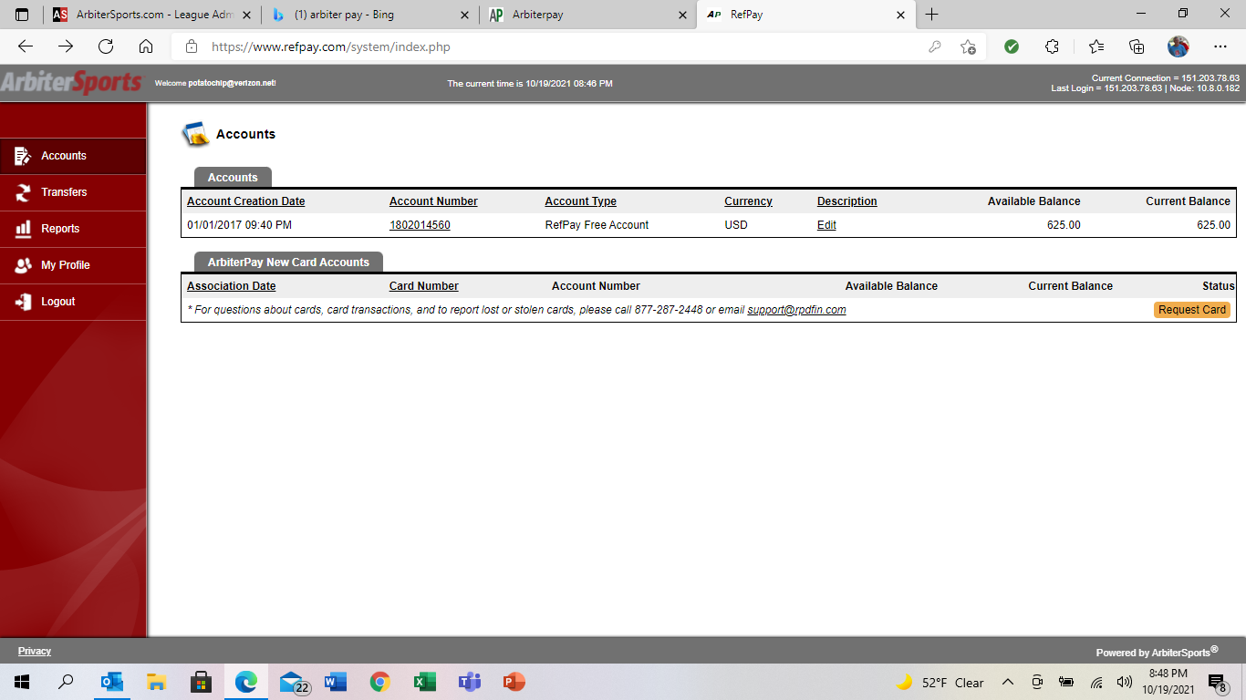

Slide 44
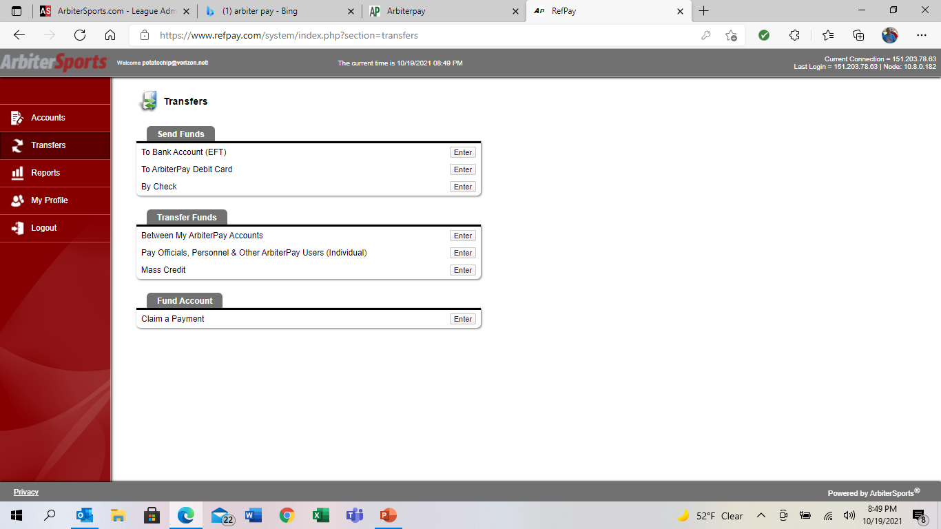


Slide 45
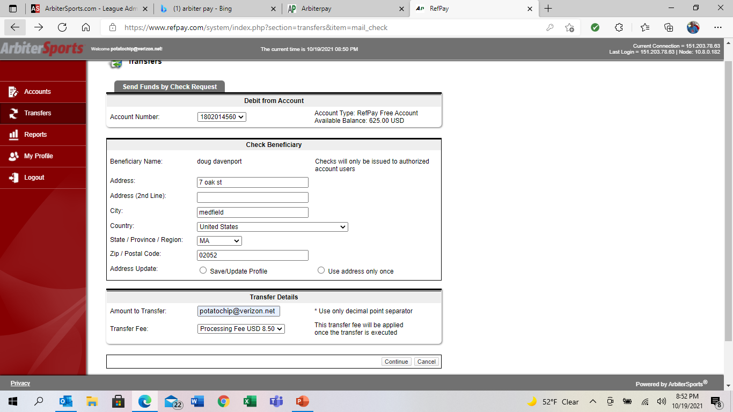

Slide 46
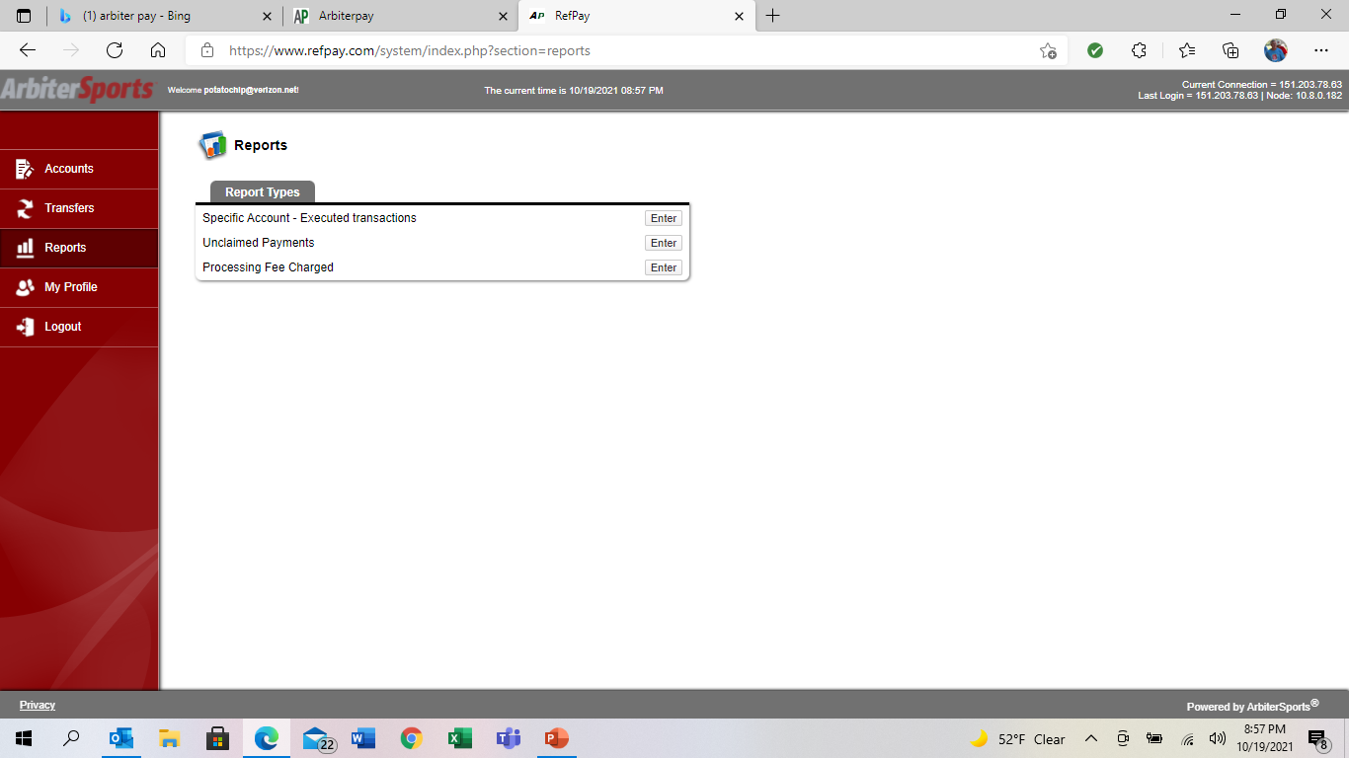

Slide 47
EMLOA 2023 - Arbiter Training
Thank you! - Q&A

