Slide 1
Week 1
EMLOA 2022
New Candidates Class

Slide 2
EMLOA
EMLOA - Eastern MA Lacrosse Officials Association
Over 400 Officials
Service over 250 secondary schools, youth and adult leagues and tournaments
Primary Function is to develop and train officials while servicing schools and leagues

Slide 3
Membership Compliance
Annual Dues/Training class fee
MIAA Registration
US Lacrosse Membership
Annual Rules Test - US Lacrosse
Attend Annual Meeting
Meeting Minimum Regular Season Meeting Requirements see website www.emloa.org

Slide 4
Locations
Annual Meeting is held at central location on March 6th @ Medway High School
Regular Season Meetings & Candidates Classes
see website www.emloa.org
Monday - Forekicks Marlboro
Tuesday - Cape Cod Tech
Wednesday - Dedham American Legion
Thursday - Woburn High School

Slide 5
Trainers
Who we are?

Slide 6
Course Outline
Week 1: Organization, Lax 101, Common Terms & Rules 1, 3, & 4
Week 1A: Annual Meeting
Week 2: Fouls - Personal & Technical
Week 3 - Mechanics, Positioning & Game Management
Test to be completed on-line thru US Lacrosse

Slide 7
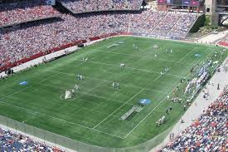
What is Lacrosse?
Lacrosse is a team game, in which a ball is thrown, caught, and carried with a stick to a goal at each end of the field.

Slide 8
Purpose of Official
Safety
Fairness

Slide 9
Common Terms
X
Center X
Alley
Box
Play - ON!
Flag Down!
Notes:
Add any additional terms you see fit

Slide 10
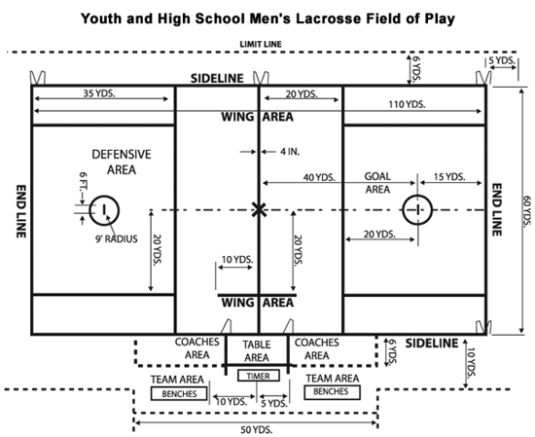
Field of Play
Notes:
Go over different areas of field

Slide 11
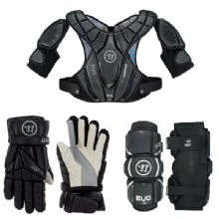
Personal Equipment
Field Player
Gloves
Shoulder pads
(new standards 2022)
Elbow Pads
Helmet (NOCSAE)
No Tinted Eye Shields
Mouthpiece
Crosse
Goalie
Gloves
Chest Protector
Throat Guard
Helmet (NOCSAE)
No Tinted Eye Shields
Mouthpiece
Goalie Stick
No Legally equipped goalie, No game!

Slide 12
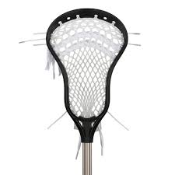
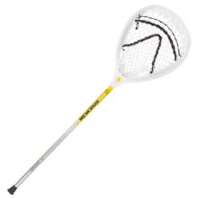
The Stick
Head
Must be 6-10 inches wide at widest point
Ball must roll out freely
Deep Pocket - ball can be below sidewall
Length
Short Stick: 40-42 inches
Long Stick: 52-72 inches (4 limit on the field)
Goalie: 40-72 inches length, head 10-12 inches and must be on the field and used by goalie

Slide 13
Game Personnel
10 Players on the field
Goalie, Defense, Middie, Attack
In-Home - Is a designated Starter in the game and serves “team/coaches” penalties
Goalkeeper: must be a designated & equipped goalkeeper on the field at all times

Slide 14
Timing
Varsity: 4 - 12 minute stop time quarters
Sub-varsity/Youth: Varies
Halftime: 10 minutes
Quarter Intervals: 2 minutes
Timeouts: 2 minutes
Overtime: 4 min. periods - sudden victory until winner

Slide 15
Rule 4 - Play of the Game
This section of the rule book contains many of the definitions and procedures for the game of lacrosse.

Slide 16
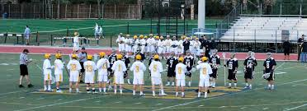
Coin Toss and Line-Up
Coin Toss: Held with captains, visiting teams have choice for coin toss. Winning team chooses Alternating Possession (AP) or side to defence
Line-up: Starters line-up prior to opening face-off

Slide 17
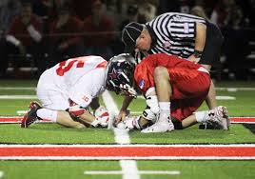
Face-Off
Begin every period w/faceoff and after goals
Unless the there is an uneven situation then team w/possession retains possession
Flag down that creates an uneven situation also denotes possession
Team must have 4 players in defensive area and 3 players in offensive area (except if 3 men down)
Players are not “released” until possession, ball goes into off/def zone or OOB.

Slide 18
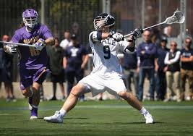
Out of Bounds
Shot
If the ball goes OOB on a shot the ball is award to the player that was closest to the ball where and when it went OOB
A shot remains a shot until it comes to rest, possessed or goes OOB
Everything else
OOB when a player or loose ball touches boundary line or anything beyond
Award ball to player of the opposing team

Slide 19
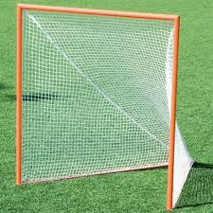
Goal
A goal is scored when a loose ball passes from the front completely through the imaginary plane formed by goal post.
Ball can be thrown, kicked or directed with part of the body by either team.

Slide 20
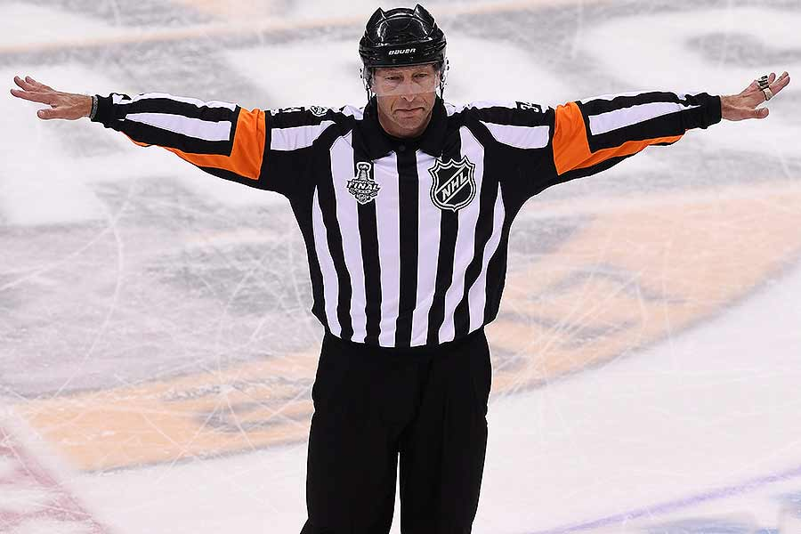
When a Goal Doesn’t Count
Ball is shot after time expired
Any part of an offensive player’s body is in crease
Official blows their whistle
Head comes off stick on shot of shooter
A player “dives” and lands in crease
Attack team is offside or too many men
A foul on scoring team prior to goal
Time-out recognized

Slide 21
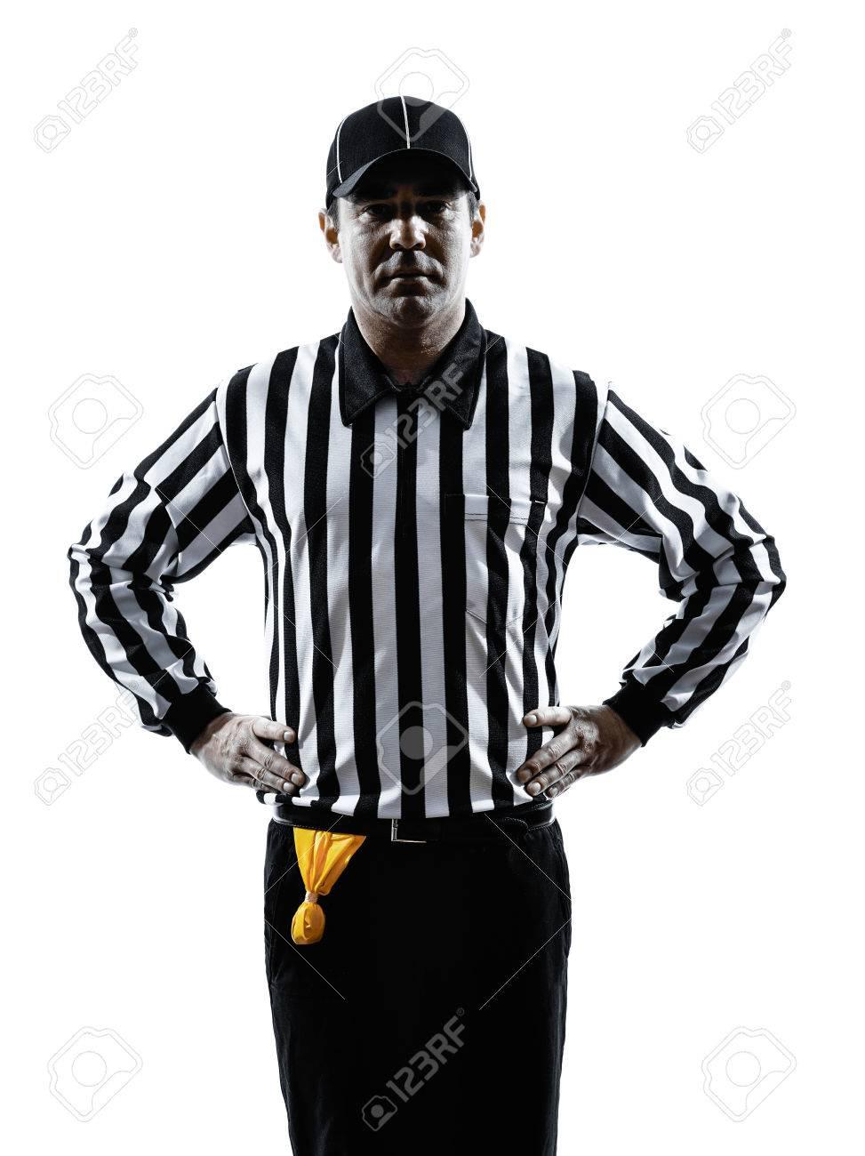
Offsides
Offense: No more than 6 players
Defense: No more than 7 players
**Includes players in penalty box**
Count Forward - Not a penalty to be short players

Slide 22
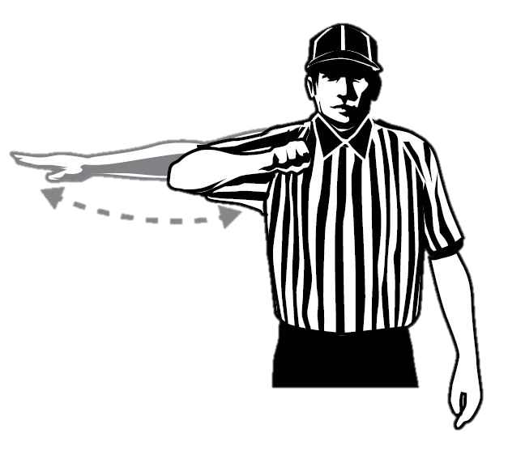
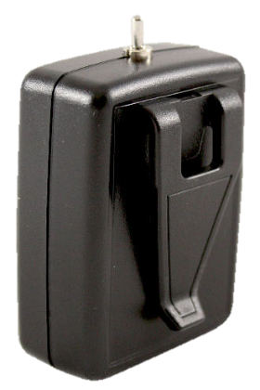
Advancement Counts
20 seconds
10 seconds
Crease: 4 seconds

Slide 23
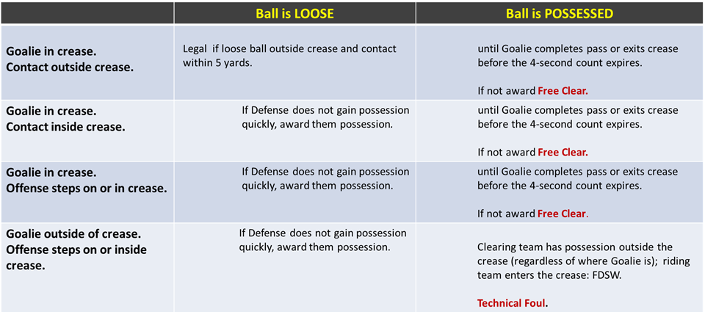
Goalie Crease Privileges

Slide 24
Crease Continued...
Cannot Carry ball into the crease
Goalie can bat ball but not pick up or catch with hand inside crease
Field players cannot jump into the crease with perceived intent of blocking shot
Strike 1 – Conduct Foul
Strike 2 – Releasable Unsportsmanlike Conduct

Slide 25
Substitutions
Regular Substitutions
Must go through the substitution area (box)
Player on the field must come off first
Player exiting field has right of way
Special Substitutions
“Wholesale” subs may take place:
End of period
After goal
Injury time-out
Time serving foul
Team time out
Equipment adjustment

Slide 26
Restarts
Sideline/Endline
Must come to “rolling stop”
Play restarted where ball went OOB
Field of Play
Offense - can’t start in box
Defense - can start in box/crease
Substitution Box
Slower Restart
Move ball in 5 yards from box
Offensive Players: No offensive player may be within 5 yards of player restarting ball
Defensive Player: May be within 5 yards but may not play ball carrier without gaining 5 yards of separation

Slide 27
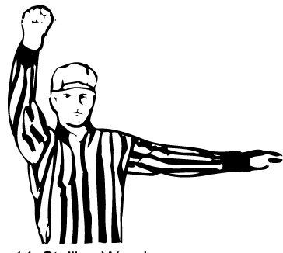
Get it In/Keep it In!
Required to Get it in the Box (10 secs)
and Keep it in the Offensive Box
Last 2 Minutes: Required by team winning by 4 of less goals
Any other time: Can be required by officials if offense isn’t creating offense

Slide 28
Official’s Time Outs
Injury
Goalie equipment becomes broken
Player loses equipment in scrimmage area
If ball is loose AP
If ball is in possession the team retains possession
***Try to have some with possession***

Slide 29
Team Time Outs
May be called by head coach or player on the field
Team must have possession during live ball
Either team can call a timeout during dead ball
2 timeouts per half

Slide 30
Uniform
2 inch striped shirt (long & short)
Black “golf” Shorts
Black Pants
Black Ankle Socks
Black Belt
All black shoes
Black hat w/piping
Black Jacket***
2 yellow penalty flags
Coin
20 second timer
Small Tape Measure
Pencil/Scorecard
Whistles

Slide 31
Looking Ahead
Annual Meeting - bring a whistle!
Medway High School - Sunday, March 6th
7:00-8:20 AM Registration
8:20 AM Meeting Begins
Vendor will be onsite with apparel
Next Week Personal & Technical Fouls

Slide 32
Questions???

