Slide 1
2022 EMLOA Update MIAA State Boys Lacrosse Tournament
Prepared and Presented by Darrell Benson June 2, 2022
Additional Panelists Jim Carboneau, Dan Brothers

Slide 2
Welcome
Agenda
Introduction - Darrell Benson
Key names
Tournament Format
Tournament Calendar - Dan Brothers
Tournament Protocols, Arbiter – Darrell Benson
10 Commandments – Darrell Benson
3 Man Overview - Jim Carboneau
Q & A

Slide 3
Introduction 2022
Key Names
Rich Riley - 2022 MIAA Boy’s Lacrosse Liaison
Dan Brothers - 2022 MIAA State Boy’s Lacrosse Tournament Director
Darrell Benson - 2022 Tournament Assigner for State Semi’s and State Finals
John Hill, Roy Condon, Jim Tighe, Bob Maguire, Craig Brown (Wmass), Darrell Benson - 2022 Local Assigners Preliminary Round, Rounds of 32, 16 and 8

Slide 4
What’s New – 2022
Tournament Format
State Format – not regional
4 Divisions - based on school population, roughly 50 teams in each Division
Top 32 in each Division qualify based on Power Ranking, add anyone .500% or better
Higher seeds host in preliminary round and rounds of 32, 16 and 8
Semi’s at Neutral sites, Finals at sites tbd based on geography

Slide 5
Tournament Calendar
Important Dates: These are TENTATIVE dates and are subject to change
Boys & Girls Lacrosse Cut-off Date: Thursday, June 2
Tournament Seeding Day: Sat June 4
Preliminary Round: June 6-7
Round of 32: June 8-9
Round of 16: June 10-12
Round of 8: June 13-15
Final Four Round (State Semi-Finals): June 16-18
State Championships: June 20-23

Slide 6
The 10 Commandments
Commandment # 1
Thou shall block out dates in Arbiter that you are not available to officiate from the end of regular season (today) to the end of June.
Commandment # 2
Thou shall not take a game if you have seen either of the competing teams more than 4 times during season or 3 times at same home site, or if you have a “history” with the team/coach. Contact the local assigner and he will move you.
Commandment # 3
Thou shall attempt to complete a concussion education course on either NFHS, MIAA or CDC websites. Print out certificate and keep it with you in case you need proof of completion

Slide 7
The 10 Commandments
Commandment # 4
Thou shall ACCEPT or DECLINE the game on The Arbiter immediately. WE NEED VERY QUICK TURNAROUND ON THIS! The name listed first is the referee is the “crew chief.” The 2nd official shall contact “crew chief” 24-48 hours prior to game time. Contact means CONFIRMATION via a phone conversation, two way text or email connection – not a one-way email, one way text or a voicemail with no response.
Commandment # 5
Thou shall check MIAA website for official game times (www.miaa.net). Game time is subject to change and they do it frequently. Game times change for proms/senior banquets. Check it often. THOU SHALL NOT GO BY TIMES PRINTED IN THE “GLOBE” OR THE “HERALD or any other newspaper, media outlet or social network.”

Slide 8
The 10 Commandments
Commandment # 6
Thou (Crew Chief) shall contact the HOME TEAM Athletic Director (not coach) to confirm game time and venue, schools move to college stadium with seats or turf fields.
Commandment # 7
Thou shall have proper EMLOA uniform – black hat with white piping, 2” striped shirt, black shorts (clean and pressed), short black socks (not below top of shoe) and ALL black shoes (shined!). Make sure your beeper works! Any deviations MUST be cleared by respective assigner.
Commandment # 8
Thou shall arrive at game as early as possible…30+ minutes! Be aware of traffic, especially on Friday evenings North & South (Cape especially). Plan ahead for sporting events. Be aware of multiple games at same venue (boys/girls double or other tourney games and any other traffic and parking nightmares. Anticipate a problem.

Slide 9
The 10 Commandments
Commandment # 9
Thou shall know the MIAA rules – MIAA reminder regarding sportsmanship. Review time-outs/taunting. Full certification to coaches. NFHS has EYE BLACK rule - limited to single line under eye – no “face painting”. Horn at table. Forms filled out for ejections. Review altercations. FREEZE BENCHES! Be proactive – expect the unexpected. GET NUMBERS! EVEN IF LOSING TEAM DOES THE CRIME…YOU DO THE PAPERWORK!
Commandment # 10
Thou shall call Assigner of your game from the parking lot with winner and SCORE! No call…NO MORE GAMES! KNOW WHO ASSIGNED YOU TO THE GAME!!!! Arbiter may be misleading regarding who assigned since other assigners may use DB’s login – check Schools on EMLOA page

Slide 10
3 Man
Lead – Primary Responsibilities
1. Goal, crease
2. 10 count
3. Endline out of bounds and restart
4. All play around crease
5. Too many men call

Slide 11
3 Man
Single – Primary Responsibilities
1. Face off
2. 20 second count
3. Offsides
4. Second lead on goal and crease
5. Far side out of bounds and restart

Slide 12
3 Man
Trail – Primary Responsibilities
1. Goalie four count and clear
2. Sweep box in transition
3. Listen for coach’s communication
4. Late hit on passer or shooter
5. Near side out of bounds and restart
6. Penalty relay to table

Slide 13
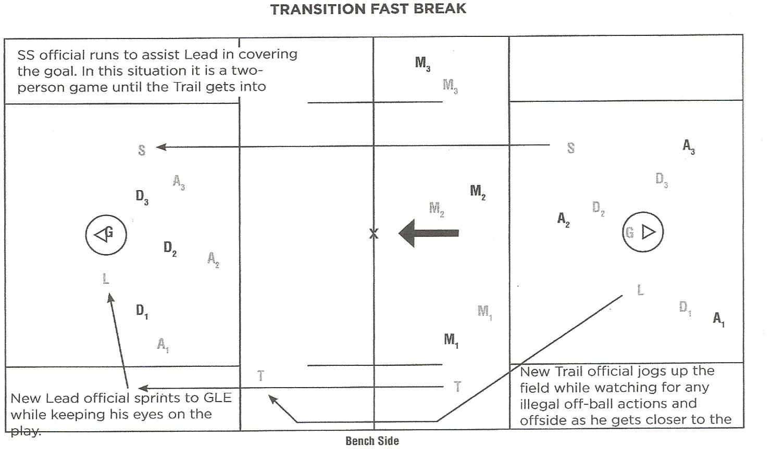
3 Man

Slide 14
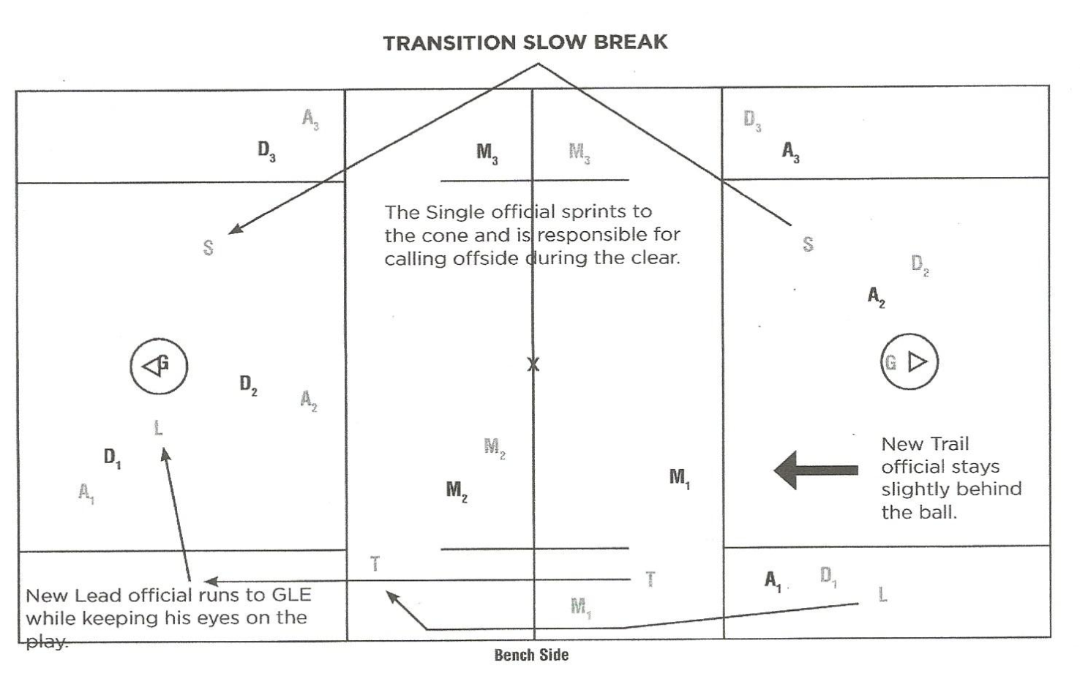
3 Man

Slide 15
Noteworthy Items
Eye Black – one inch strip on cheek, no “war paint”
Mouthpieces – they got them and they are wearing them correctly
Elbow pads – they got them and they are wearing them correctly
Lightning and thunder – 30 minute delay from last sighting or boom
Attention to detail – sometimes the little things can create the bigger problems
Listen, Listen, Listen for trash talk or other nonsense
Communicate, Communicate, Communicate

Slide 16
Q&A
Thank You for Your Attention and Good Work!

