Slide 1
2022 EMLOA Associate Official Training Remote Session - Part 1
Prepared by
Darrell Benson Associate Officials Program Director
Jon Izzo Associate Officials Ass’t Program Director
Rick Catalano Associate Officials Ass’t Program Director
Rev March 23, 2022

Slide 2
Introduction
Opening Remarks
Program History –
Now in 16th year.
Over 2,200 High School students have participated
Primary Responsibilities
Player Safety
Promote Fair Play through Rules Knowledge and Mechanics knowledge

Slide 3
WELCOME
Opening Remarks
ANNUAL CERTIFICATION REQUIREMENTS
New AO
Classroom/Remote Training
Certification Test
Mentoring
Ongoing Evaluations for all AO’s

Slide 4
WELCOME
Opening Remarks
ASSOCIATE OFFICIAL STATUS
RETURNING AO – If you officiated games in 2019 or 2021, you are a RETURNING AO
NEW AO – If you have not officiated games you are a NEW AO.
SENIOR AO – Senior in HS and officiated for two seasons.

Slide 5
WELCOME
Opening Remarks
Certification/Recertification
Sports officials are Certified/Recertified every year – all levels
New AO’s – Full content plus Mentoring
Returning AO’s (incl. Senior AO’s) – Full content review plus evaluation

Slide 6
WELCOME
Opening Remarks
Noteworthy Items
Save all receipts – Dues, Registration, Uniform Some towns will reimburse you for all or some expense
Covid 19 will be with us for Spring 2022 season but due to the low numbers, there are no Covid restrictions

Slide 7
WELCOME
Opening Remarks
ASSOCIATE OFFICIAL CERTIFICATION PROCESS
Pay 2022 Dues and Registration – Check or Online
Attend a Classroom session or a Remote session
Take and PASS online Certification Test
(continued on next slide)

Slide 8
WELCOME
Opening Remarks
ASSOCIATE OFFICIAL CERTIFICATION PROCESS (cont)
Evaluations
Mentor Games – New AO’s
Observation Games (New, Returning and Senior AO candidates)

Slide 9
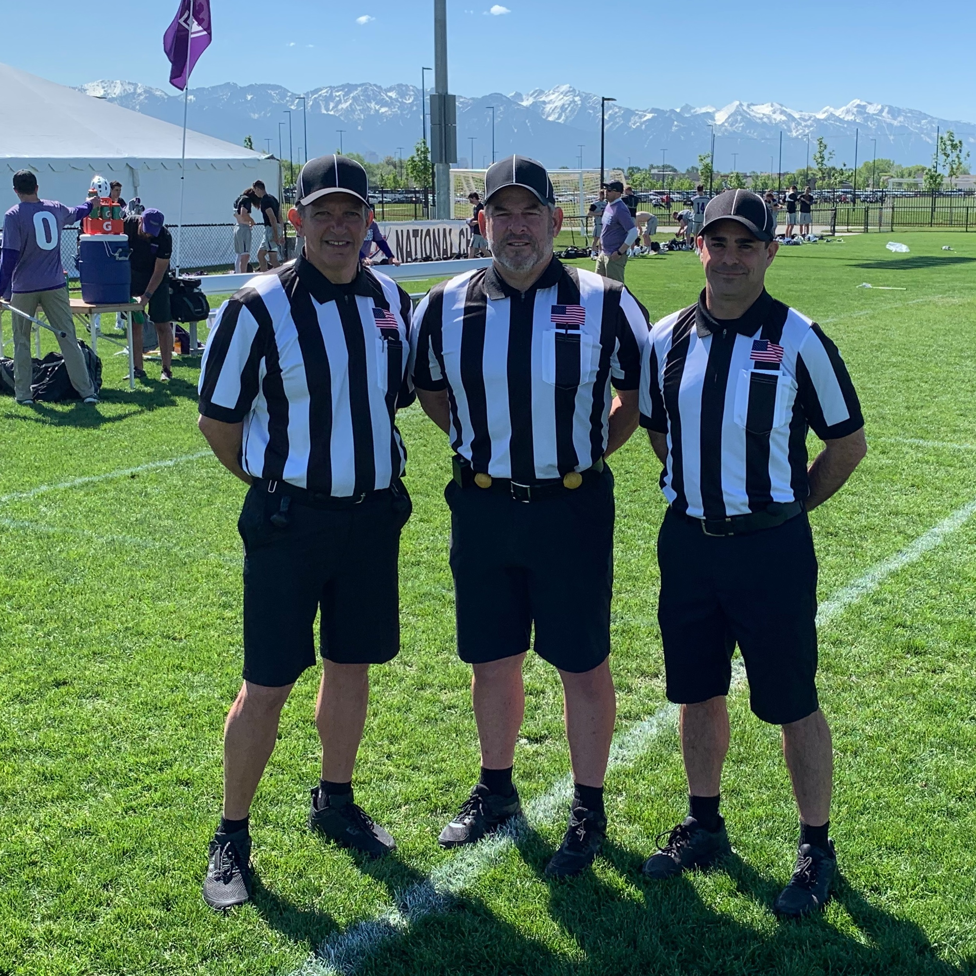
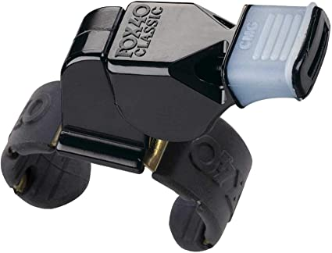
PROFESSIONALISM - Uniform
Black Hat w/white piping
US Flag (1” above pocket)
2-inch striped shirt w/black collar
Card & pencil (have spares)
Black belt
Flags (black or yellow balls)
Black shorts w/pockets
Fox40 finger whistle (have a spare)
Black socks above ankle
All black shoes/sneakers

Slide 10
PROFESSIONALISM - Uniform
Other items to consider
Digital wristwatch - Should have countdown timer function.
Coin - Half-dollar size or larger. EMLOA coins available to AO’s who have worked two seasons.
Cold weather gear – Black jackets, long pants, beanie hats Should be all- or predominantly black
6’ mini tape measure - Not construction worker size!
20-second timer
Coaches’ certification cards

Slide 11
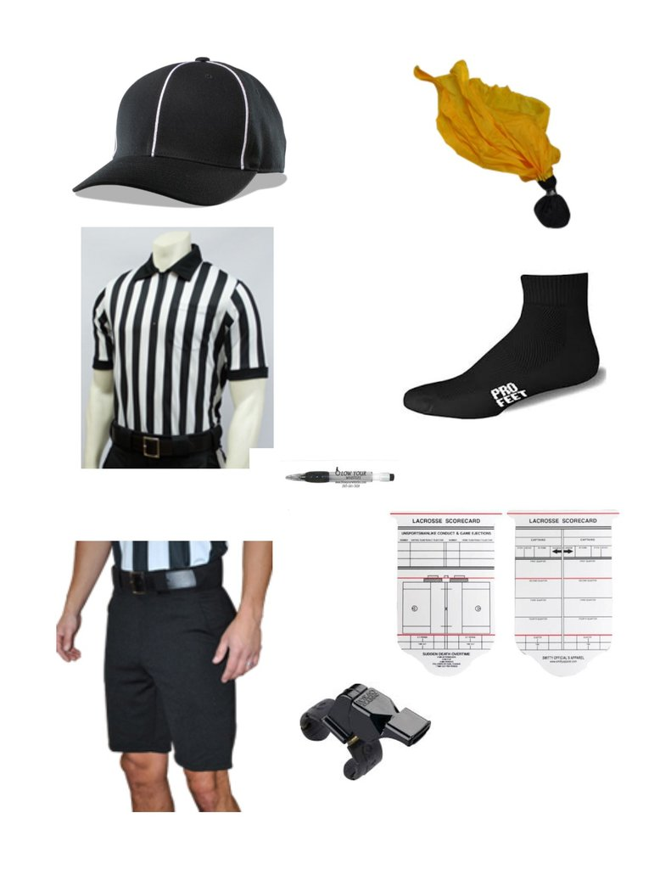
PROFESSIONALISM - Uniform
Starter
package
Flags (black or yellow balls)
Black Hat w/white piping
2” striped shirt w/black collar (1” OK if you have one)
Black socks above ankle
Black shorts w/pockets
Card & pencil (have spares)
Blow Your Whistles site
Fox40 finger whistle (have a spare)

Slide 12
PROFESSIONALISM - Uniform
2” striped shirts required
Returning AOs can use old 1” shirts
New AOs should get new 2” shirts
Shorts, hat, black shoes, flags, whistles (e-whistle?), black socks, facemasks
(BYW discounts – use promo code: EMLOA)
Notes:
Cat

Slide 13
PROFESSIONALISM
The five P’s
Points of Emphasis
Preparation for your games
Pre-game
Play of the game
Post-Game
Notes:
DB

Slide 14
PROFESSIONALISM
Appearance
introduce yourself, check nets, certify, review rules.
Timeliness
Be early, on field 15 Min before game time
Rules Knowledge
Mechanics/Positioning
Communications
Notes:
Iz

Slide 15
PROFESSIONALISM
Appearance – Always look your best by wearing the proper uniform and keeping it neat and clean. This is what gives coaches and parents their first impression of you as an official.
Timeliness – Being on time means being early. Always show up early and get comfortable.
Rules Knowledge – It takes a long time to fully understand all the rules. Continually review the rules and their application to help you develop more quickly.
Mechanics - In addition to knowing the rules, officials need to know where to go on the field and what their responsibilities are at any given time.
Game Management – There are opportunities in every game when an official can keep a game running smoothly without using a flag or whistle. Some of these will be discussed in class.
Focus – Concentrate on your responsibilities throughout the entire game – don’t lose focus. Try to not get distracted and don’t dwell on a call that you make.

Slide 16
SECTION 1 – PROFESSIONALISM
Conditioning – Stay in good shape so you look the part and you can always get to the right position to make your calls
Communication – Communication is a very important part of your job. Constantly communicate with your partner. Use appropriate contact when needed with the players and the coaches.
Conduct – Be respectful at all times. Try to avoid appearing aloof or indifferent
Confidence – Be firm and demonstrative with your calls. Coaches and parents will see you as a more accomplished official than if you are quiet and appear timid.
Consistency – Try to be consistent with your calls on both teams. Also try to stay consistent with your partner – on the same page.
Courage – Try to get it right. Show the courage to make an unpopular call or no-call as long as you are confident that it is the right call.

Slide 17
SECTION 2 PLAYER SAFETY
Notes:
DB

Slide 18
PLAYER SAFETY
Player Safety is our #1 Responsibility. It is the #1 Reason Officials are on the game.
Must protect the kids.
Must call fouls and Must control game.
Big hits
High hits
Late hits
Wild slashes
All these will serve time
These are Personal Fouls
MBYLL games 1 Hand Checks are now OK at Grades 7/8 but Flags at 5/6 and 3/4
Notes:
IZ

Slide 19
SECTION 3 DEFINITIONS & TERMINOLOGY
Notes:
DB

Slide 20
DEFINITIONS
Zones of field
Lines (end-, side-, wing-, restraining, midline, etc.)
Sub area, Bench area, crease
Face-Off Official/Wing Official
Lead/Trail
On/Off ball- “ON” official watches ball,”OFF” official watches offball or away from ball activity.
Live ball/dead ball Live ball means play is happening, dead ball means play has stopped.
Dead ball Officiate! Plenty to do…..
Possession-must be able to cradle,pass,or shoot the ball. Be slow to call P during F/O’s.
Notes:
Iz

Slide 21
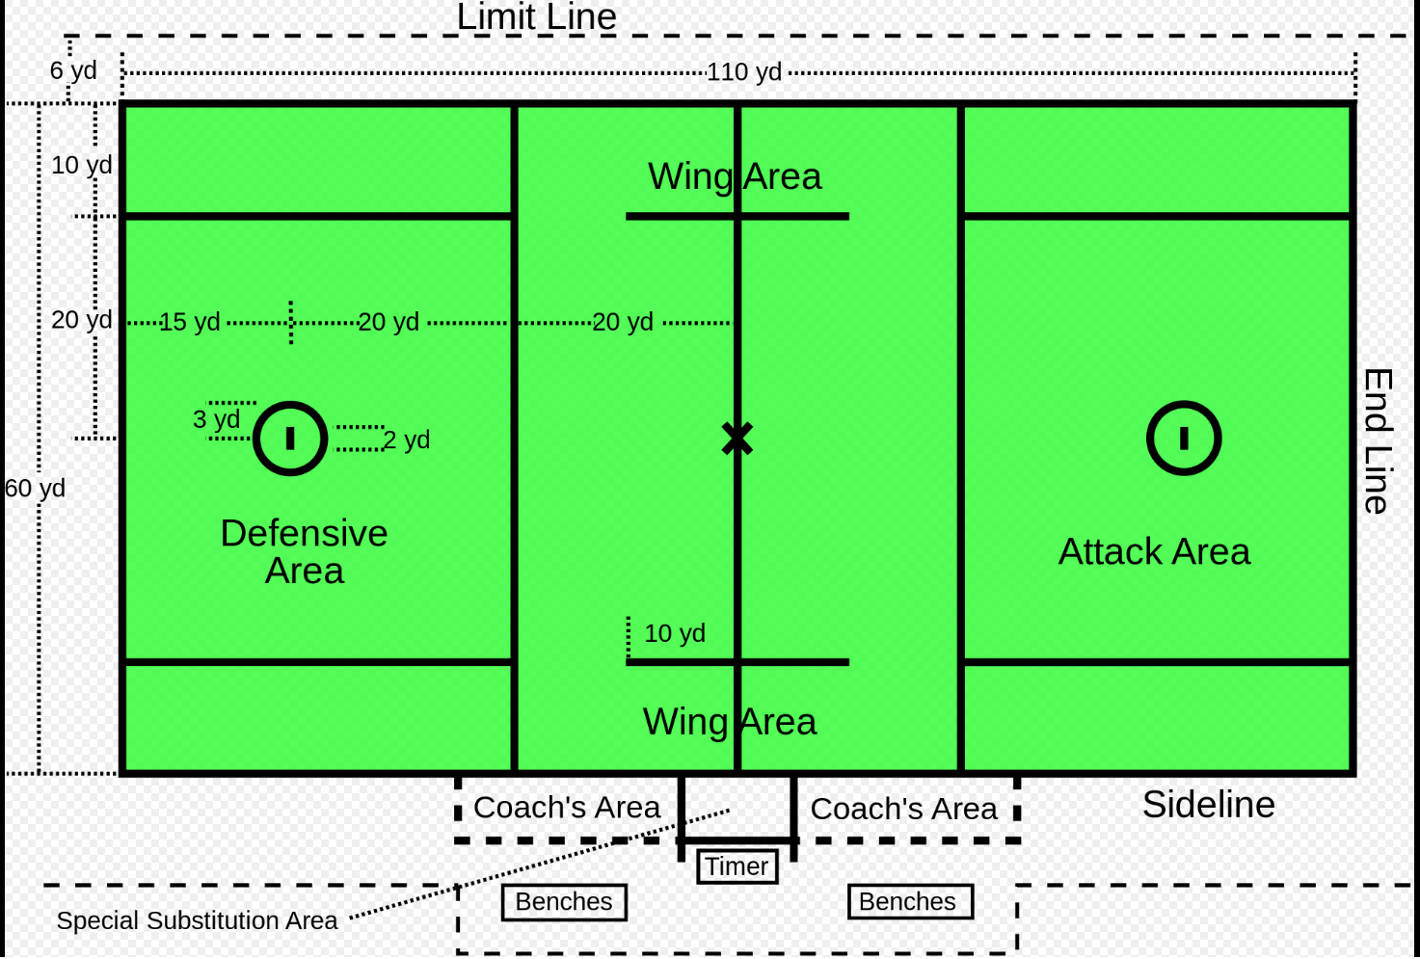
DEFINITIONS – Field
Mid-line
Restraining line
Alley
Crease
Notes:
Iz

Slide 22
DEFINITIONS
Play-Ons
Allows team fouled to keep advantage
loose ball scrum, blow whistle award ball AP
Slow-whistle technique
When team in possession gets fouled, we allow play to continue so team fouled can complete play and get an extra scoring opportunity. FDSW,when flag thrown, wait...
Notes:
Iz

Slide 23
SECTION 4 PLAY OF THE GAME
Notes:
DB

Slide 24
PLAY OF THE GAME
Preparing for your games
Make sure uniform is clean and in good order
Review Rules
Plan to be early
MBYLL - different age/different rules.
Notes:
Cat

Slide 25
PLAY OF THE GAME
Pre-game Responsibilities include
Meet with Partner (2-man game)
Identify Site Director
Coach Certification
Coin Toss
*every game has a C/T! visitor calls
*covid distance, quick simple.
Line-up-every game has L/U, quick simple covid.
Notes:
Iz

Slide 26
PLAY OF THE GAME
Coach Certification
Best to get both coaches together
“Coach 1, do you certify that all your players are legally equipped by rule?”
CORRECT ANSWER IS YES
“Coach 2, do you certify that all your players are legally equipped by rule?”
CORRECT ANSWER IS YES

Slide 27
PRE-GAME
The following two slides depict the traditional mechanics for
Coin Toss
Line-Up
Notes:
Cat

Slide 28
Coin Toss
Referee conducts the coin toss.
Away team calls the toss BEFORE tossing the coin.
Winner of the coin toss chooses end or A.P.
U
R
A A A
H H H
Notes:
Cat
- This is the typical procedure for a HS game.
Youth games you work will vary, but typically it’ll be one captain from each team and only the referee.
The AO will escort the visting captain to the center of the field, remaining socially distant, then move away from the area toward the far sideline

Slide 29
Line-Up
Referee
Introduces Crew, Brief Talk, Good Luck!
Goalies shake first “down the shoot” then players crossover to shake and go to their positions
A A A M M M D D D
G
U
R
G
D D D M M M A A A
Notes:
Cat
As part of usually mechanics, this slide shows how we conduct a lineup to start a game.
Youth games will likely not have us conduct a lineup, but check with your partner during your pregame talk.
Based on the coin toss teams line up with their left shoulder next to the goal they’re defending

Slide 30
PLAY OF THE GAME
Mechanics: 2-Man / 1-Man
Face-offs
Restarts
Out of Bounds
Goals, Exchange
Crease Play

Slide 31
PLAY OF THE GAME
Mechanics
2-man mechanics, working with an EMLOA official
U15, U13, and even some U11 games
1-Man mechanics
When you work U9 games alone, after any mentoring
When you work U11 games alone as a Sr. AO

Slide 32
PLAY OF THE GAME Faceoffs Officials Responsibilities
Faceoff Official
Conducts Faceoff
Waits for Ready for play signal from partner
Will call most of the violations on faceoff
Wing Official
Positioned between end of wing line & restraining line
Ensures field is ready for play by holding arm up – points when ready
Watches wing players
Watches big picture
Notes:
Go over the FO responsibilities
Face-off procedure will change depending on the youth league
May not have face-offs at all.
Talk about what a goalie clear is if there’s no FOs.
Go over Wing Official responsibilities and signal mechanics

Slide 33
Faceoff
Referee conducts the opening faceoff
M
M
D A
D A
U
W
M
R
FO
D A
G
A D
M
G
D A
A D
M
M
Notes:
Explain what “running left” means – you’re running left toward the goal line you’re covering
What to watch as the WO official
As an AO, you should be on the far side most, if not all the time.

Slide 34
Faceoff Towards FO Goal
M
M
D A
D A
L
FO
D A
G
A D
M
G
M
Wing Official holds arms up and points toward goal when the field is ready
D A
T
A D
W
M
M

Slide 35
Faceoff Away from FO Goal
M
M
T
D A
D A
FO
D A
G
A D
M
G
M
L
D A
A D
W
M
M
Notes:
- Stress that as an AO you should look at the far side movement. That’s where you’ll be most/all of the time.

Slide 36
Faceoff Towards FO Goal
Wing Official holds arms up and points toward goal when the field is ready
M
M
W
L
D A
D A
D A
G
A D
M
G
FO
M
D A
T
A D
M
M

Slide 37
Faceoff Away from FO Goal
T
M
M
W
D A
D A
D A
G
A D
M
M
G
FO
L
D A
A D
M
M

Slide 38
PLAY OF THE GAME 1-MAN MECHANICS

Slide 39
One-Man mechanic
- Check both goalies are ready.
- Conduct FO.
- Move top of box and sideline to sideline with team in possession.
M
M
D A
D A
D A
G
A D
M
G
FO
M
D A
A D
M
M
Notes:
Use this mechanic for games you do alone, as the only official
Move top of the box, to top of the box, covering both sidelines
During pregame, tell coaches you’ll “favor” the far sideline, but may need their help with a hand up when the ball or player carrying the ball is OOB.

Slide 40
PLAY OF THE GAME
ADVANCING THE BALL
Faceoff – After possession is gained and official yells “possession”, team with the ball has to advance the ball into the Attack Area
If they gain possession in defensive half of the field, they have 20 seconds to get the ball across midfield line and 10 seconds to get the ball in to attack area
If they gain possession in defensive half of the field, they have 20 seconds to get the ball across midfield line and 10 seconds to get the ball in to attack area
Notes:
DB

Slide 41
PLAY OF THE GAME
ADVANCING THE BALL (cont)
Change of Possession – When there is a change of possession, the team with the ball has to advance the ball into the Attack Area
If they gain possession in defensive half of the field, they have 20 seconds to get the ball across midfield line and 10 seconds to get the ball in to attack area
If they gain possession in defensive half of the field, they have 20 seconds to get the ball across midfield line and 10 seconds to get the ball in to attack area

Slide 42
PLAY OF THE GAME
ADVANCING THE BALL (cont)
Other considerations–
If defense tips a pass and it stays in play and offense regains possession, the count continues
If defense tips a pass and it goes out of bounds, offense regains possession, the count starts over
If offense creates a loose ball and regains possession, the count continues
If offense creates a loose ball and during scrum, the defensive team commits technical foul (e.g., loose ball push or hold) the count starts over

Slide 43
Restarts
Slow Restart:
Count the players
Look to partner for ready signal
Don’t blow through the Stop Sign (“not ready” signal)
Quick Restart:
Don’t need to count and should make eye contact with partner
In settled play the official closest to the ball usually takes the restart
L
All restarts near the substitution box should be slow and the ball should me moved in 5 yards!
T
Notes:
IZ

Slide 44
ON/OFF Responsibilities
The official closest to the ball is typically the ON official and will be responsible for fouls on the player in possession. Narrow Focus
The OFF official will watch the big picture fouls and for off ball fouls. Wide Focus
Must work together in communicate on overlap.
Notes:
IZ

Slide 45
ON/OFF - Settled Situations
On Official:
Has a narrow focus that is on the player in possession and surrounding 5 yards.
Watches for fouls like pushing, holding, tripping, illegal body checks, unnecessary roughness, slashing, and warding.
L
Off Official:
Has a wider view of the play because off ball involves more players in a larger area.
Watches for fouls like interference, illegal offensive screens, crease violations (cutters running through the crease), and late hits after passes.
T
Notes:
IZ

Slide 46
LEAD / TRAIL
LEAD
Goal
End Line
L
TRAIL
Shooter
Far Goal
Over and Back
T
Notes:
IZ

Slide 47
LEAD/TRAIL Positioning in Settled Situations
As the ball and play moves you should move with it to be in the best position to make the call.
Don’t kill the grass! Move your feet.
Lead get as tight to the goal as play will allow you too.
L
T
Notes:
IZ

Slide 48
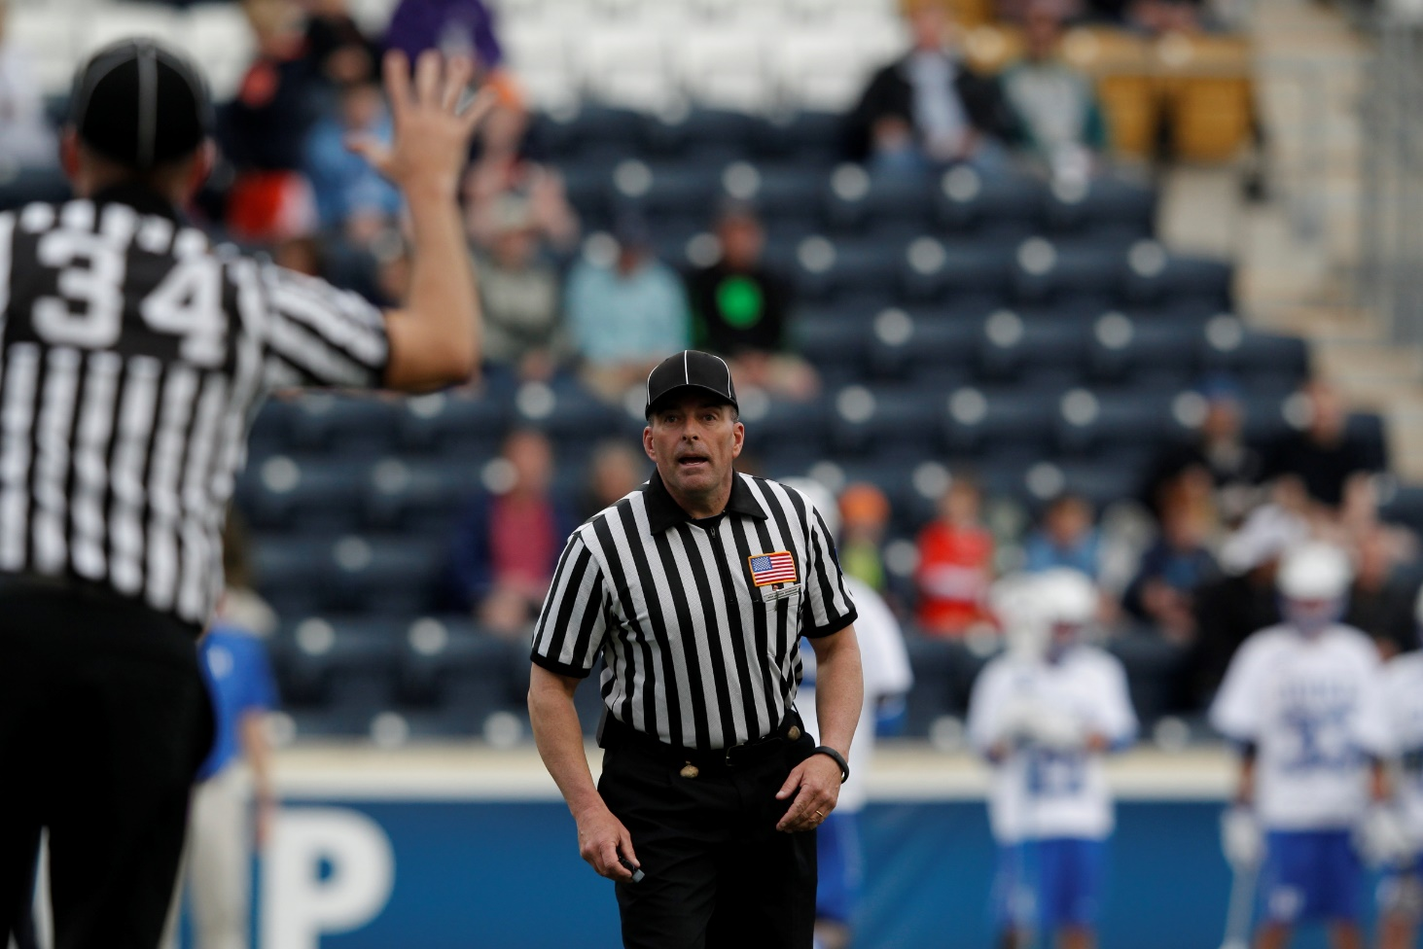
Penalty Relay
Get’s the Field Ready for player
Blue, 27, push.
Got it!
L
Trail always reports foul.
Uses C-NOTE
T
C-Note
Color, Number, Offense, Time, Explanation
Blue 27, Push, 30 Seconds
White 14, Slash, 1 Minute
Notes:
CAT

Slide 49
Penalty Relay
TRAIL still reports fouls from the far side.
Move Closer to box, don’t yell across field
T
L
Notes:
CAT

Slide 50
Out of Bounds
Each official is responsible for the end line behind the goal they cover as the Lead official and the sideline they run along.
Signaling Out of Bounds:
Sound whistle while signaling dead ball with one hand in the air
Signal direction of play and call out the color of the team “Blue” or “Blue ball!”
Place hand back into the airair to signal dead ball
L
T
Notes:
CAT

Slide 51
After Goal
Lead gets the ball, jogs to restraining line and becomes wing official.
Make’s sure field is ready
Lead runs to crease
Signals goal
Gets ball
KEEP OFFICIATING
W
L
L
FO
Trail Meets Lead and gets the ball.
Jogs to FO and conducts the next FO
Trail watches shooter!
Watches big picture
T
Notes:
CAT
Again, this assumes we do faceoffs after a goal is scored.
If no face-offs, give teams time to substitute, then a goalie/defensive clear from GLE
A lopsided score can result in the clear being given at center X
Review w/partner during pregame what lopsided score results in free clear at center X

Slide 52
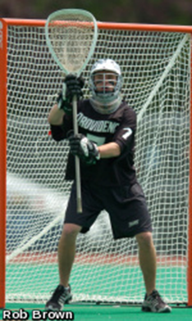
CREASE PLAY – Goalies, the most privileged players on the field
When is the goalie in the crease…….
Nobody can touch or check him.
Nobody can touch or check his stick in the crease
He CAN bat the ball. He CAN NOT pick it up.
He has the right to follow through on an outlet pass
These privileges only apply to the properly equipped goalie.
Clamping is NOT Possession!
Notes:
DB
Following Through – Has to be a normal throwing motion. Goalie can be called for a slash if it’s violent. Anticipate & Watch his point of focus.
Goalie can’t initiate contact with an offensive player and expect an interference call.

Slide 53
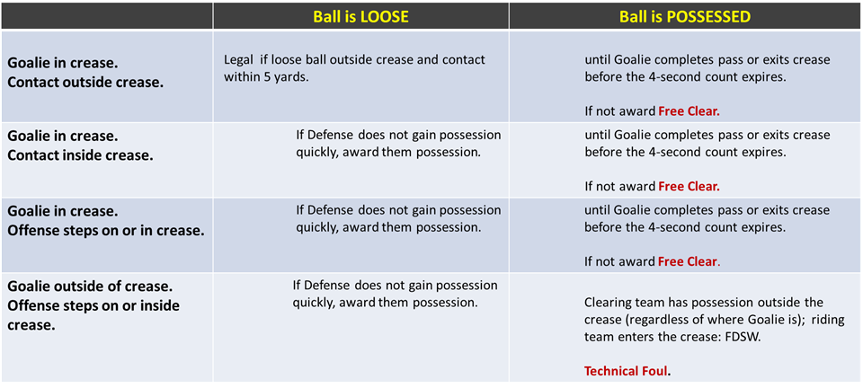
CREASE PLAY - Goalie Crease Privileges

Slide 54
CREASE PLAY
Some NO-NO’s Around the Crease
Nobody can carry the ball into the crease
A goal does not count if an offensive player was in the crease
Goalie can’t hold the ball in the crease
Goalie can’t touch the ball at all outside the crease
Field players cannot jump into the crease with perceived intent of blocking shot
Strike 1 – Conduct Foul
Strike 2 – Releasable Unsportsmanlike Conduct

Slide 55
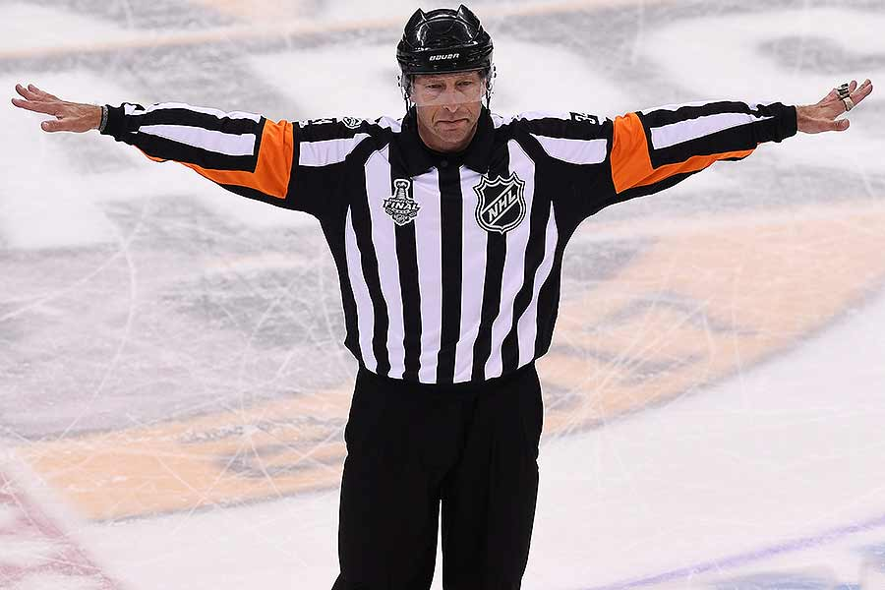
CREASE PLAY
When a Goal Doesn’t Count
Ball is shot after time expired
Any part of an offensive player’s body is in crease
Official blows their whistle
Head comes off stick on shot of shooter
A player “dives” and lands in crease
Attack team is offside or too many men
A foul on scoring team prior to goal
Time-out recognized

Slide 56
Game Management
Lopsided games
Mercy rules & consideration
Coaches/Parents/Partners
COVID-19
What we know and what to expect
Player & coaches distancing
…

Slide 57
Game Management
Lopsided games: Mercy rules & considerations
Know the mercy rule for goal differential
6-goal lead, team down gets a free clear
Recognize when one team or player is dominating
Talk frustrated players out of a bad situation
Bring coaches together to discuss alternatives
Have players try new positions and/or weak hand
Complete x passes before shooting
Put it in the right stick

Slide 58
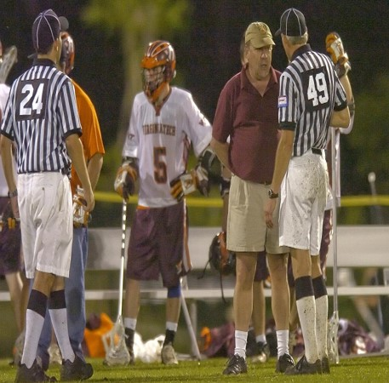
Game Management
Coaches
Talk to coaches calmly, explain what you saw
Be available to them
Your view & perspective is different than theirs
Most won’t know the rules like you & your partner
Know situations when they’ll likely call TO!
Use “the ramp” to control players/coaches

Slide 59
Game Management
Ejection
Coaches – The Ramp!
For poor behavior by Team A, options are:
Try to work through these steps in order.
Sometimes you may need to skip steps, especially with taunting and racist behavior.
1 to 3 min. locked! (in-home)
Unsportsmanlike
Conduct
Rule 5:10
Conduct Foul
With B in Possession
30-second penalty
Rule 6:6
Loose Ball Conduct Foul
Award ball to opposing team
Verbal Warning

Slide 60
Game Management
Parents
Don’t get into conversations with them
Let your partner and coaches know if you have unruly parents – Get them removed!
Maintain your social distancing

Slide 61
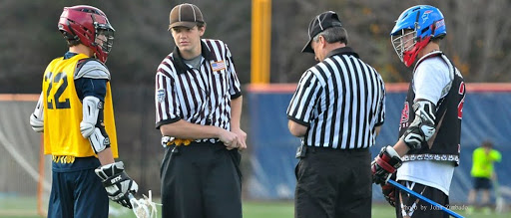
Game Management
Partner
Arrive early to meet partner and pre-game
Review what to expect during mentor games
You should work away from the benches (“single side”)
Ask questions
Rules, mechanics, penalty enforcement

Slide 62
NEXT UP
2022 EMLOA Associate Officials Remote Training – Part 2
SECTION 5 FOULS
Personal Fouls and Technical Fouls

