Slide 1
2022 EMLOA
Associate Officials Training Part 2
Prepared and Presented by
Darrell Benson Associate Officials Program Director
Jon Izzo Assoc. Officials Asst. Program Director
Rick Catalano Assoc. Officials Asst. Program Director

Slide 2
SECTION 5 FOULS

Slide 3
Personal Fouls
Most important fouls to call - Safety Fouls
Fouls that are serious in nature.
Never wiped out by goal
Always serve time
1-2-3 min at refs discretion
Could be locked in , non-releasable, or ejection
MBYLL - 3 per fouls or 5 total min of personal fouls - player is disqualified.

Slide 4
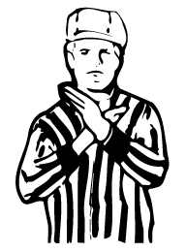
Personal Fouls
Most common personal fouls
Slashing
Uncontrolled stick
Big wild swing, 1-handed swing
Even a big swing and miss can be
called (1-handed miss called in MBYLL)
Excessive contact to helmet, back, legs, arms is slashing.

Slide 5
SECTION 5 FOULS Personal Fouls
Most common personal fouls
Slashing
Insert video

Slide 6
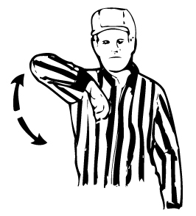
SECTION 5 FOULS Personal Fouls Illegal Body Check
Any body check NOT from the Front
or Side below the neck above the waist is
illegal.
Body checks in youth lacrosse are strictly
enforced.
Lower the age the less is allowed.
Age-appropriate contact.
Any body check to defenseless opponent is locked in penalty time.
Contact to opponent who is on ground.

Slide 7
Illegal Body Check

Slide 8
Illegal Body Check
Insert video

Slide 9
SECTION 5 FOULS Personal Fouls
Contact to the head or neck
(1) A player shall not initiate contact to an opponent’s head or neck with a cross check or any part of his body (head, elbow, shoulder, etc.). Any follow-through from these actions that contacts the head or neck shall also be considered a violation of this rule.
(2) A player shall not initiate an excessive, violent or uncontrolled slash to the head/neck.
(3) A player, including an offensive player in possession of the ball, shall not block an opponent with the head or initiate contact with the head (known as spearing).

Slide 10
Contact to the Head/Neck Area

Slide 11
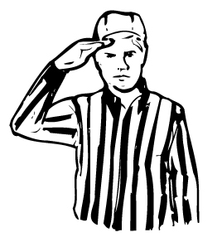
Unnecessary Roughness
Late hits to passer/shooter.
Ball more than 5 yds away can’t
check opponent
TRAIL OFFICIAL WATCH SHOOTER !!!!!
Running over “blowing up” a pick.
CROSSCHECK
Extended the cross into the body of opponent.
Tripping, illegal stick 2-min locked in all violations. Stick can be fixed.

Slide 12
Unnecessary Roughness
Insert video

Slide 13
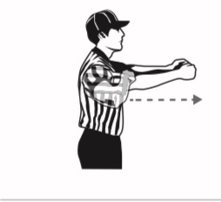
Cross Check
A player may not check his opponent with
that part of the handle of the crosse that is
between the player’s hands, either by
thrusting away from the body or by holding it
extended from the body.

Slide 14
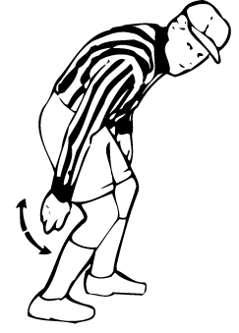
Tripping
A player may not trip an opponent with any
part of his body or his crosse.

Slide 15
Tripping

Slide 16
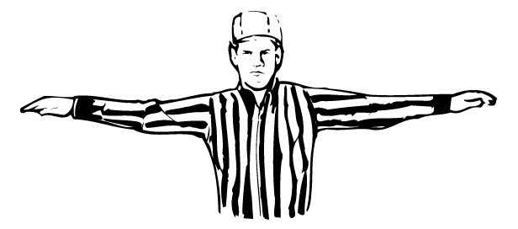
Unsportsmanlike Conduct
A player, Coach, Parent can be
flagged for UC.
Using bad Language, taunting, baiting, calling excessive attention to oneself.
Excessive complaints about referee calls, etc.
Try to talk them out of bad behavior, “The Ramp” (later in slides) Approach..
UC is Locked in Penalty time. 2 UCs in a game the player is disqualified.

Slide 17
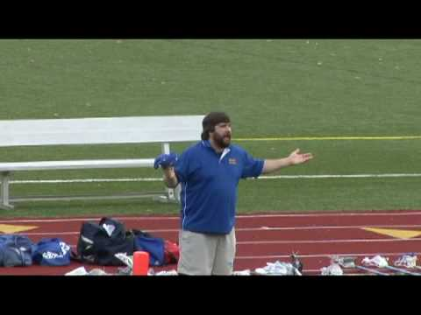
Unsportsmanlike Conduct

Slide 18
Rules Review
Technical Fouls
Technical fouls are those of a less serious nature than personal fouls and include all other violations that are not listed as personal fouls. These are referred to as “game management” fouls.
Advantage/Disadvantage
30 seconds penalty time or change of possession
Releasable
Flag or Play-ON

Slide 19
Rules Review
Technical Fouls
Most Common Technical Fouls
Pushing
Holding
Offsides
Illegal screens
Crease Violations

Slide 20
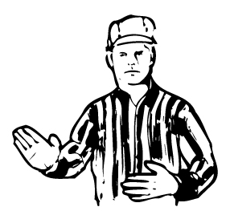
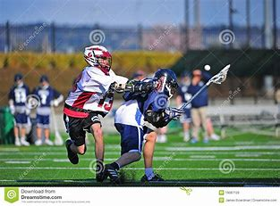
Rules Review
Technical Fouls
Push - Pushing, thrusting or shoving
an opponent from the rear.

Slide 21
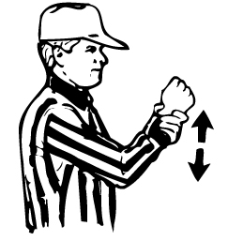
Rules Review
Technical Fouls
Hold - A player shall not impede the movement of
an opponent or his crosse. Hold is considered
illegal under the following conditions:
a. Use the portion of the handle that is between his hands to hold an opponent.
b. Step on the crosse of an opponent.
c. Hold an opponent with his crosse.
d. Hold or pin an opponent’s crosse against body of the opponent with his crosse.
e. Hold an opponent with his free hand that is off the crosse.
f. Hold the crosse of the opponent using any part of his body.
g. Use his crosse to hold or pin an opponent’s crosse to the ground on a face-off.
Note - Ok to hold cross within 5 yards of loose ball or in possession

Slide 22
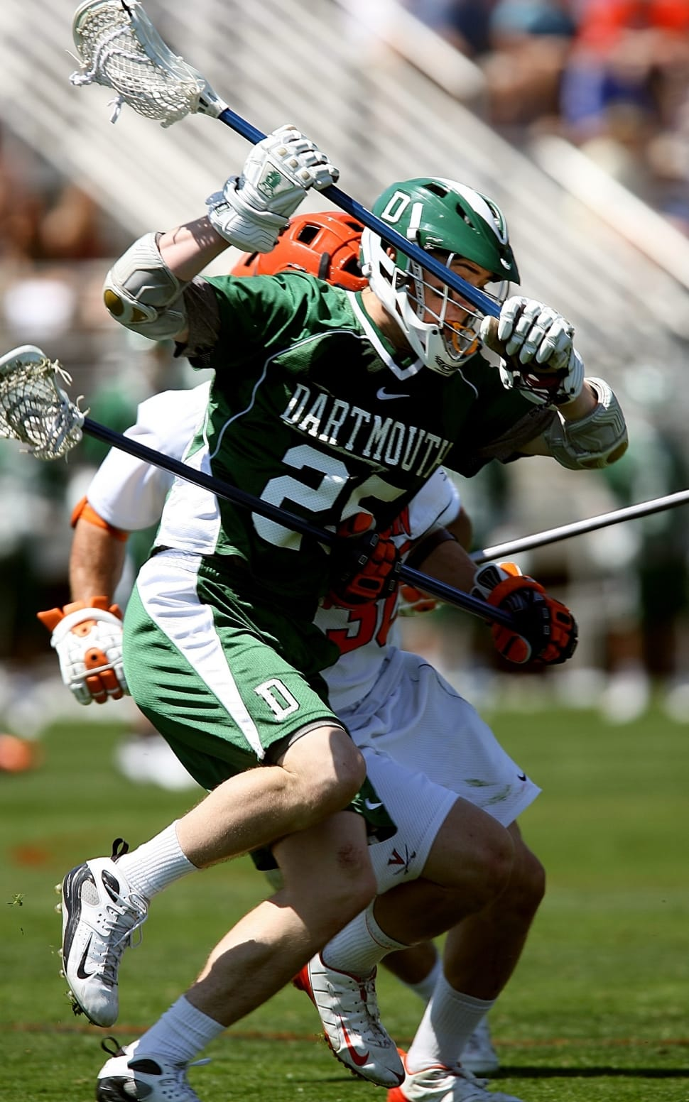
Rules Review
Technical Fouls
Hold

Slide 23
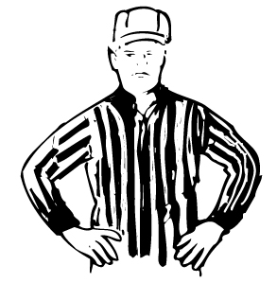
Rules Review
Technical Fouls
Offsides - A team is considered offside when
a team has more than 6 players in its offensive
half of the field or more than 7 players in its
defensive half of the field.
*Includes players in the sub box or serving penalties
*Not a penalty to have too few players

Slide 24
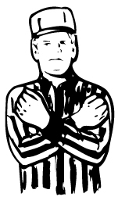
Rules Review
Technical Fouls
Interference - A player shall not interfere in any manner
with the free movement of an opponent, except when
that opponent has possession of the ball, the ball is in
flight and within 5 yards of the players, or both players are within 5 yards of a loose ball.

Slide 25
Rules Review
Technical Fouls - Interference
Insert interference video

Slide 26
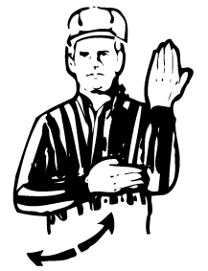
Rules Review
Technical Fouls
Illegal Screen
No offensive player shall move into and make contact with a defensive player
The offensive player shall not hold his crosse rigid or extend his crosse rigid to impede the normal movements of the defensive man.
the offensive player shall be stationary before the contact occurs, with his feet no wider than shoulder-width apart.

Slide 27
Rules Review
Technical Fouls – Illegal Screen

Slide 28
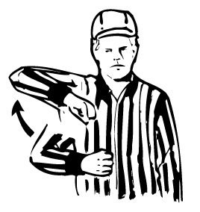
Rules Review
Technical Fouls
Warding Off - A player in possession of the
ball shall not use his free hand or arm or
any other part of his body to hold, push or
control the direction of the movement of
the crosse or body of the player applying the check.
A player in possession of the ball may protect his crosse with his hand, arm or other part of his body when his opponent makes a play to check his crosse.

Slide 29
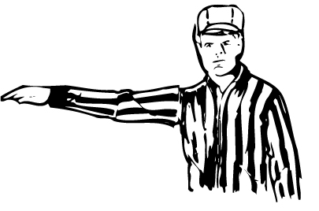
Rules Review
Technical Fouls
Conduct - Used most as a
less severe unsportsmanlike conduct.

Slide 30
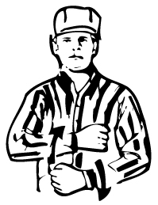
Rules Review
Technical Fouls
All the other Technical Fouls - ILLEGAL PROCEDURE:
Any action on the part of players or substitutes of a
technical nature that is not in conformity with the
rules and regulations governing the play of the game shall be termed illegal procedure.
The following are examples of illegal procedure:
a. Touching the ball – A player shall not touch the ball with his hands while it is in play. The exception is the goalkeeper while both he and the ball are inside the crease.
b. Illegal actions with crosse – A player shall not: 1. Throw his crosse under any circumstances. 2. Take part in the play of the game in any manner without his crosse when (a) a player lose his crosse in any legal way, so that repossession of the crosse would cause him to violate a rule, the slow-whistle shall be employed by an official (b) Should a crosse be in the crease so as to possibly interfere with the goalkeeper’s play of an attempted shot at the goal, play shall be suspended immediately. 3. Intentionally kick an opponent’s crosse.
c. Crosse in face of opponent – A player shall not push at, thrust or flick his crosse in the face of an opponent.

Slide 31
Rules Review
Technical Fouls
ILLEGAL PROCEDURE (cont):
d. Avoidable lateness of team – When a team fails to appear on the field ready to play at the appointed time for the start of a contest, and this tardiness is avoidable.
e. Entering the game from the penalty area before authorized to do so by the timekeeper. The player shall be returned to the penalty area to serve his remaining time, plus 30 seconds. If the ball is loose or in possession of the player’s own team, it shall be awarded to the opposing team and the player leaving the penalty area early does not have to serve an additional 30 seconds. In the event that a goal is scored by the opponent, the unexpired penalty time is nullified, and the 30-second penalty is erased.
f. Delaying the game – When it is a team delay, the penalty shall be assigned to the in-home. Delaying the game shall be the consuming of more than 20 seconds:

Slide 32
Rules Review
Technical Fouls
ILLEGAL PROCEDURE (cont):
g. Participation in the play of the game by a player out of bounds.
h. Any player not in his restraining area at the time the whistle is blown to start play at the time of a faceoff.
i. Failure to remain 5 yards from a player awarded the ball for a restart.
j. Any violation of the rules for substituting players.
k. Any violation of the rules relating to the goal-crease area.
l. Any violation of the rules for time-outs.

Slide 33
Rules Review
Technical Fouls
ILLEGAL PROCEDURE (cont):
m. Having more than 10 players in the game at any time, including a player or players in the penalty area.
n. Violation of the rules on positioning for a faceoff. Award the ball to offended team in its offensive side of the field at Center. (See Rule 7.3)
o. If a head coach makes two or more requests in which no violations are found for either counting of long crosses or inspecting any opponents’ equipment, a time-out will be charged. If no time-outs remain for that half or overtime period, a technical foul will be called.
p. Having more than four long crosses in the game.

Slide 34
Rules Review (DB)
Technical Fouls
ILLEGAL PROCEDURE (cont):
q. Failure of the player in possession of the ball to place the ball directly on the field or hand it to the nearest official on a change of possession. An example is if the player rolls the ball away or creates a delay or disadvantage to the team being awarded the ball.
r. Failure to advance the ball beyond the center line into the goal area within 10 seconds as required, or upon gaining possession of the ball inside the defensive half of the field, to advance the ball beyond the center line within 20 seconds.
s. Failure to provide a scorebook, timing device, table and working horn.
t. Failure to have a clearly marked center line that runs the entire width of the field.

Slide 35
Rules Review
Technical Fouls
ILLEGAL PROCEDURE (cont):
u. Failure to have a properly equipped designated goalkeeper on the field of play.
v. When no player from the team awarded possession picks up the ball and moves to the position of the restart within five seconds after the officials are ready to restart play.
w. Take a dive or feign a slash to the head or body in order to deceive the official and draw a penalty.
x. Failure to wear required mouthpiece (unless it comes out during play).
Other Technical Fouls – Stalling, Withholding ball from play

Slide 36
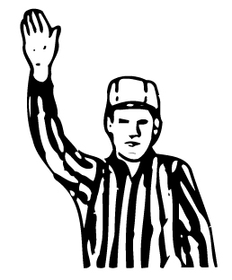
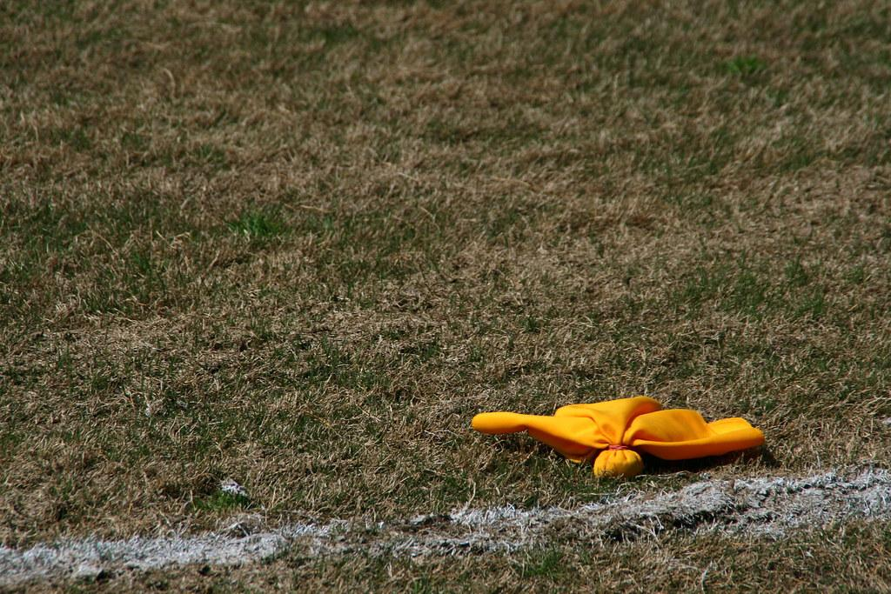
Rules Review
Technical Fouls
ENFORCEMENT - Technical fouls are administered
in 3 ways
Award – if the ball is loose, and offended team is not going to gain possession (following Play-on), stop the play and award the ball the team that was offended.

Slide 37
Rules Review
Technical Fouls
ENFORCEMENT - Technical fouls are administered
in 3 ways. This is the 2nd.
Change of Possession (COP) – if team in possession commits
the foul, stop the play and give the ball to the other team

Slide 38
Rules Review
Technical Fouls
ENFORCEMENT - Technical fouls are administered
in 3 ways. This is the 3rd.
Flag – 30 second foul if team with possession of the ball is offended. Releasable and wiped out if a goal is scored during slow whistle.

Slide 39
Rules Review
Rule Changes for 2022
NFHS Rules - Review quick restart 5 yd cushion
NFHS vs NCAA
Youth rules differences
MBYLL, TPL, others?

Slide 40
Wrap-up & Next Steps
Online certification test
Working with your TAC
New AO’s – Mentoring
Returning AO’s - Observations
All AO’s - Register on MBYLL site
Attend a live Q&A sessions – dates tbd

Slide 41
Wrap-up & Next Steps
EMLOA AO page review
www.emloa.org/associate-officials/
Sr. AO requirements
2-years previous AO experience
Town approval
Game observation on 1-man mechanics to work U11 games alone
Have fun!

Slide 42
Resources
www.emloa.org
http://emloa.org/associate-officials/
http://www.mbyll.org/
http://www.tpllax.com/
www.arbitersports.com
www.miaa.net

Slide 43
Thank You!

